Slide 1
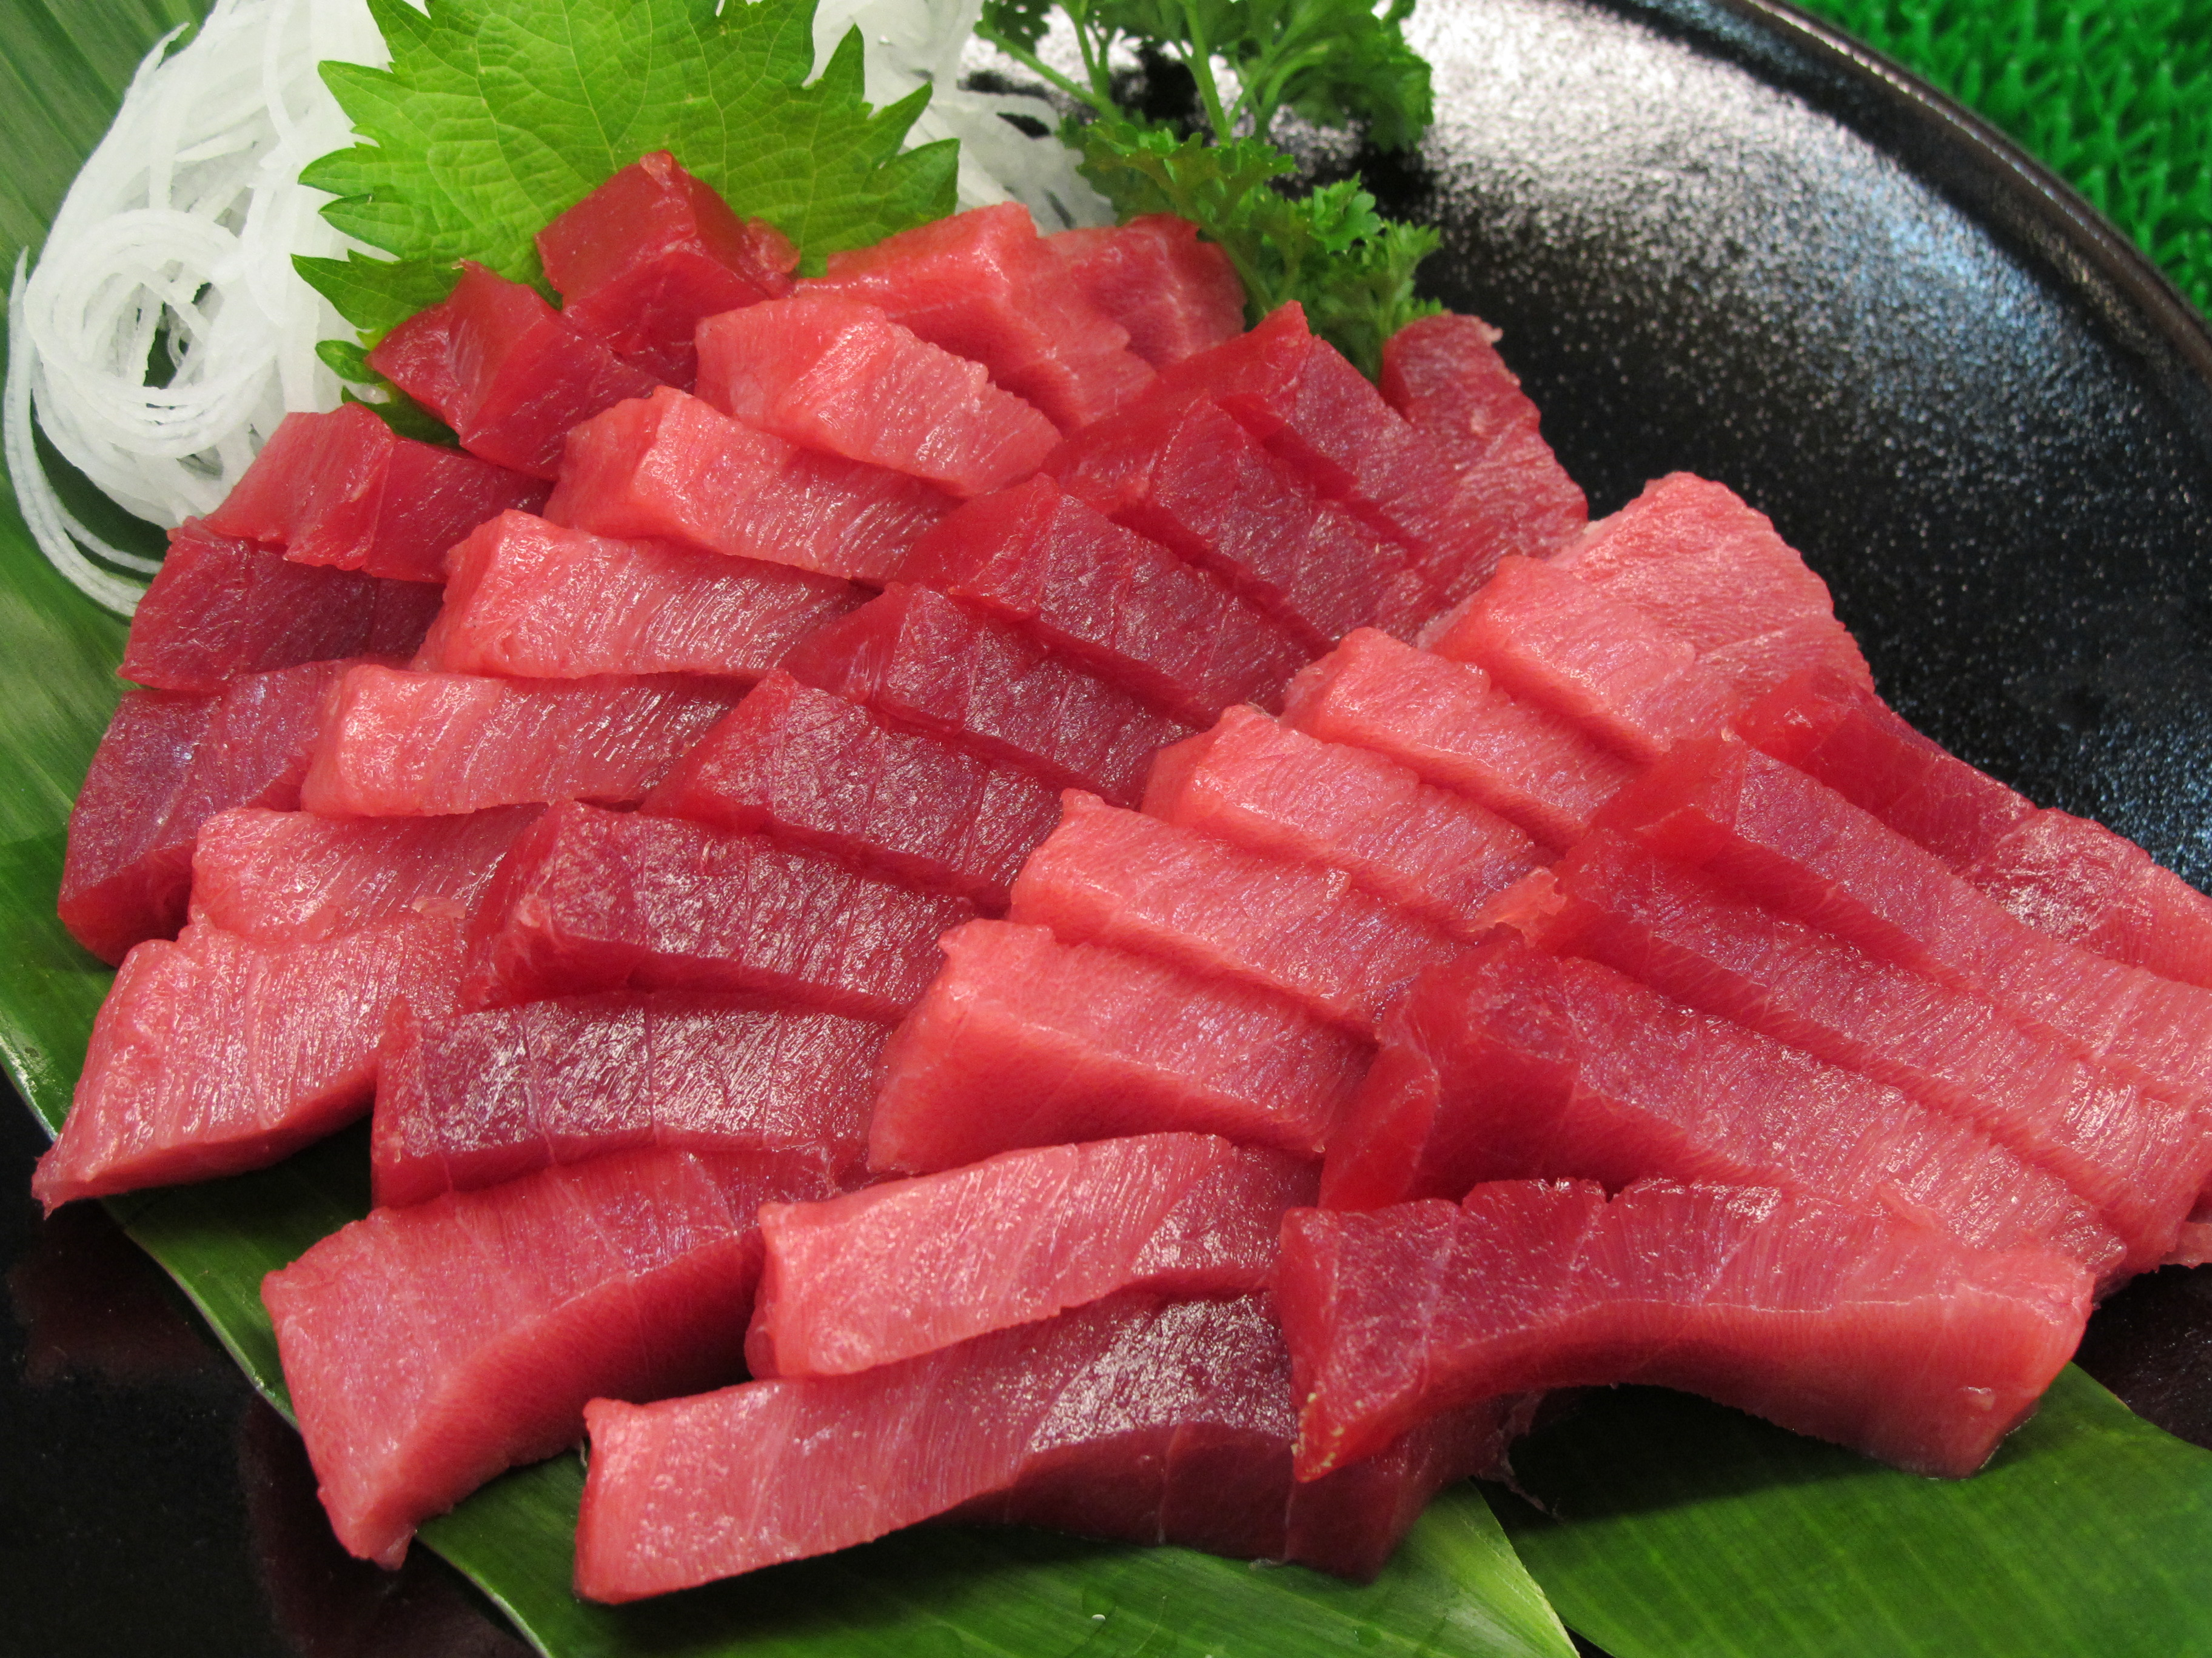
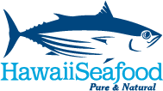
What Makes Hawaii Seafood Sustainable?
John Kaneko MS, DVM
Hawaii Seafood Council
Photo: John Kaneko

Slide 2
overview
Why Sustainable Seafood?
Growing concerns about the condition of the world’s ocean fish stocks.
Many people don’t know where their seafood comes from.
Many don’t understand fisheries or fishery management.
Need information. (ex. from fishery managers, eco-labels, consumer guides, other sources?)

Slide 3
OVERVIEW
Locally-Produced Seafood
Wild-caught fish is a major protein food produced in Hawaii, by Hawaii-based fishermen
Competes with imported seafood
Seafood Supply in Hawaii? Estimated to be 37% local seafood
US Seafood Supply? Less than 10% of supply is domestic American seafood
Source: Loke, M., C. Geslani, B. Takenaka and P Leung. 2012. Seafood Consumption and Supply Sources in Hawaii 2000-2009. Mar Fish Rev 74(4):44-51; NOAA, 2014. Fisheries of the United States 2013 https://www.st.nmfs.noaa.gov/commercial-fisheries/fus/fus13/index

Slide 4
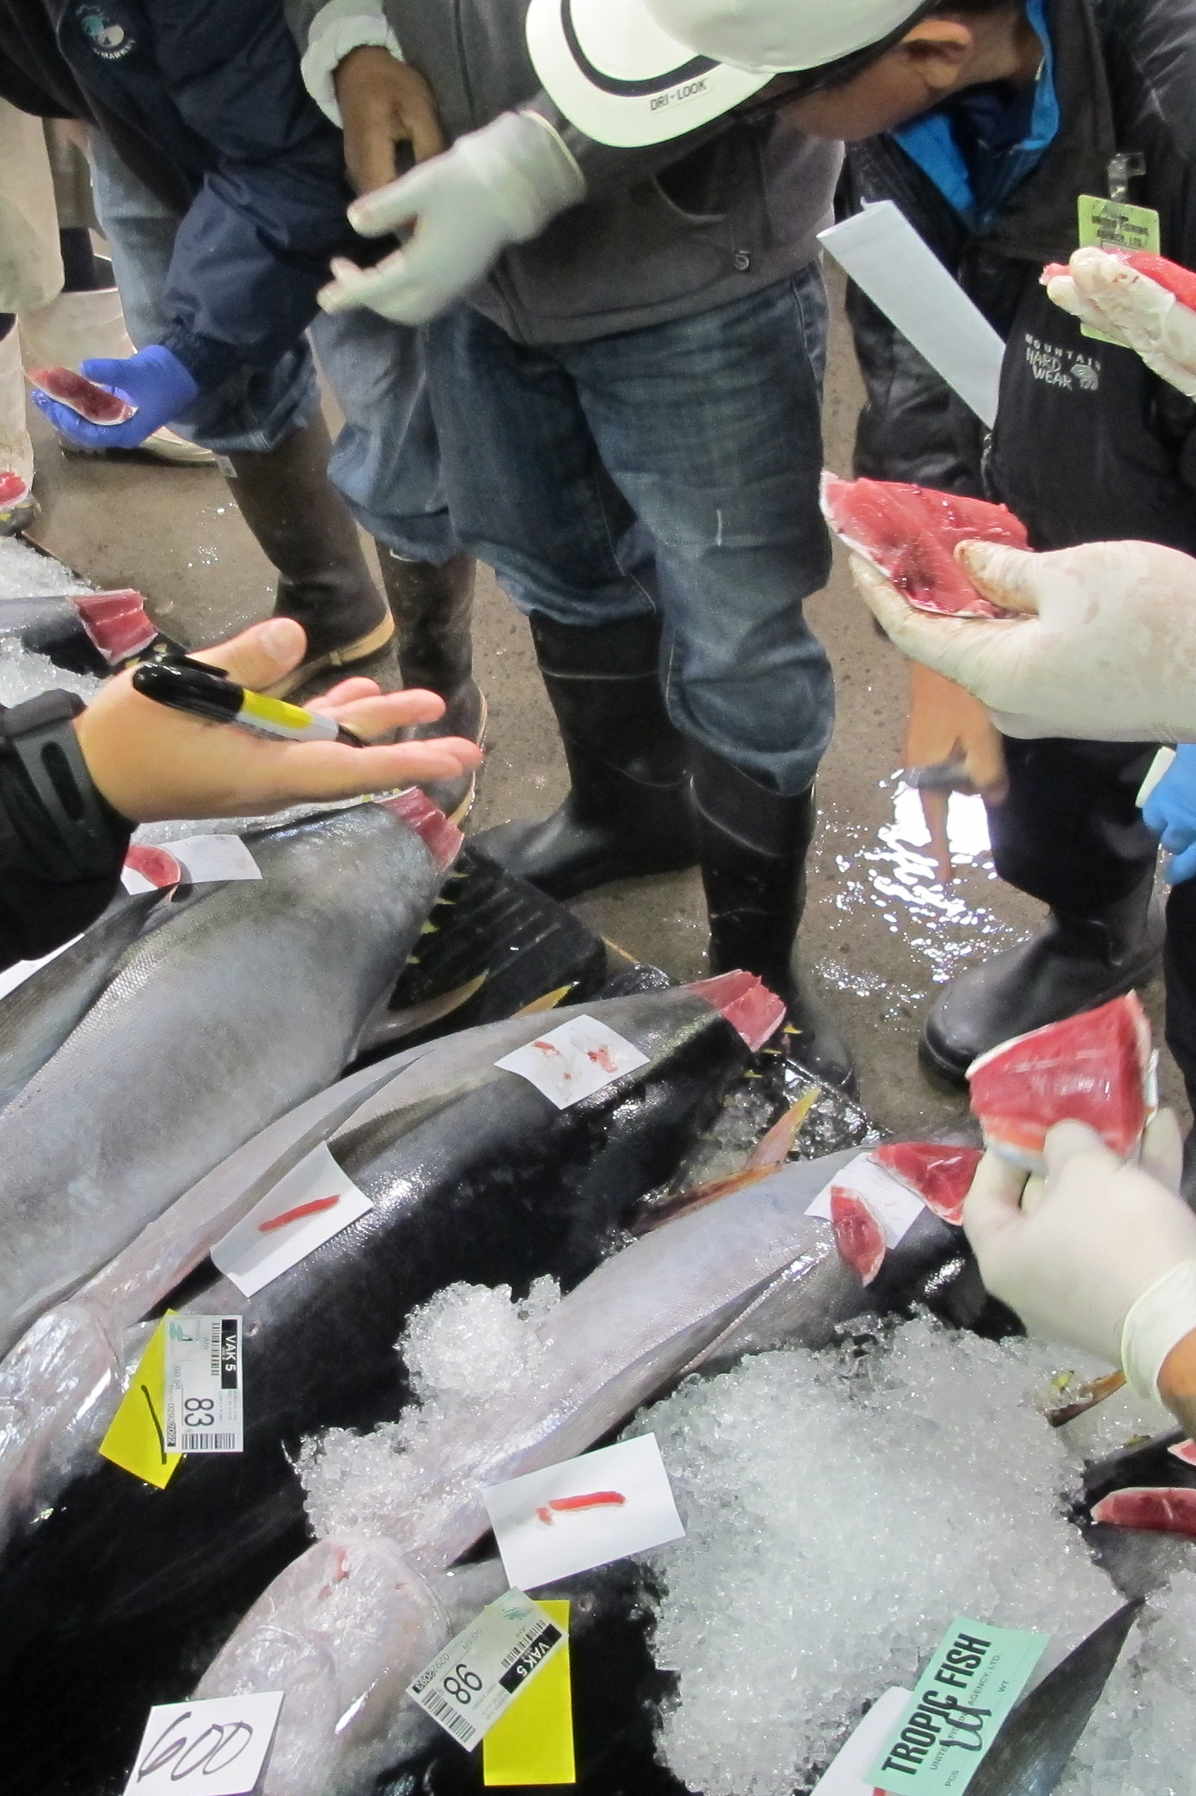
WE can judge fish quality.
What about sustainability?
Photo: John Kaneko

Slide 5
Sustainable Wild Seafood
What Is Sustainable Wild Seafood?
Sustainable wild seafood is harvested from renewable ocean resources that are managed in a way that can maintain production year after year without jeopardizing the ecosystem.

Slide 6
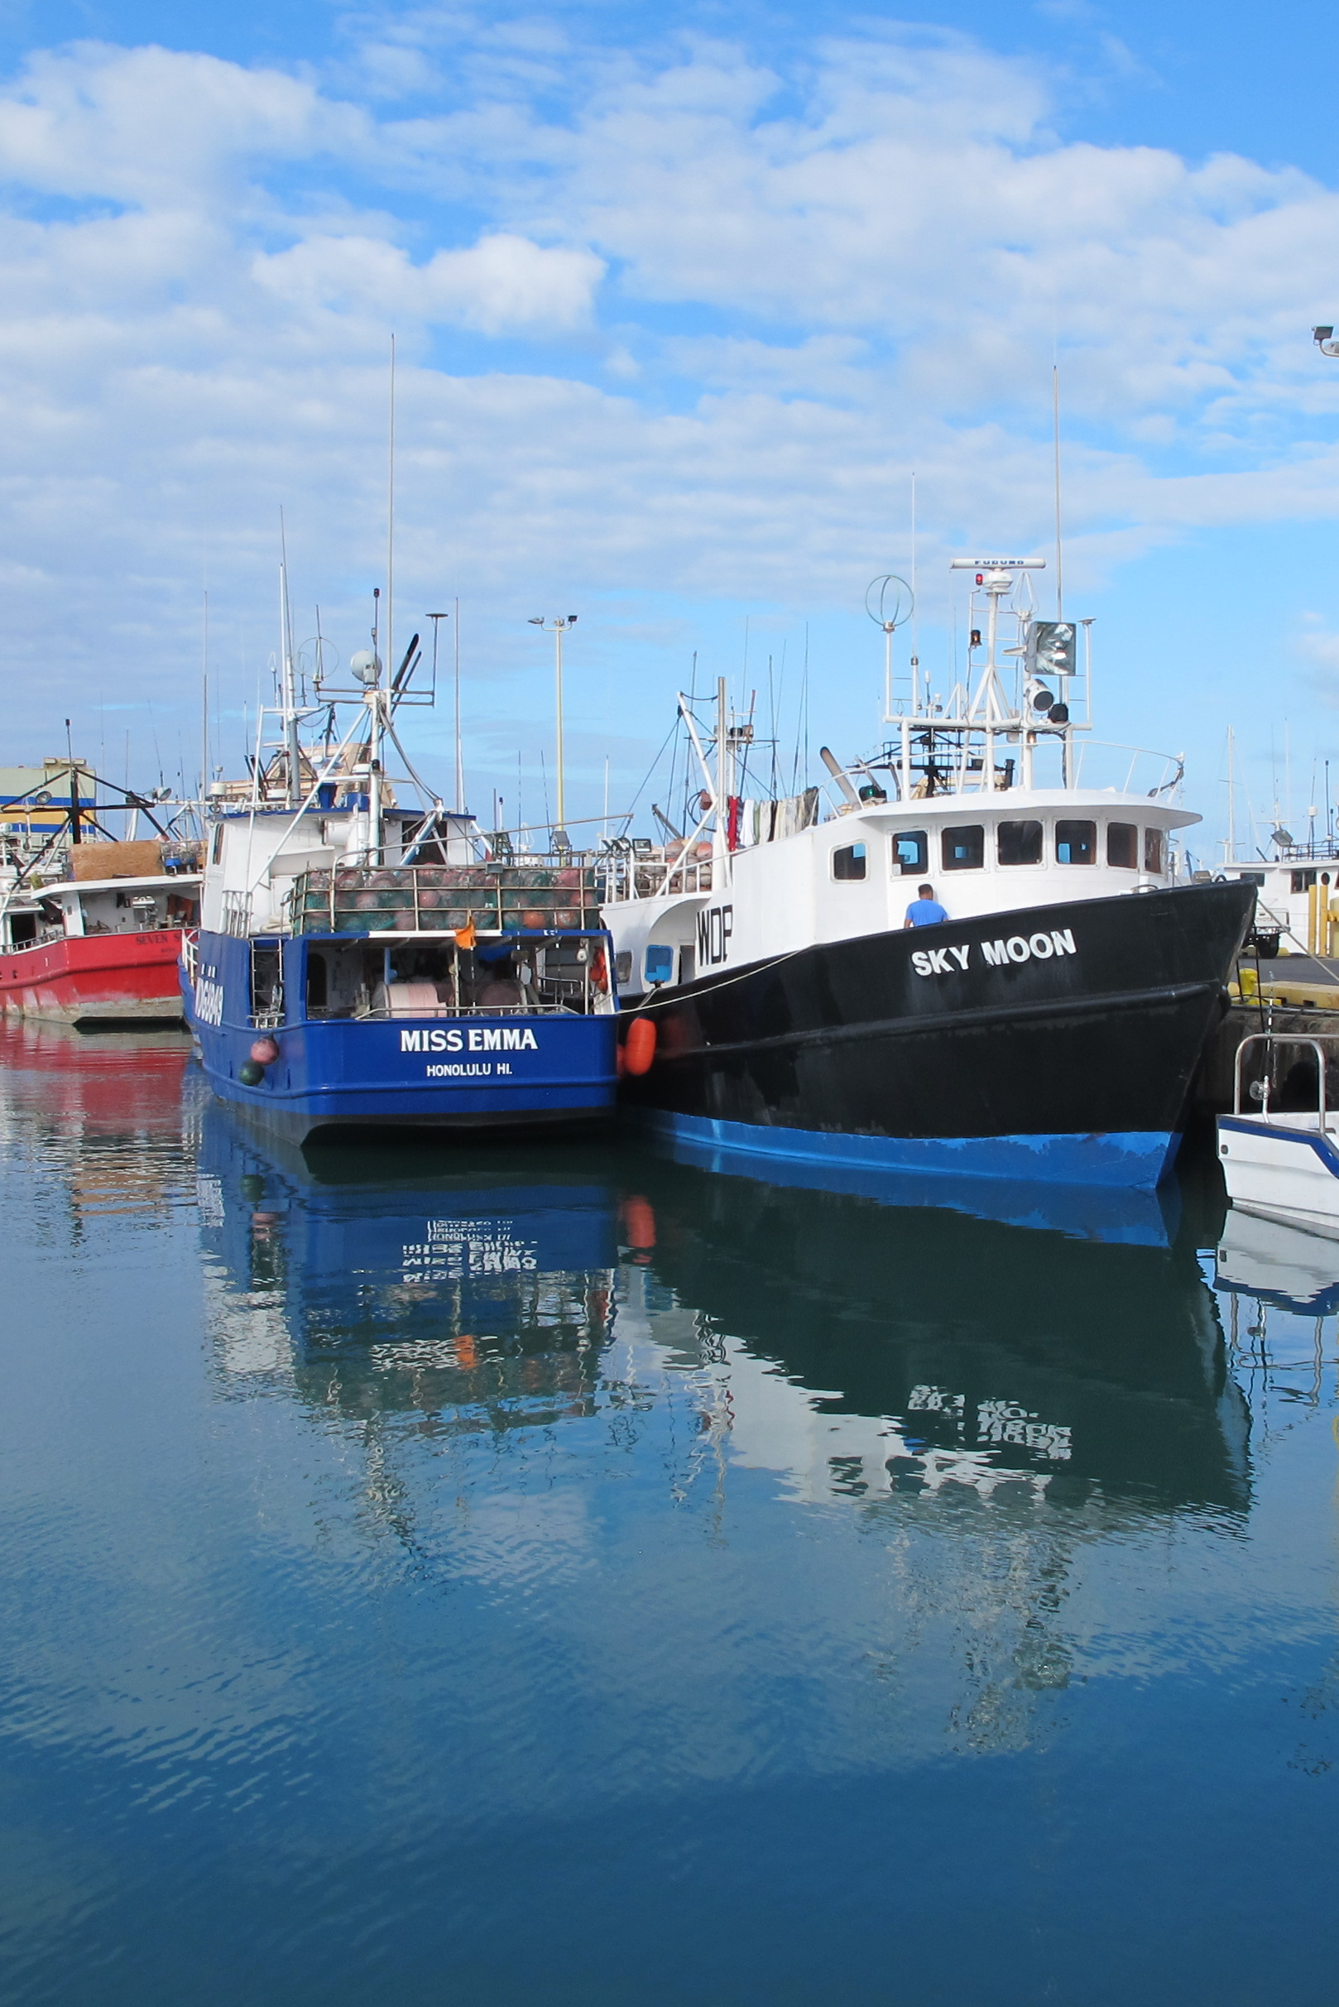
Hawaii longline fishery
Photo: John Kaneko

Slide 7
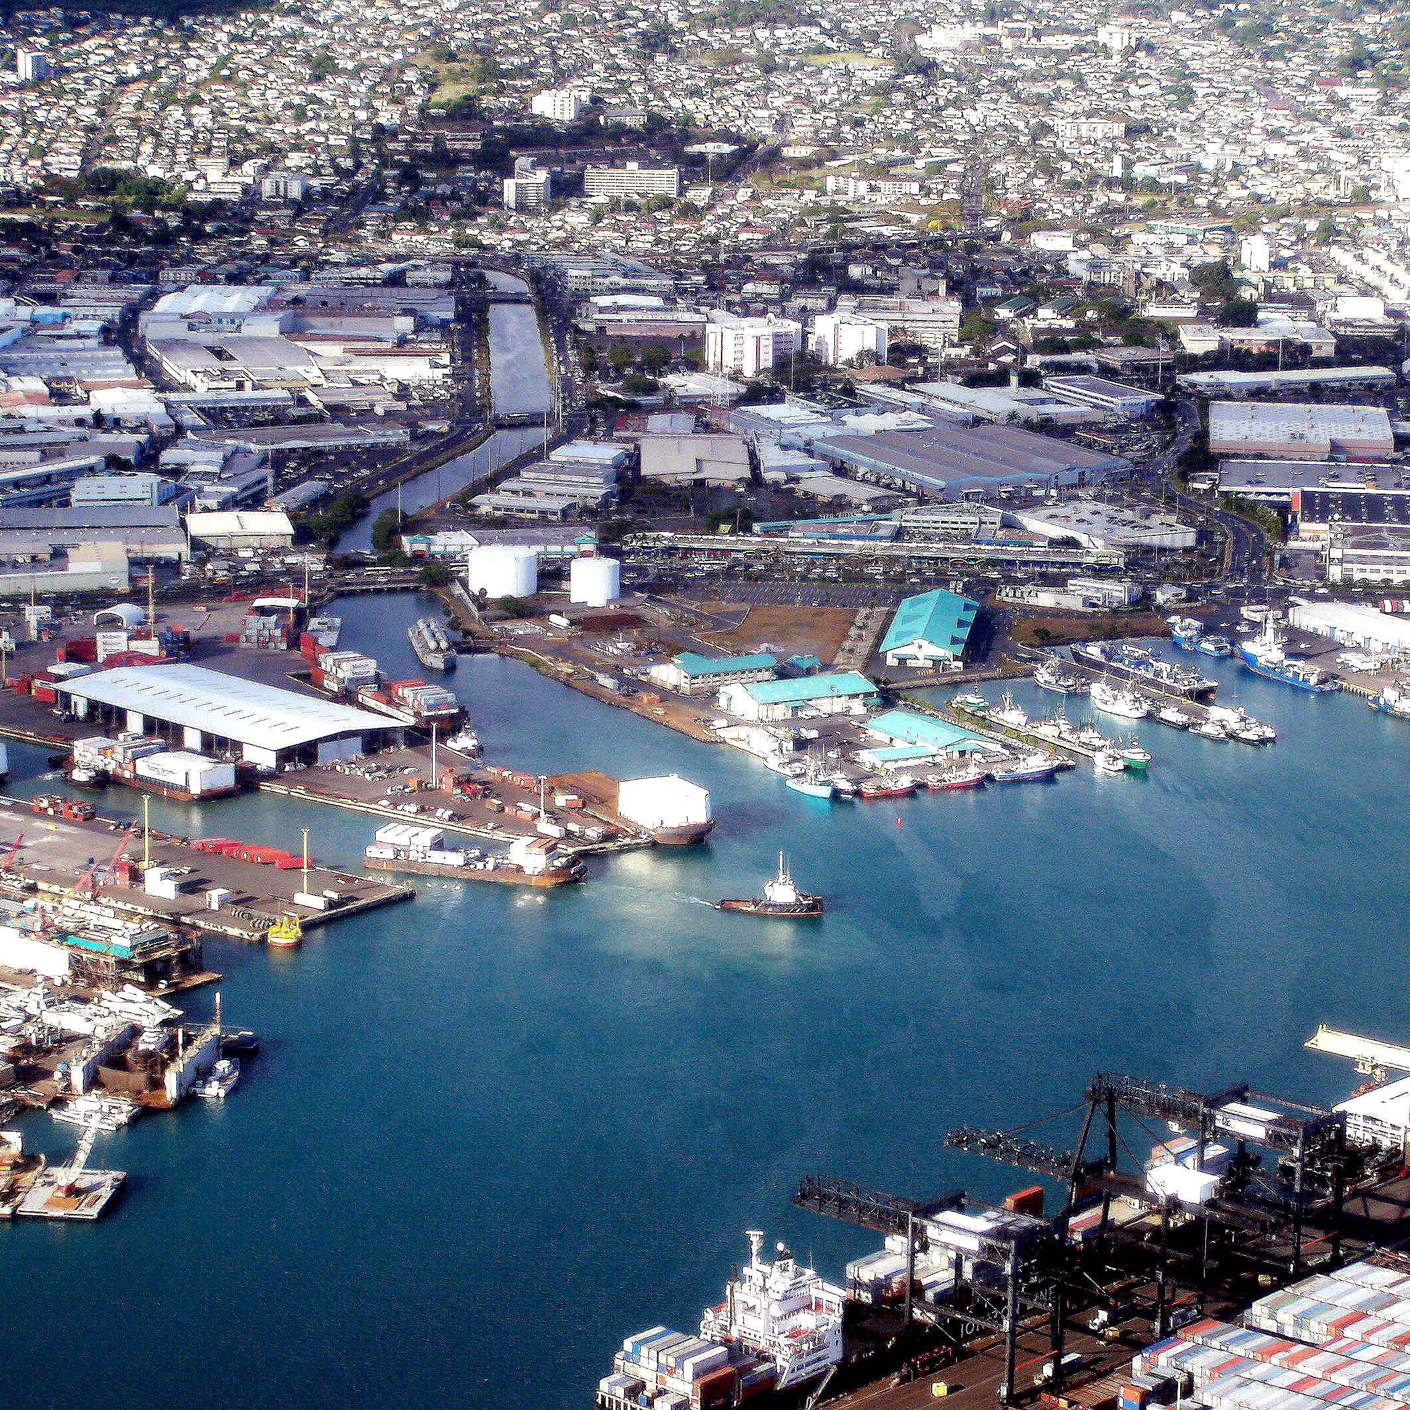
Hawaii Longline Fishery
Port of Honolulu Ranking in 2013
“We do more with less.”
32nd in the US in landed fish volume (29 million lbs.)
6th in the US in landed fish value ($100 million)
Source: NOAA 2014. Fisheries of the United States in 2013. Photo: Bob Lamb/Big Island Photography

Slide 8
Hawaii Longline Fishery
2011 Top 10 Hawaii Food Crops (farm gate or dockside)
 | Fish (wild, open ocean) | $87.5M
 | Sugarcane | $78.1M
 | Cattle | $46.4M
 | Macadamia Nuts | $38.2M
 | Coffee | $31.5M
 | Algae | $25.2M
 | Bananas | $11.3M
 | Papayas | $9.7M
 | Milk | $9.5M
 | Sweet Potatoes | $7.3M
Source: USDA National Ag. Stat. Service; Western Pacific Regional Fishery Council Pelagic Fisheries Annual Report 2010

Slide 9
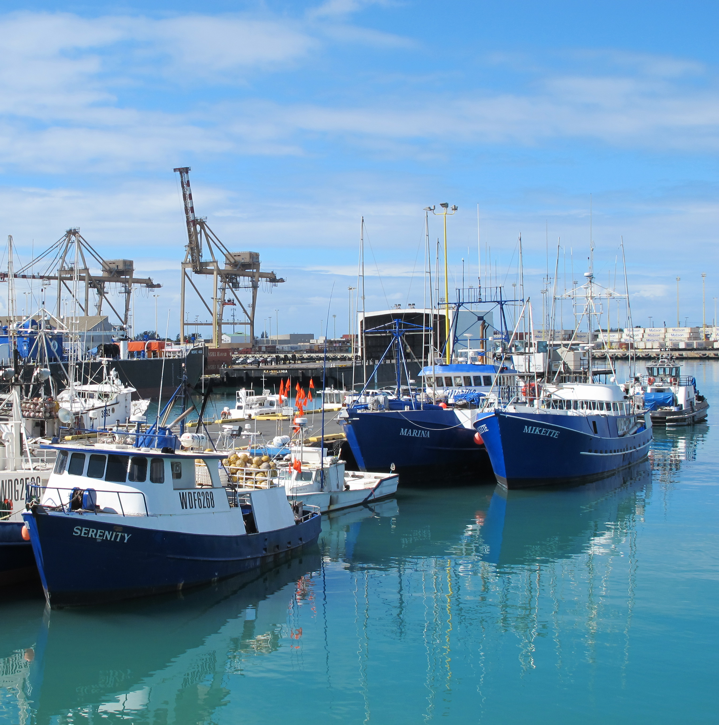
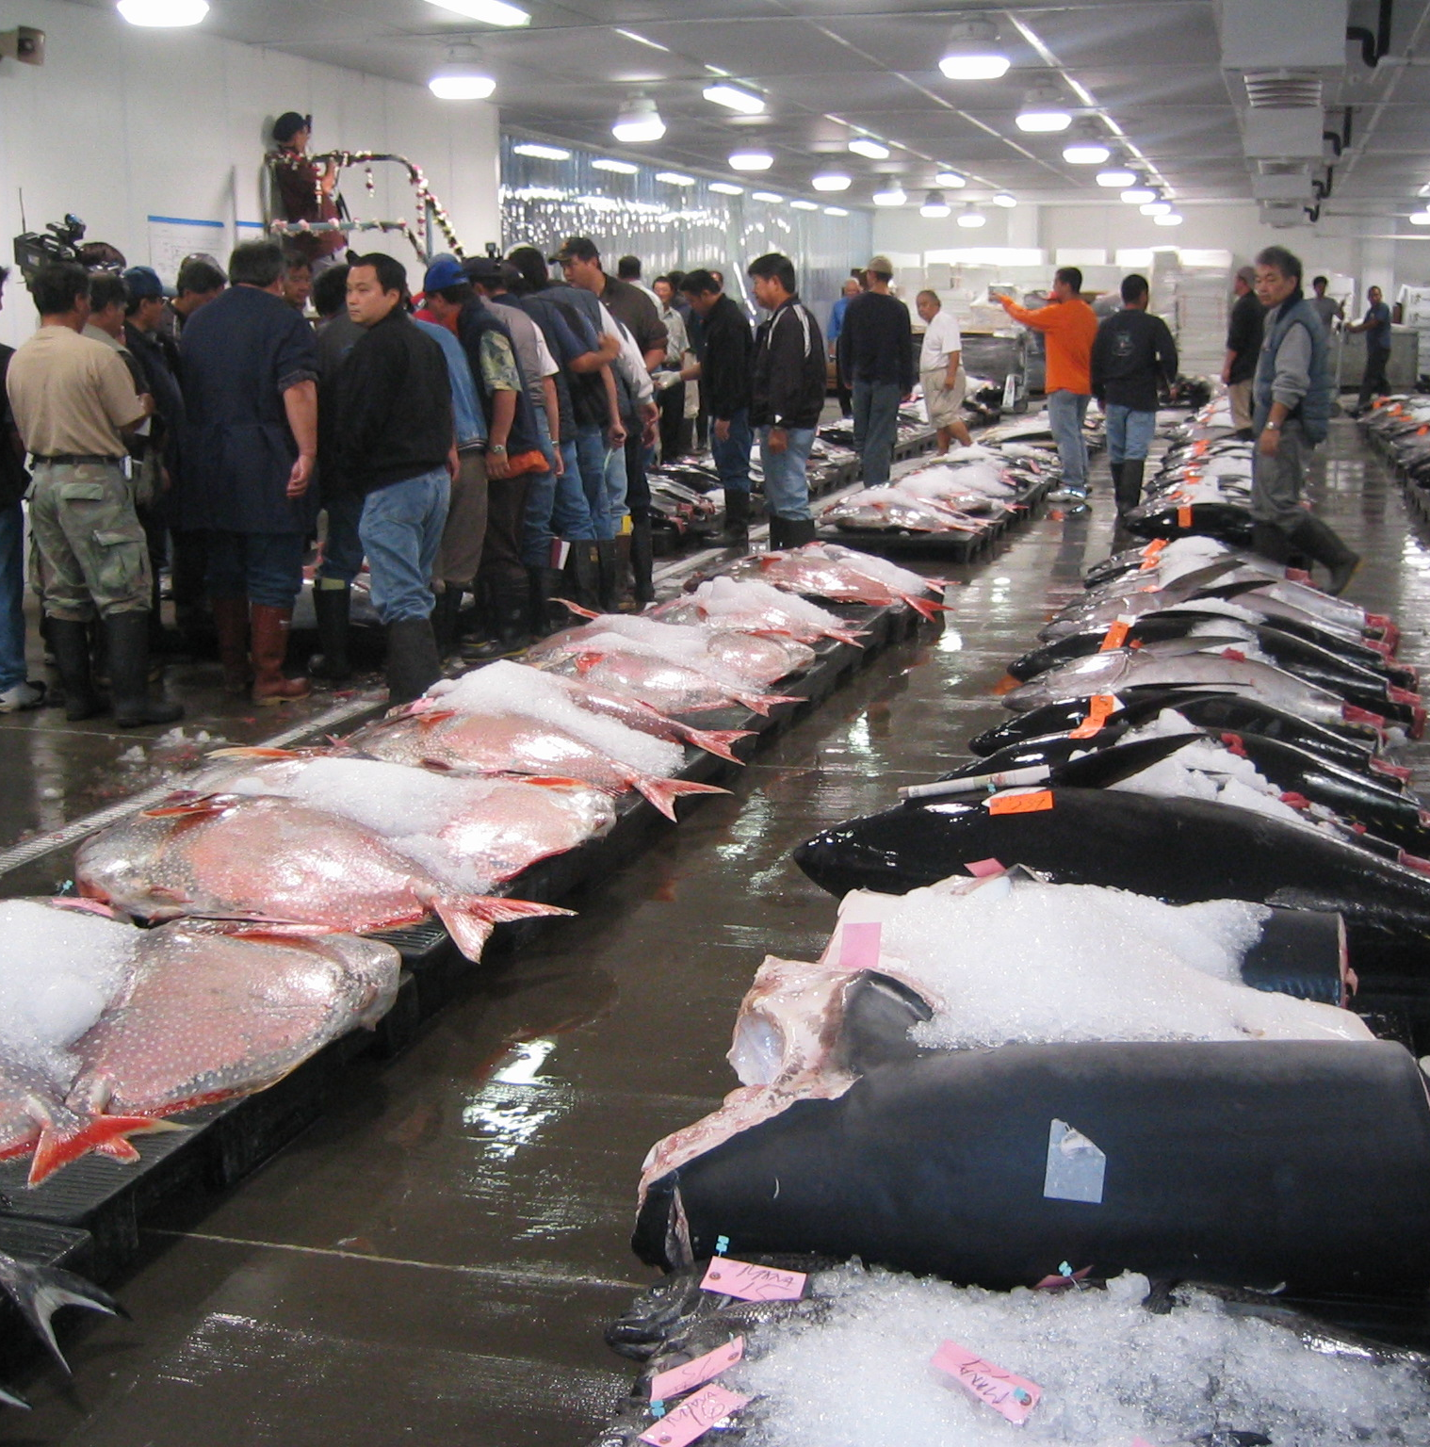
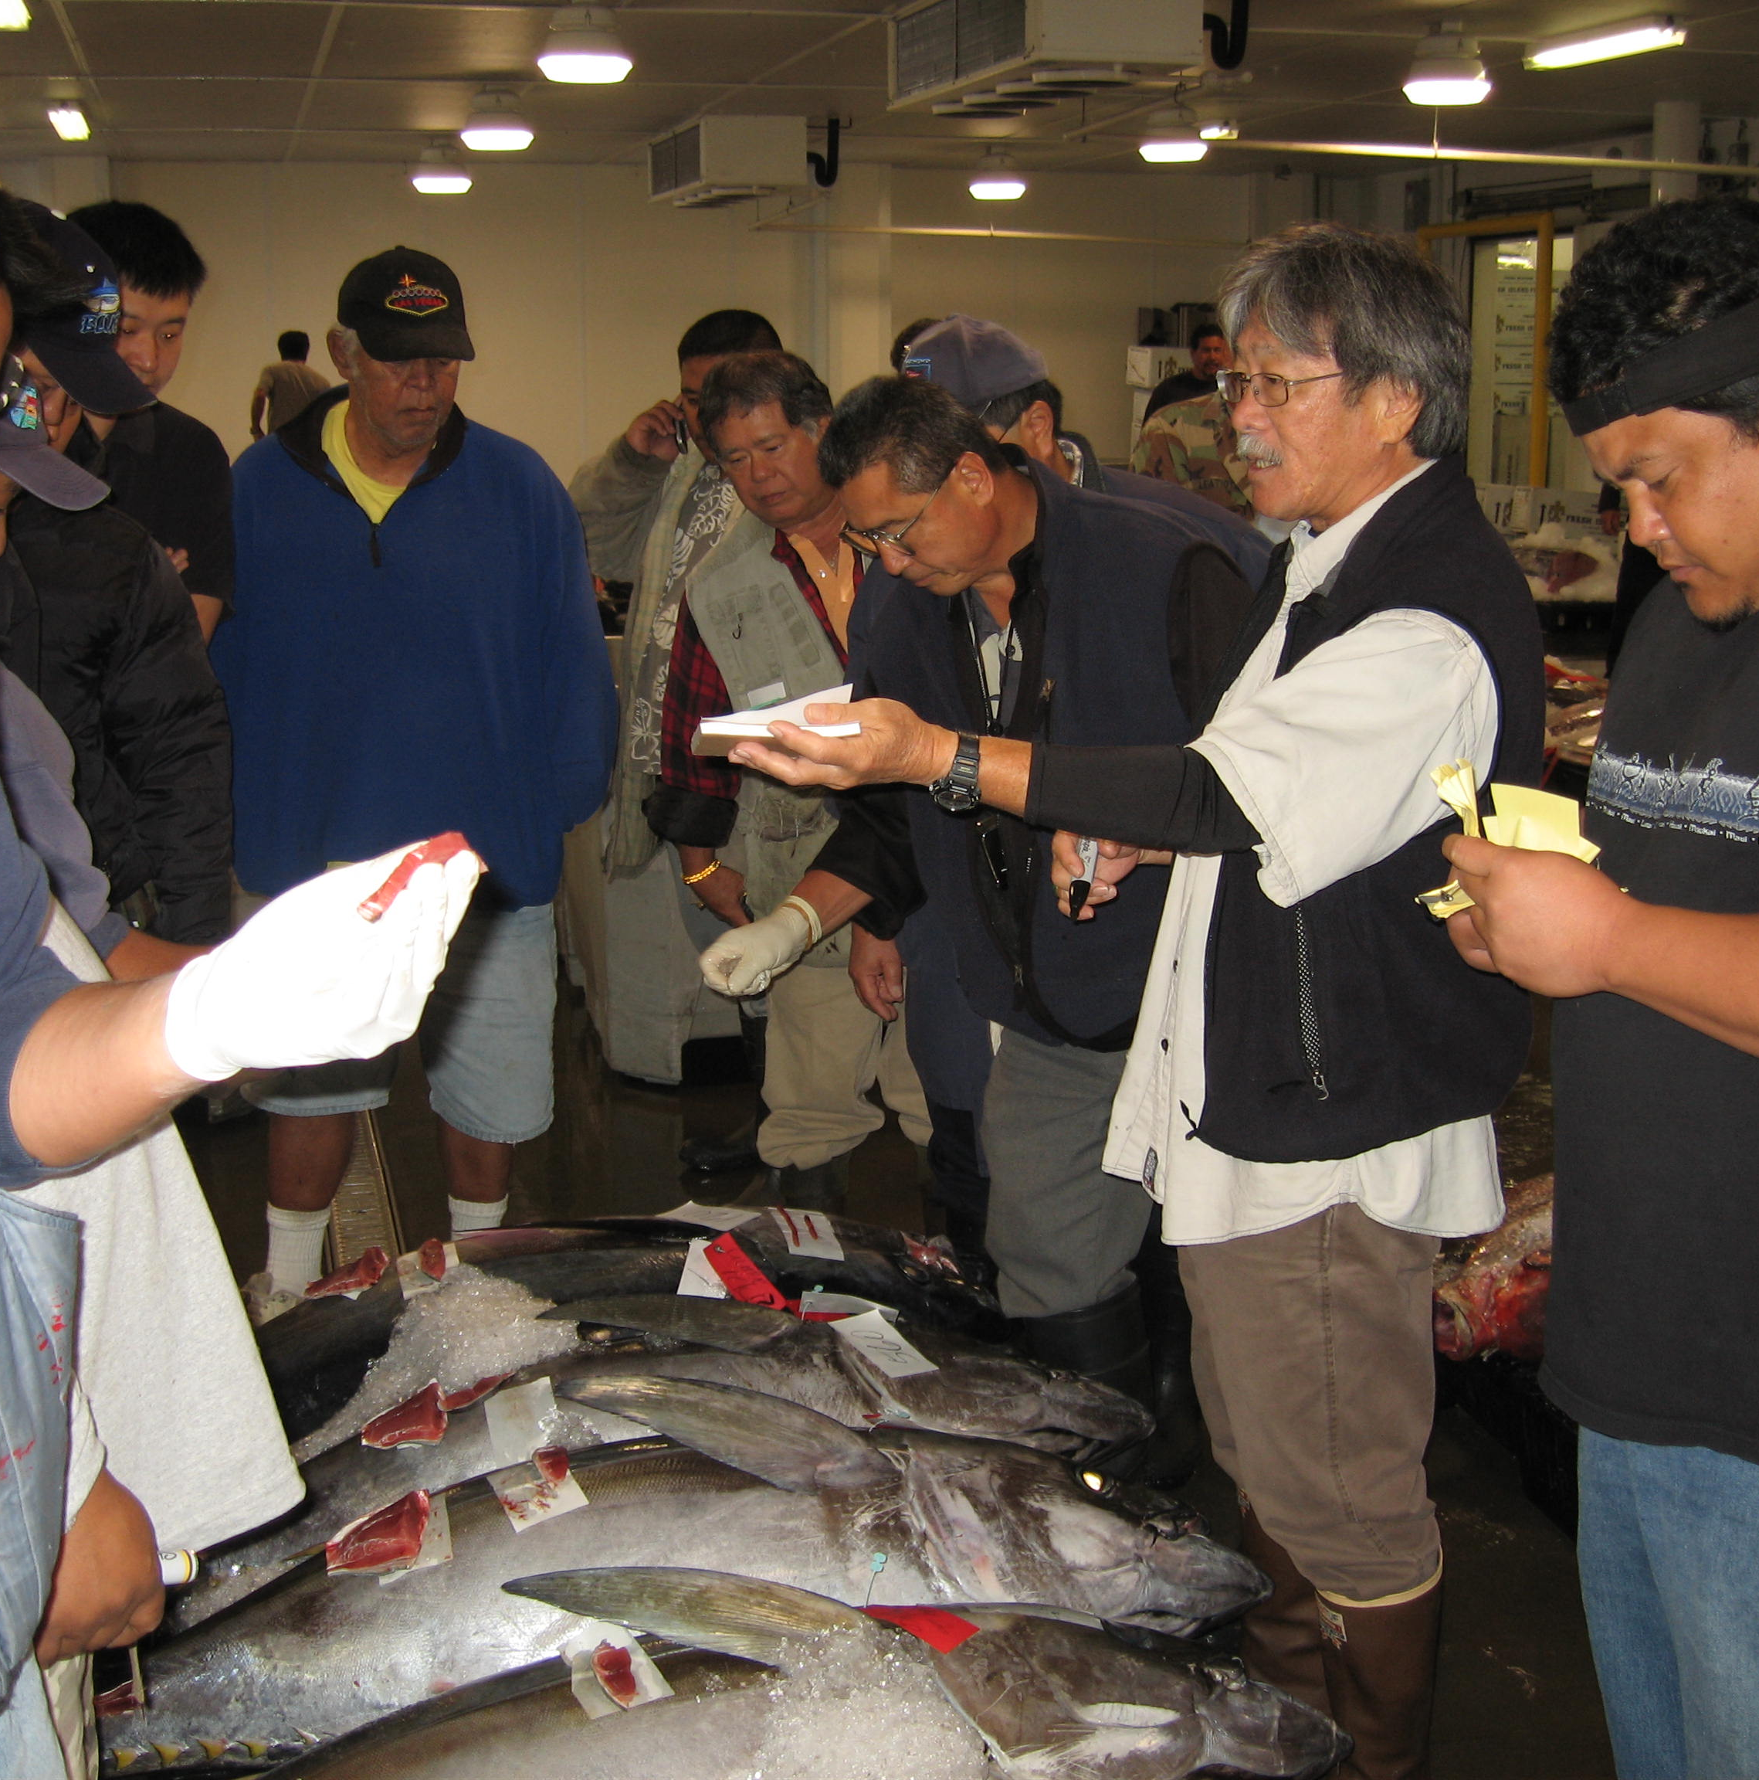
Hawaii Longline Fishery
Modern Auction Facilities
Hawaii longliners, Honolulu Harbor
First day at new Honolulu Fish Auction facility
Bidding action at the only fresh tuna auction in the US.
Photos: John Kaneko

Slide 10
Hawaii Longline Fishery
Hawaii Longline Fishery (between 2002 and 2012)
The main commercial fishery in Hawaii
80% of all Hawaii commercial fish landings
86% of total ex-vessel value
$68.6 million ex-vessel value per year average (2000-2012)
Source: 2012 Western Pacific Regional Fishery Management Council Pelagic Fisheries Annual Report

Slide 11
Hawaii Longline Fishery
Hawaii Longline Fishery
Two segments of fishery
Deep-set gear for Bigeye tuna
Shallow-set for Swordfish
Uses monofilament longline gear
Stores fish in ice
Sells through a display auction

Slide 12
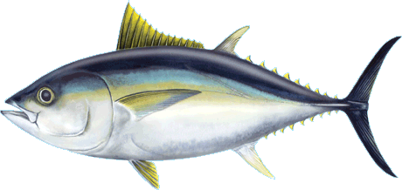
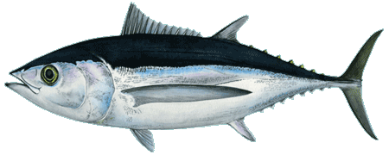
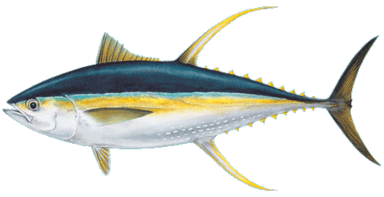
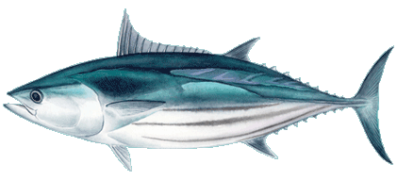
Hawaii Longline Fishery
Hawaii’s Catch: Tuna
Bigeye tuna
Albacore tuna
Yellowfin tuna
Skipjack tuna
Illustrations: Les Hata

Slide 13
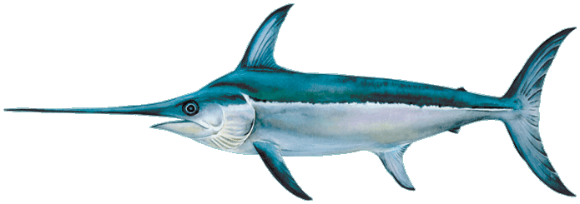
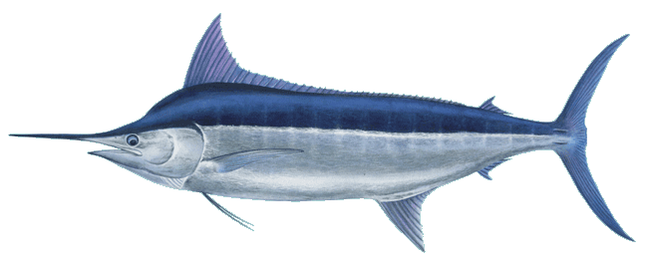
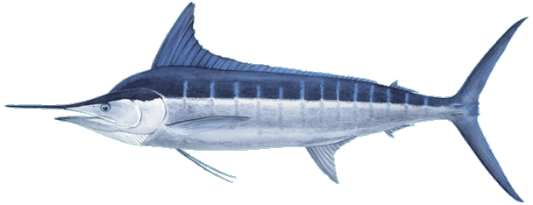
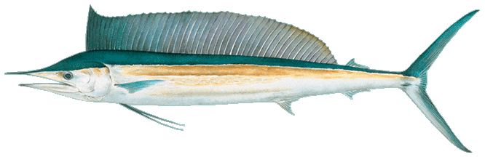
Hawaii Longline Fishery
Hawaii’s Catch: Billfish
Broadbill swordfish
Blue marlin
Striped marlin
Shortbill spearfish
Illustrations: Les Hata

Slide 14
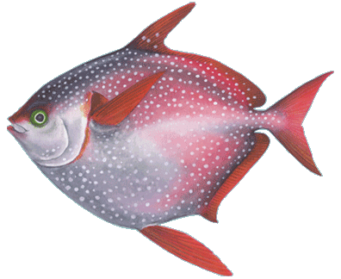
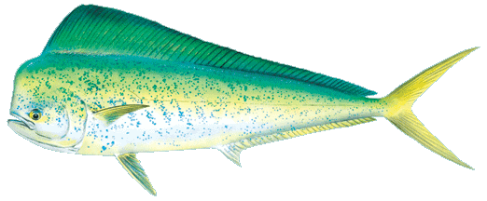
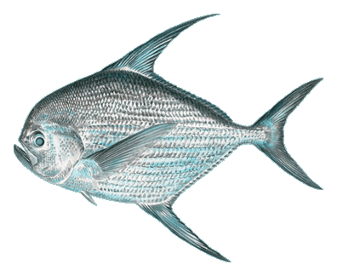
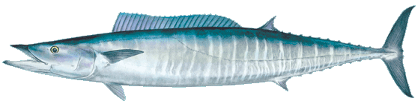
Hawaii Longline Fishery
Hawaii’s Catch: Other Open Ocean Fish
Mahimahi
Opah
Monchong
Ono
Illustrations: Les Hata

Slide 15
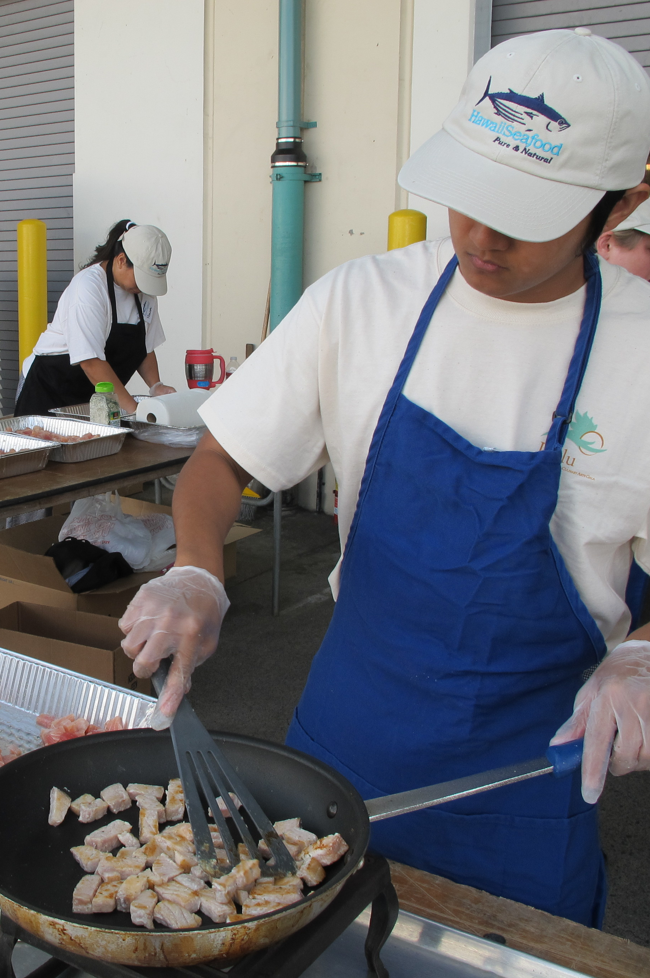
Is Hawaii Longline-Caught Seafood Sustainable?
What do you need to know? Who do you believe?
Photo: John Kaneko

Slide 16
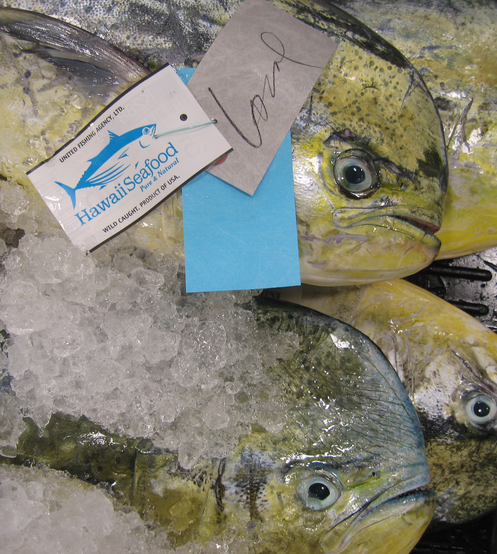
Is hawaii longline-CAUGHT seafood sustainable?
Sustainable Seafood Comes from Responsible Fisheries
Photo: John Kaneko

Slide 17
Is hawaii longline-CAUGHT seafood sustainable?
What is a Responsible Fishery?
One that is well-managed for sustainability
Controls overfishing
Controls ecosystem, bycatch, and protected species impacts

Slide 18
Is hawaii longline-CAUGHT seafood sustainable?
Is There a Global Standard for Responsible Fisheries?
Yes. The 1996 United Nations FAO Code of Conduct for Responsible Fishing
The only international agreement of what countries should have in place to develop responsible fisheries and manage them for sustainability
Source: FAO, 1996. Code of Conduct for Responsible Fisheries. Rome. FAO, United Nations.

Slide 19
Is hawaii longline-CAUGHT seafood sustainable?
FAO Code of Conduct for Responsible Fisheries
Hawaii’s Longline Fishery has the first and most comprehensive application of the Code as a scoring tool to date (according to FAO)
Hawaii Longline Fishery assessment is used by FAO as a case study for the application of the Code
Source: J.F. Caddy, FAO, personal communication, January 8, 2007; Reynolds, J.E. and G. Tegelskar Greig. 2007. Using questionnaires based on the Code of Conduct for Responsible Fisheries as diagnostics tools in support of fisheries management. FAO/FishCode Review No. 21. FAO, United Nations, Rome, 2007.

Slide 20
Is hawaii longline-CAUGHT seafood sustainable?
Responsible Fisheries Assessment (RFA)
The RFA Summary Score for Hawaii Longline Fisheries was 94% in 2008
It was 93% in 2006
Source: Bartram, P., J.J. Kaneko and G. Krasnick. 2006. Responsible Fisheries Assessment of Hawaii’s Pelagic Fisheries. Prepared for NOAA Award No. NA05NMF451112; Bartram, P. , K. Nakamura and J.J. Kaneko. 2008 Responsible Fisheries Assessment of Hawaii’s Pelagic Longline Fisheries. Prepared for NOAA Award No. NA06NMF4520222.

Slide 21
Is hawaii longline-CAUGHT seafood sustainable?
2008 RFA Results: Hawaii Longline Fisheries Scores for each Article
Article 7 | Fishery Management | 96% | 109.5 ⁄ 114
Article 8 | Fishing Operations | 93% | 70 ⁄ 75
Article 10 | Integration with CZM | 71% | 17.5 ⁄ 21
Article 11 | Post-harvest Practices/ Trade | 95% | 38 ⁄ 40
Article 12 | Fisheries Research | 91% | 30.5 ⁄ 33
Source: Bartram, P. , K. Nakamura and J.J. Kaneko. 2008 Responsible Fisheries Assessment of Hawaii’s Pelagic Longline Fisheries. Prepared for NOAA Award No. NA06NMF4520222.

Slide 22
Is hawaii longline-CAUGHT seafood sustainable?
Conclusion: Responsible Fisheries Assessment
RFA answers the basic question, “Is the fishery well-managed for sustainability?”
Fish Population Status: Rely on Fishery Stock Assessments (NOAA, WCPFC, IATTC)
Ecosystem Impacts: Rely on research and monitoring of fishery reduction of Protected Species Interactions and Bycatch (NOAA, others)
Source: Bartram, P. , K. Nakamura and J.J. Kaneko. 2008 Responsible Fisheries Assessment of Hawaii’s Pelagic Longline Fisheries. Prepared for NOAA Award No. NA06NMF4520222.

Slide 23
Is hawaii longline-CAUGHT seafood sustainable?
Is the Hawaii Longline Fishery Well-managed?
Yes. It has achieved a high compliance score with the FAO Code of Conduct for Responsible Fisheries.
Yes. It meets the 10 National Standards under NOAA and Council management.

Slide 24
Is hawaii longline-CAUGHT seafood sustainable?
Ideal Fishery Management System
Fishery Management Plan
Established Reference Points for sustainable catch limits and stock level
Receives regular Scientific Advice
Effective Monitoring and Control
Responsive Corrective Management Actions
Destructive Fishing Methods not used
Discards (bycatch) minimized
Ecosystem issues addressed
Continuous Improvement Process imbedded

Slide 25

Federal Fishery Management System (science-based management)
Well-Managed Fish Stock and Ecosystem
Graphic by Imaginary Office.

Slide 26
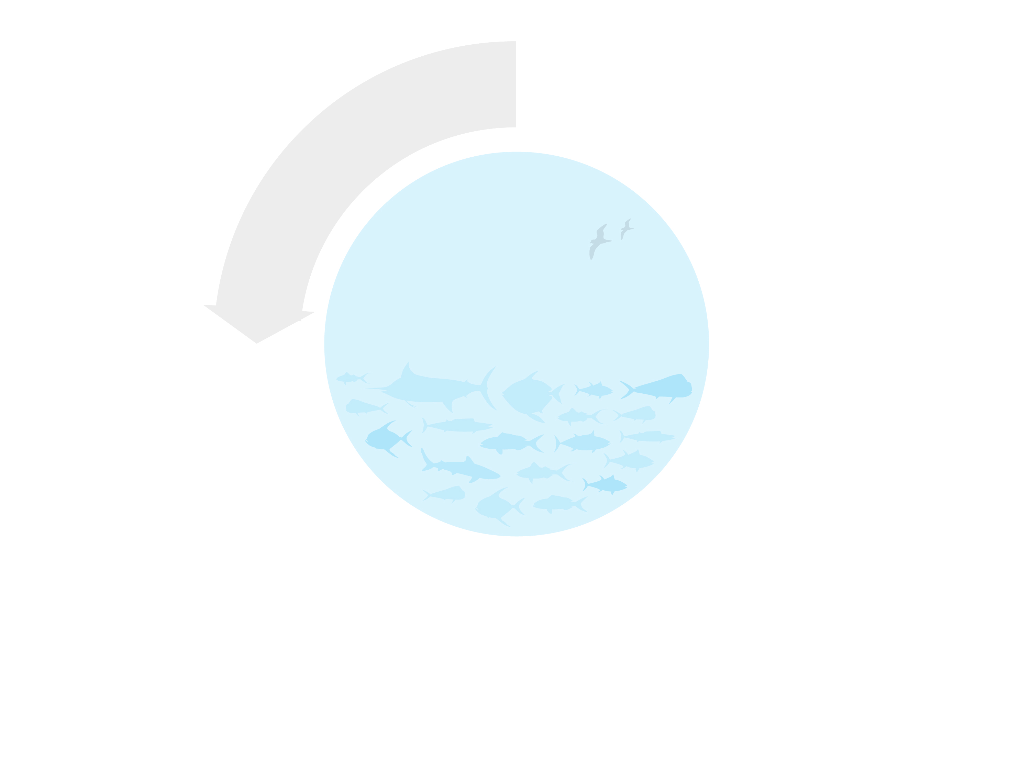

Federal Fishery Management System (science-based management)
Fishermen (Hawaii Longline Fishing Industry)
Data
Well-Managed Fish Stock and Ecosystem
Fishery Scientists
(NOAA-PIFSC, and others)
Graphic by Imaginary Office.

Slide 27
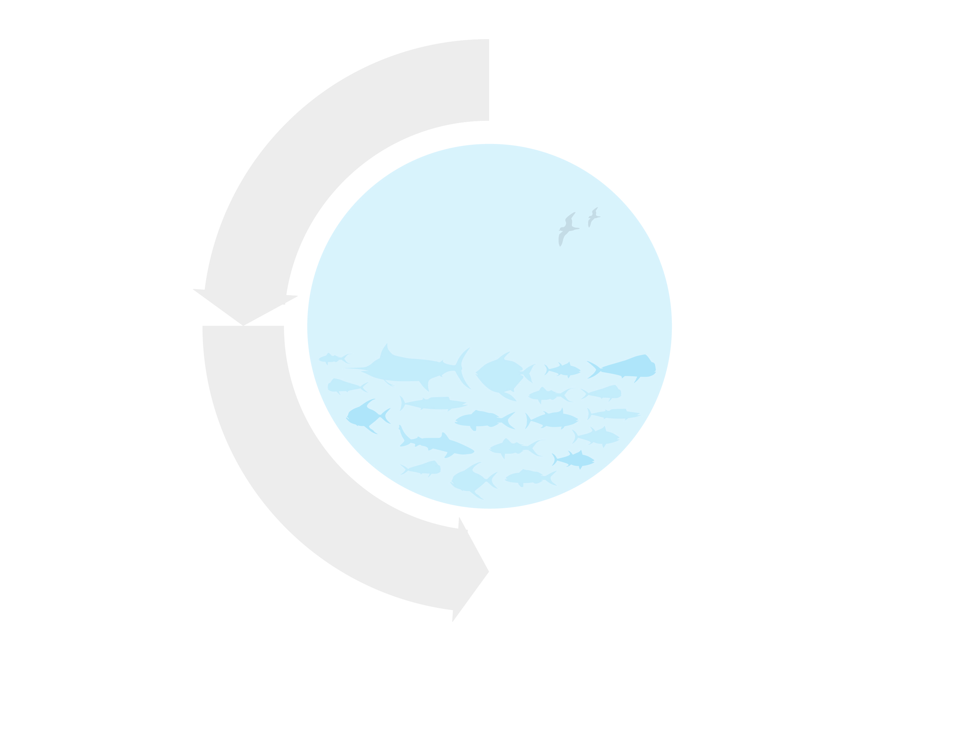
Federal Fishery Management System (science-based management)
Fishermen (Hawaii Longline Fishing Industry)
Data
Well-Managed Fish Stock and Ecosystem
Fishery Scientists
(NOAA-PIFSC, and others)
Field data, analysis, and recommendations
Fishery Management Council
(WPRFMC)
Graphic by Imaginary Office.

Slide 28
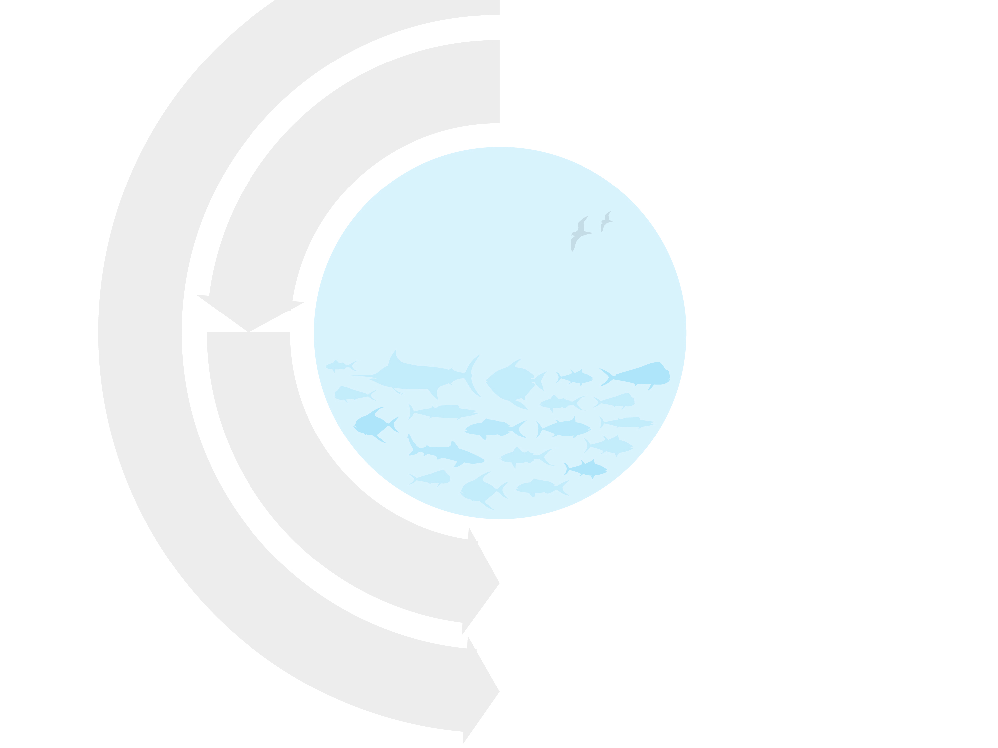

Federal Fishery Management System (science-based management)
Fishermen (Hawaii Longline Fishing Industry)
Concerns
Data
Well-Managed Fish Stock and Ecosystem
Other Stakeholders
Fishery Scientists
(NOAA-PIFSC, and others)
Concerns
Field data, analysis, and recommendations
Advisory Groups
Fishery Management Council
(WPRFMC)
Concerns
Graphic by Imaginary Office.

Slide 29

Federal Fishery Management System (science-based management)
Fishermen (Hawaii Longline Fishing Industry)
Concerns
Data
Well-Managed Fish Stock and Ecosystem
Other Stakeholders
Fishery Scientists
(NOAA-PIFSC, and others)
Concerns
Field data, analysis, and recommendations
Advisory Groups
Fishery Management Council
(WPRFMC)
Concerns
Fishery Management Plans (FMP’s) and Amendments
Graphic by Imaginary Office.

Slide 30
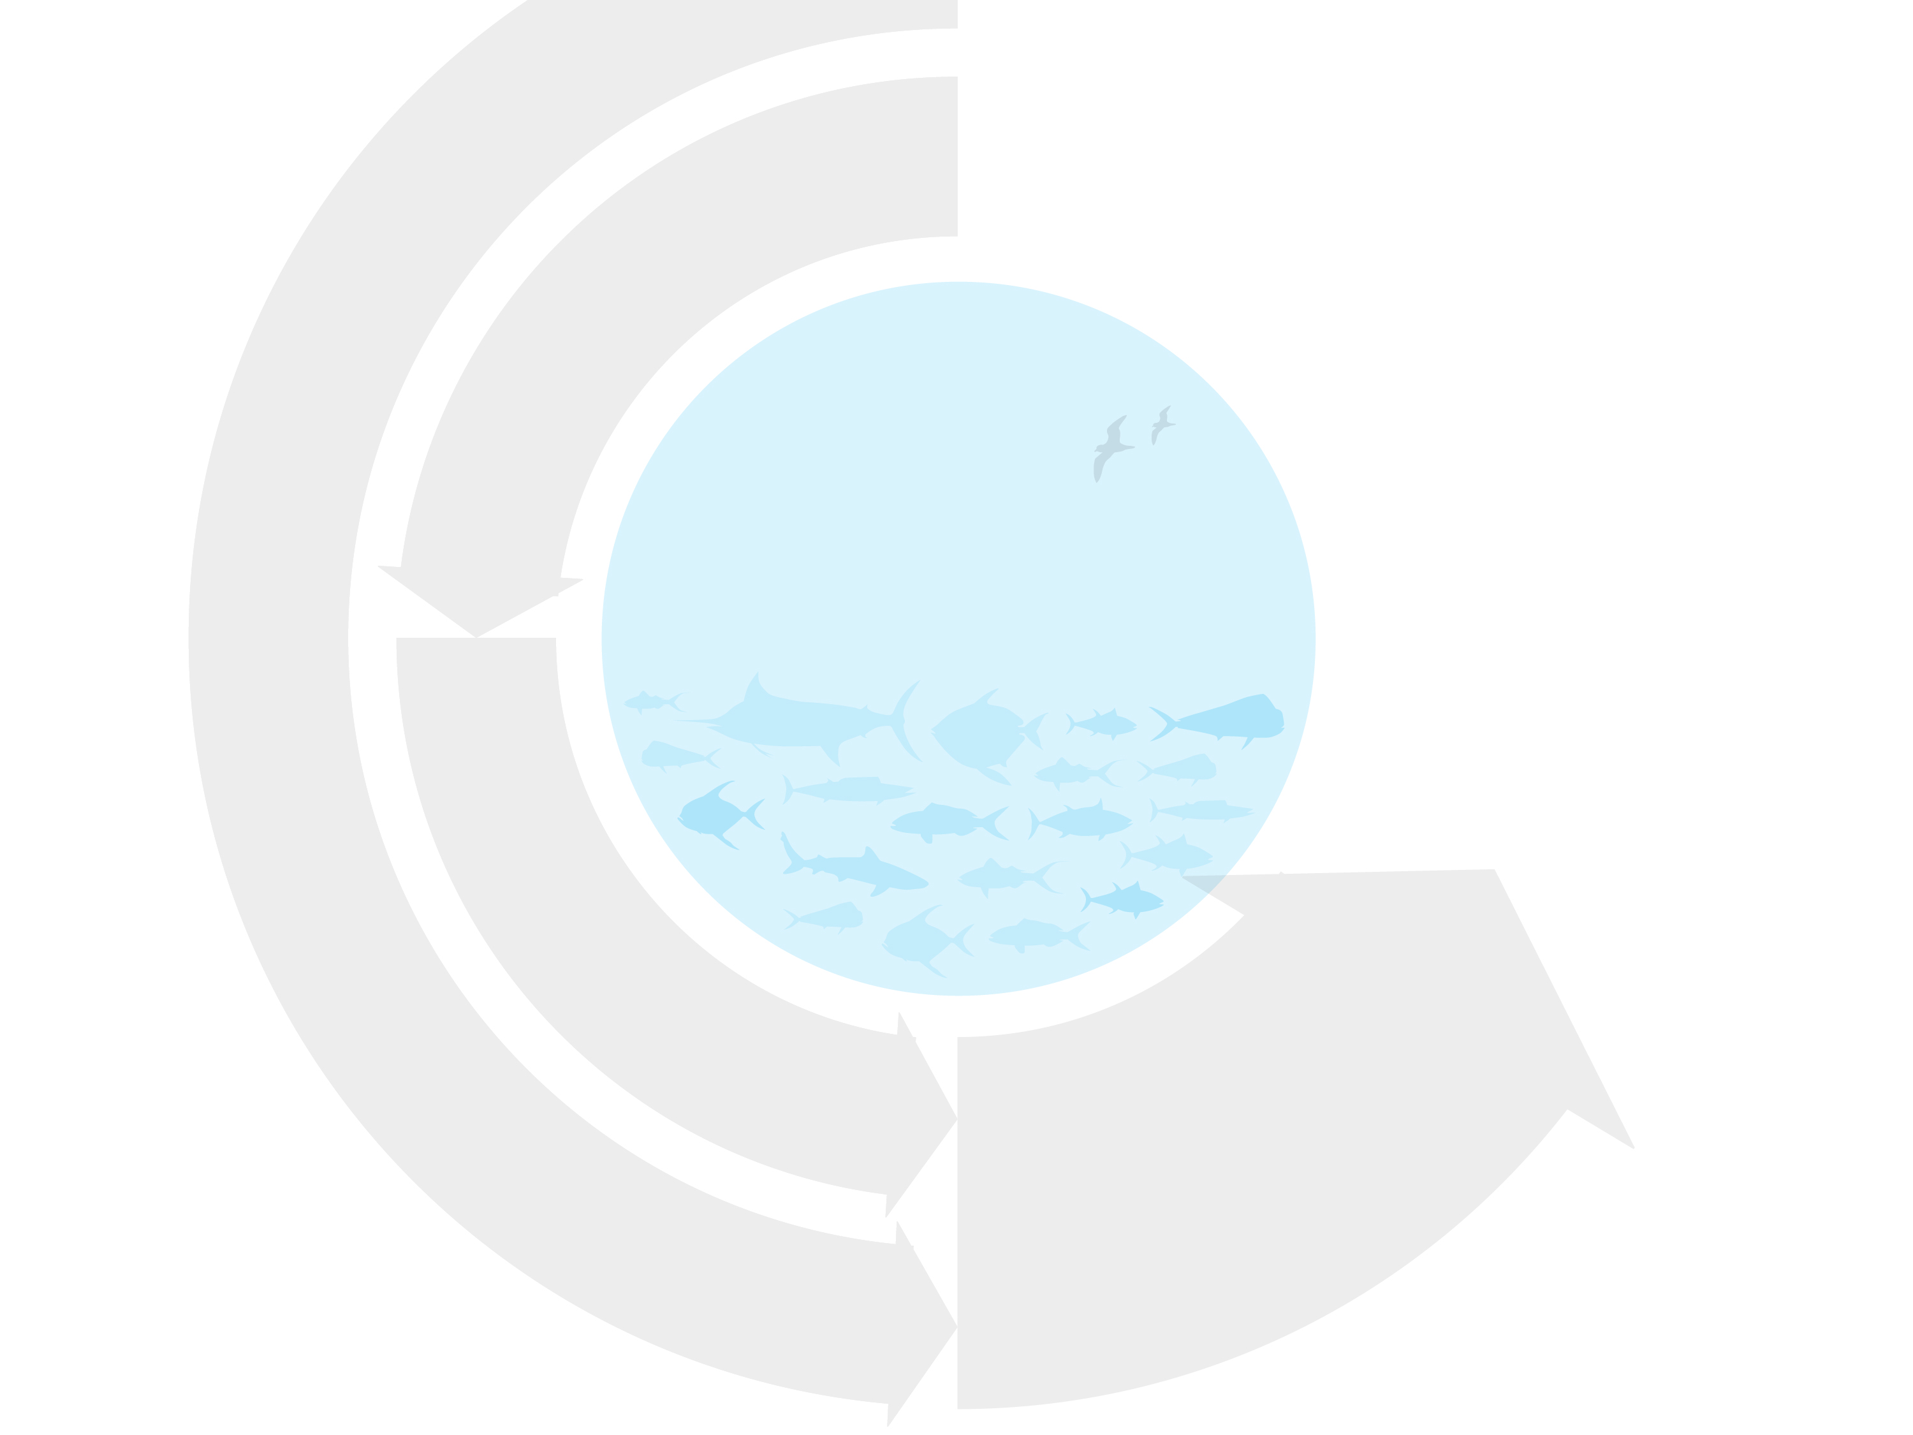

Federal Fishery Management System (science-based management)
Fishermen (Hawaii Longline Fishing Industry)
Concerns
Data
Well-Managed Fish Stock and Ecosystem
Fishery Regulators
(NOAA Headquarters, NOAA-PIRO)
Other Stakeholders
Fishery Scientists
(NOAA-PIFSC, and others)
Fishery regulations
Concerns
Field data, analysis, and recommendations
Advisory Groups
Fishery Management Council
(WPRFMC)
Concerns
Fishery Management Plans (FMP’s) and Amendments
Graphic by Imaginary Office.

Slide 31
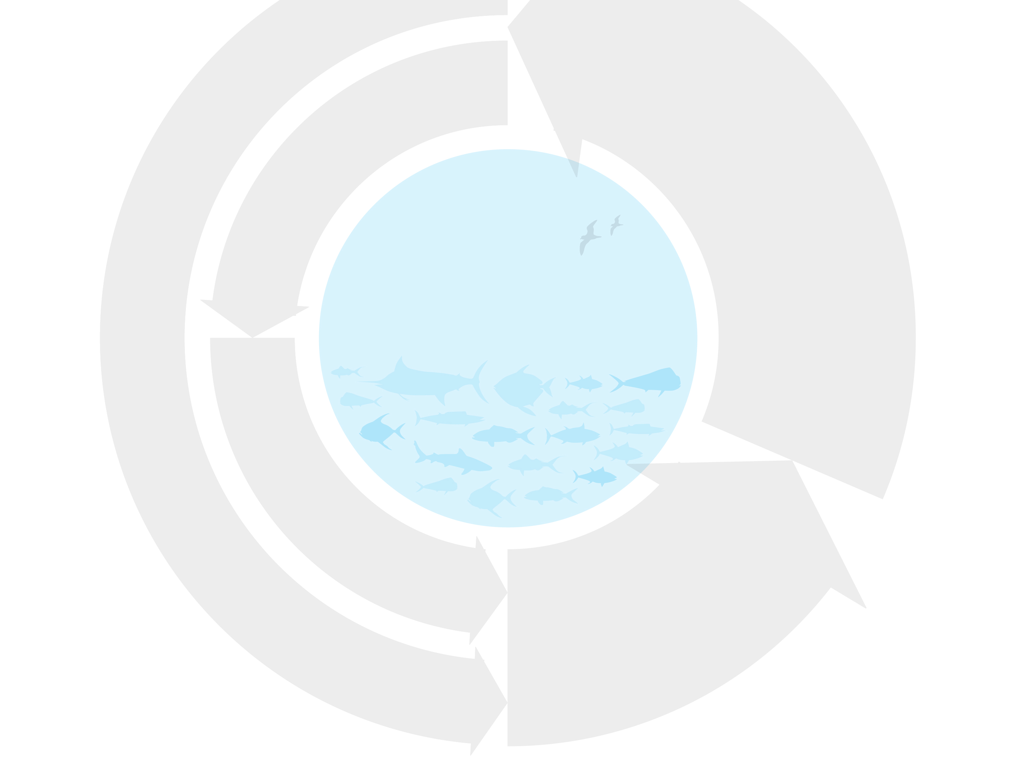
Federal Fishery Management System (science-based management)
Fishermen (Hawaii Longline Fishing Industry)
Regulation Enforcers
(NOAA, US Coast Guard)
Concerns
Data
Fishing, vessel safety, and
environmental regulations
Well-Managed Fish Stock and Ecosystem
Fishery Regulators
(NOAA Headquarters, NOAA-PIRO)
Other Stakeholders
Fishery Scientists
(NOAA-PIFSC, and others)
Fishery regulations
Concerns
Field data, analysis, and recommendations
Advisory Groups
Fishery Management Council
(WPRFMC)
Concerns
Fishery Management Plans (FMP’s) and Amendments
Graphic by Imaginary Office.

Slide 32
Is hawaii longline-CAUGHT seafood sustainable?
Comparison of Federal and State Fishery Management Process in Hawaii
 | Federal | State of Hawaii
Primary Agencies? | NOAA Fisheries (Pacific Islands Region) and Western Pacific Regional Fishery Management Council (WPRFMC) | Department of Land and Natural Resources, Division of Aquatic Resources (DLNR/DAR)
Jurisdiction? | Fishing outside of state waters from 3-200 nm within US EEZ. Beyond 200 nm, Hawaii vessels comply with federal & international regulations under 2 Regional Fishery Management Organizations (WCPFC & IATTC). | Fishing within state marine waters from shoreline out to 3 nm.
Overarching Mandate? | Magnuson Stevens Fishery Conservation and Management Act (MSA) | Description of role included in state constitution.
Fishery Council? | Yes. Eight Regional Councils established by MSA cover all US marine fisheries. WPRFMC manages fisheries in Hawaii, American Samoa, Guam and Northern Mariana Islands. | None

Slide 33
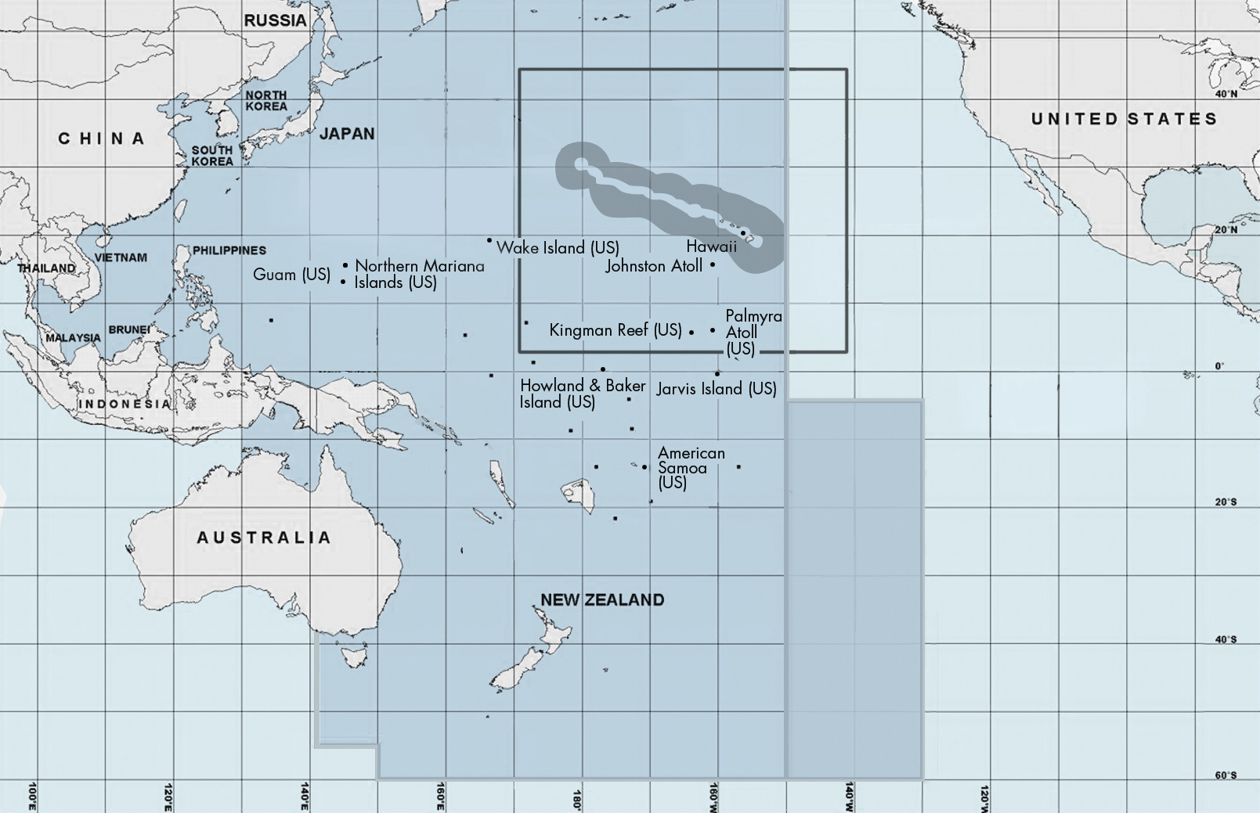
International Management of Pelagics in the Pacific Ocean
Nearshore Exclusion Zone (50-75nm)
EEZ Zone Around Hawaii
Range of Hawaii fleet
SHARED IATTC AND WCPFC ZONE
WCPFC ZONE
IATTC ZONE

Slide 34
Is hawaii longline-CAUGHT seafood sustainable?
Comparison of Federal and State Fishery Management Process in Hawaii cont’d
 | Federal | State of Hawaii
Fishery Management Plan? | Fishery Management Plans (FMP) are required by MSA. An FMP is a “living” document detailing the fishery and existing and proposed management actions vetted through the Council Process. | None
How are regulations established? | The Council Process continually maintains and amends the FMP in response to new science and changes in the fishery. Scientific and diverse stakeholder input is mandated to inform the Council in a public process. Proposed regulations are reviewed by NOAA and approved by the US Secretary of Commerce. This makes continual improvements in adaptive fishery management a requirement. | There are 2 ways. The Administrative Rules process allows DLNR to create, vet and propose new regulations to be reviewed and adopted by the Lt. Governor. The Legislative process allows new regulations to be proposed, vetted and adopted by the State House and Senate and signed by the Governor. This pathway does not require DLNR input.

Slide 35
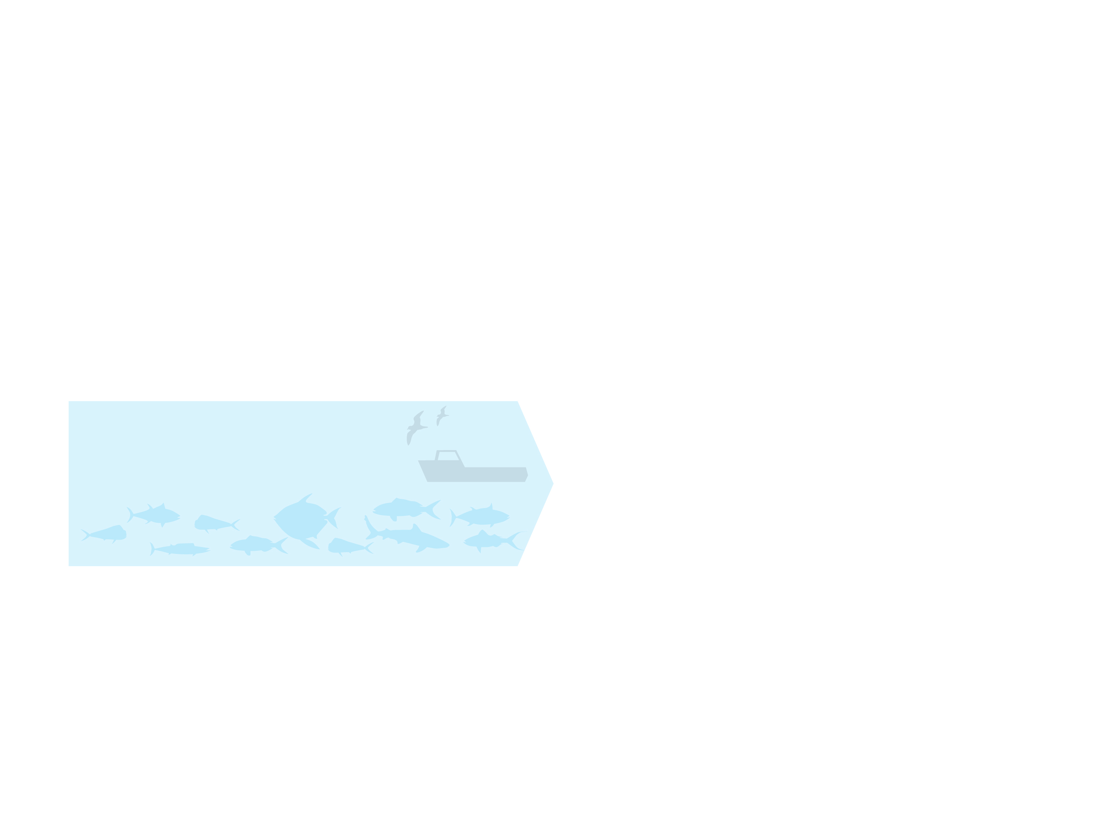
Federal Fishery Management and Seafood Regulation in Hawaii
Fishery
(Well-managed Fish Stock and Ecosystem, and HI Longline Fishing Industry)
Graphic by Imaginary Office.

Slide 36
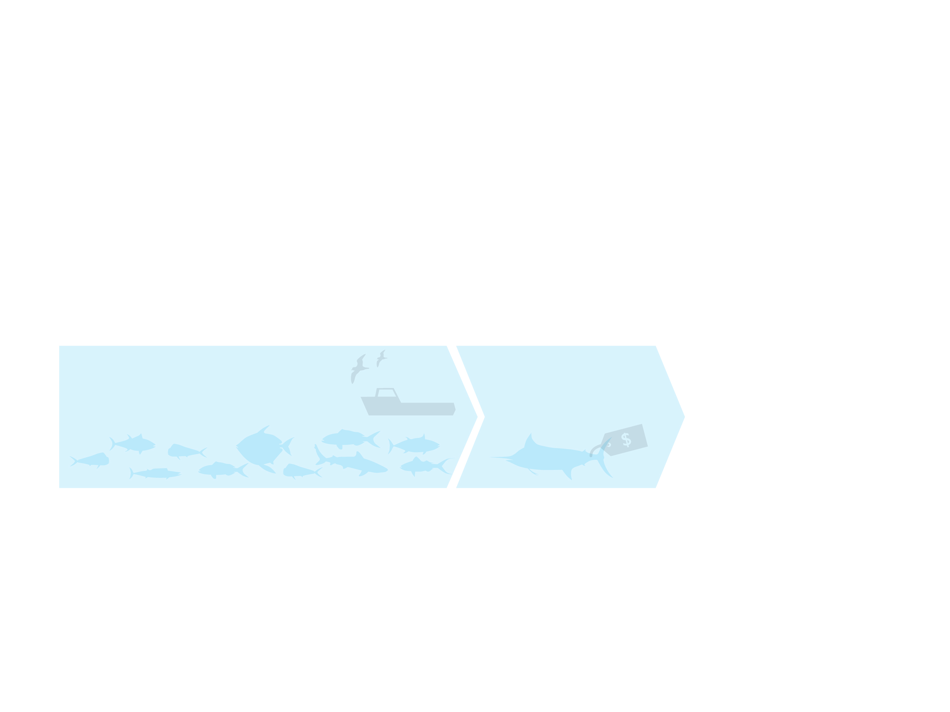
Federal Fishery Management and Seafood Regulation in Hawaii
Fishery
(Well-managed Fish Stock and Ecosystem, and HI Longline Fishing Industry)
Fish Distribution
(Honolulu Fish Auction, Wholesalers)
Graphic by Imaginary Office.

Slide 37
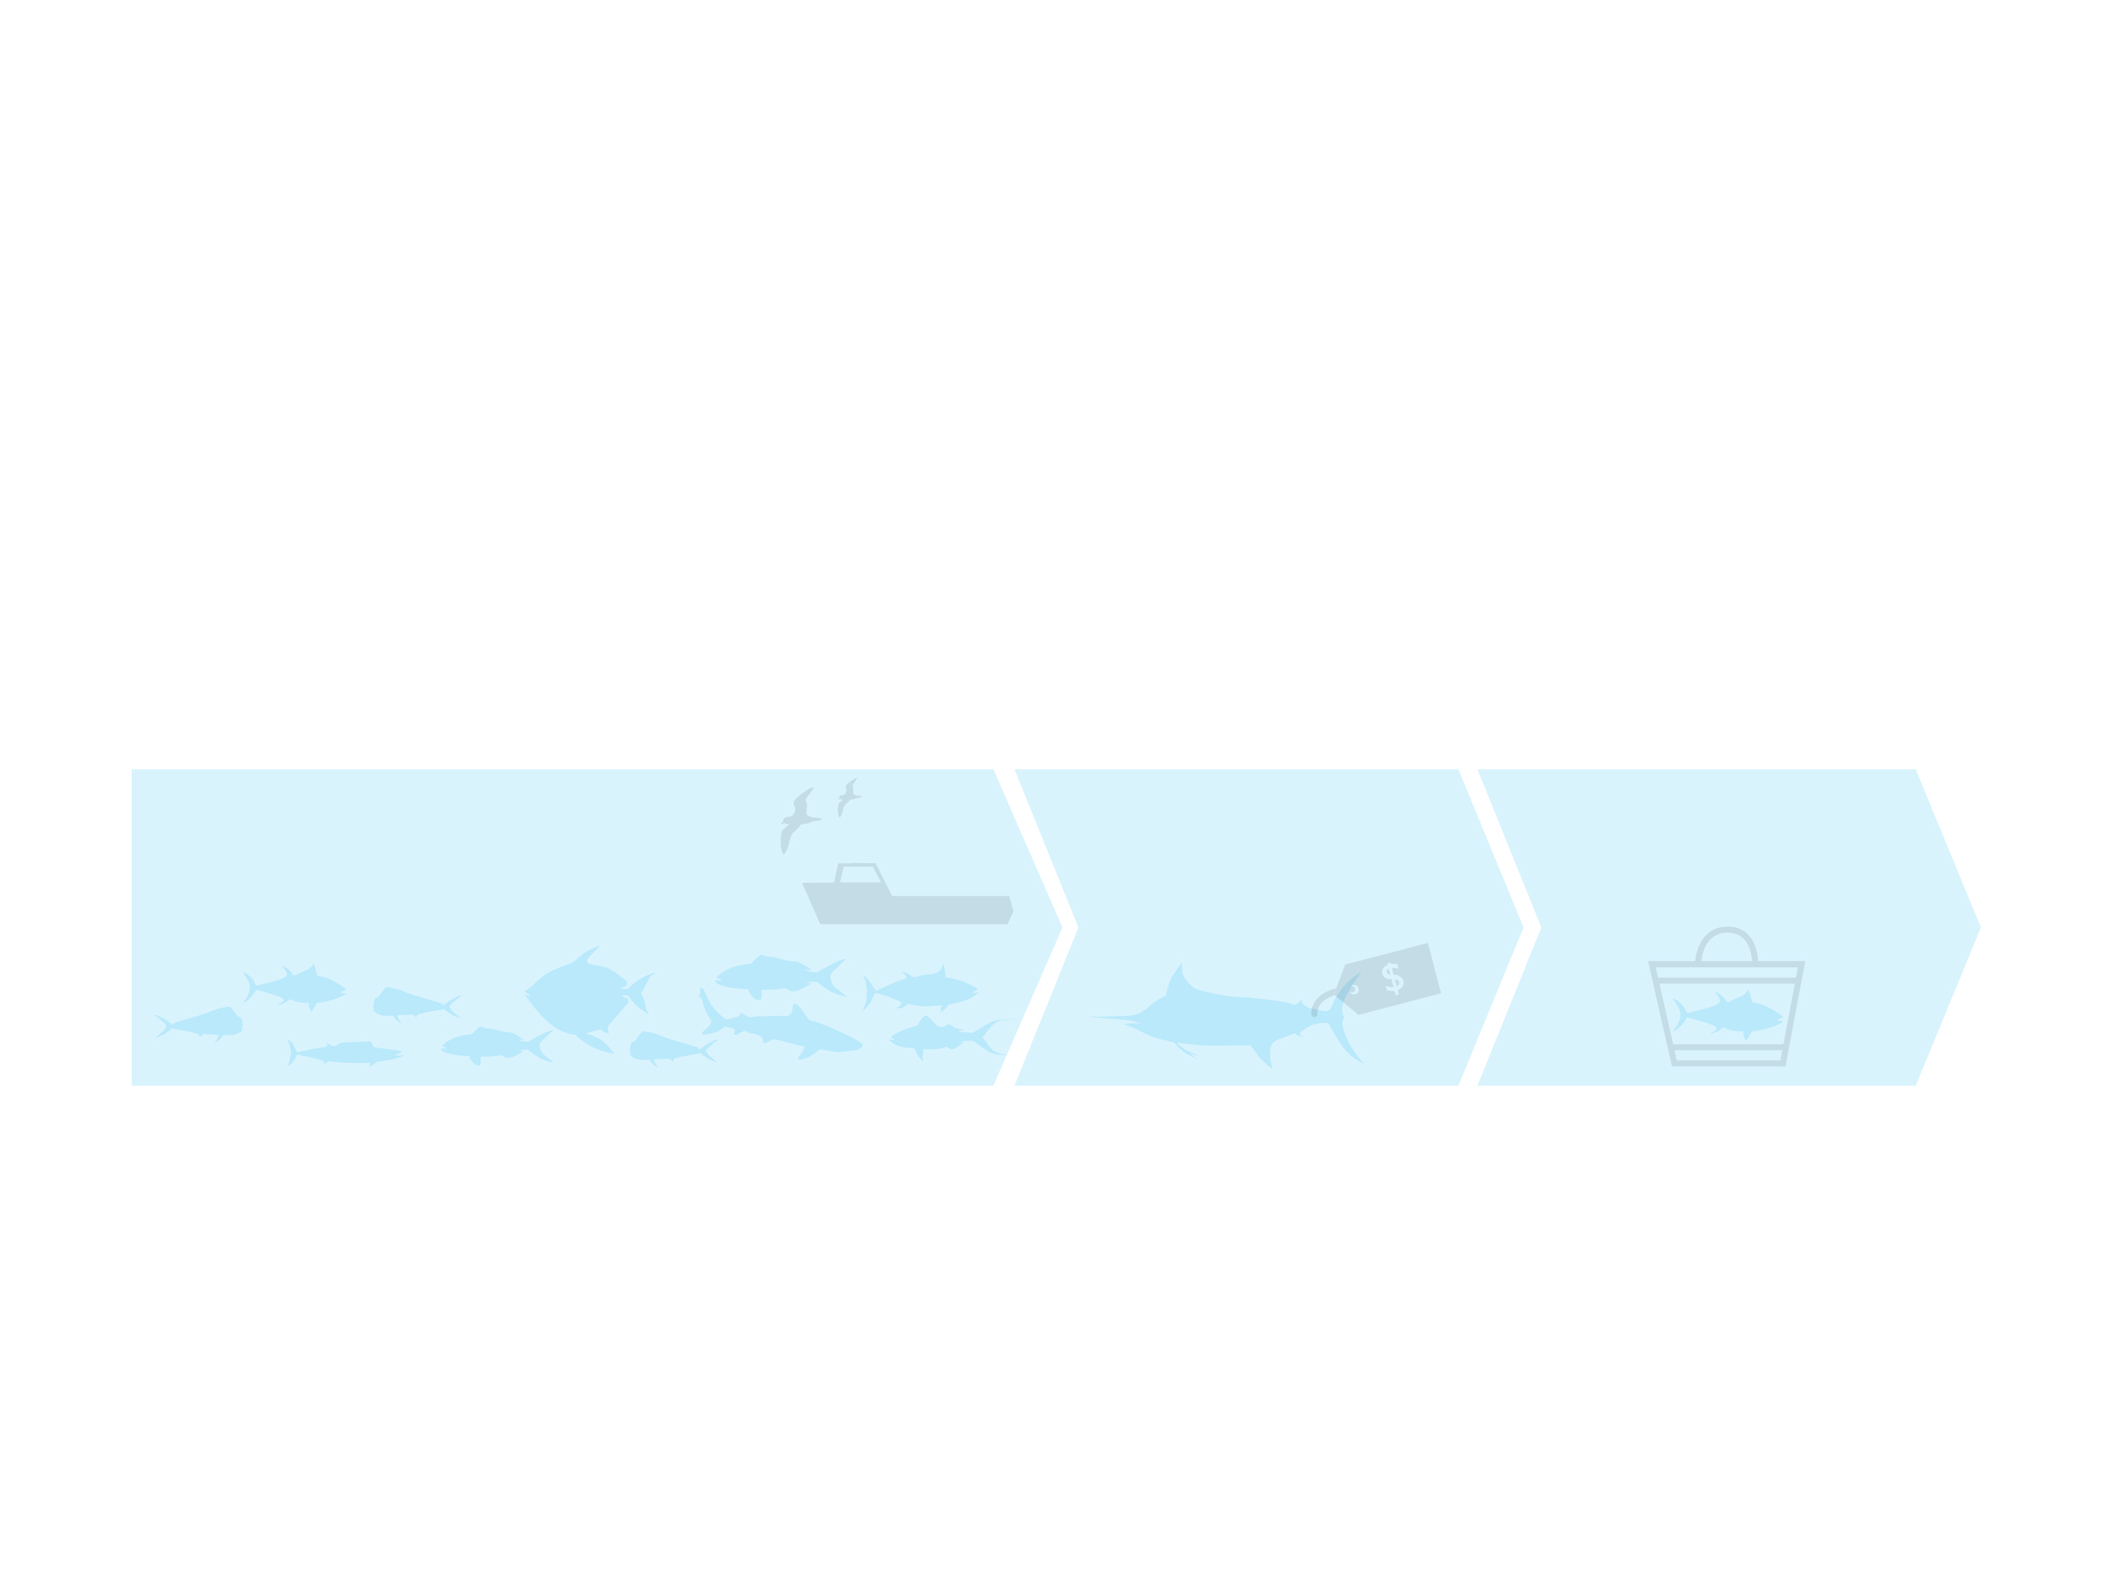
Federal Fishery Management and Seafood Regulation in Hawaii
Fishery
(Well-managed Fish Stock and Ecosystem, and HI Longline Fishing Industry)
Fish Distribution
(Honolulu Fish Auction, Wholesalers)
Fish Consumption
(Retailers and Consumers)
Graphic by Imaginary Office.

Slide 38
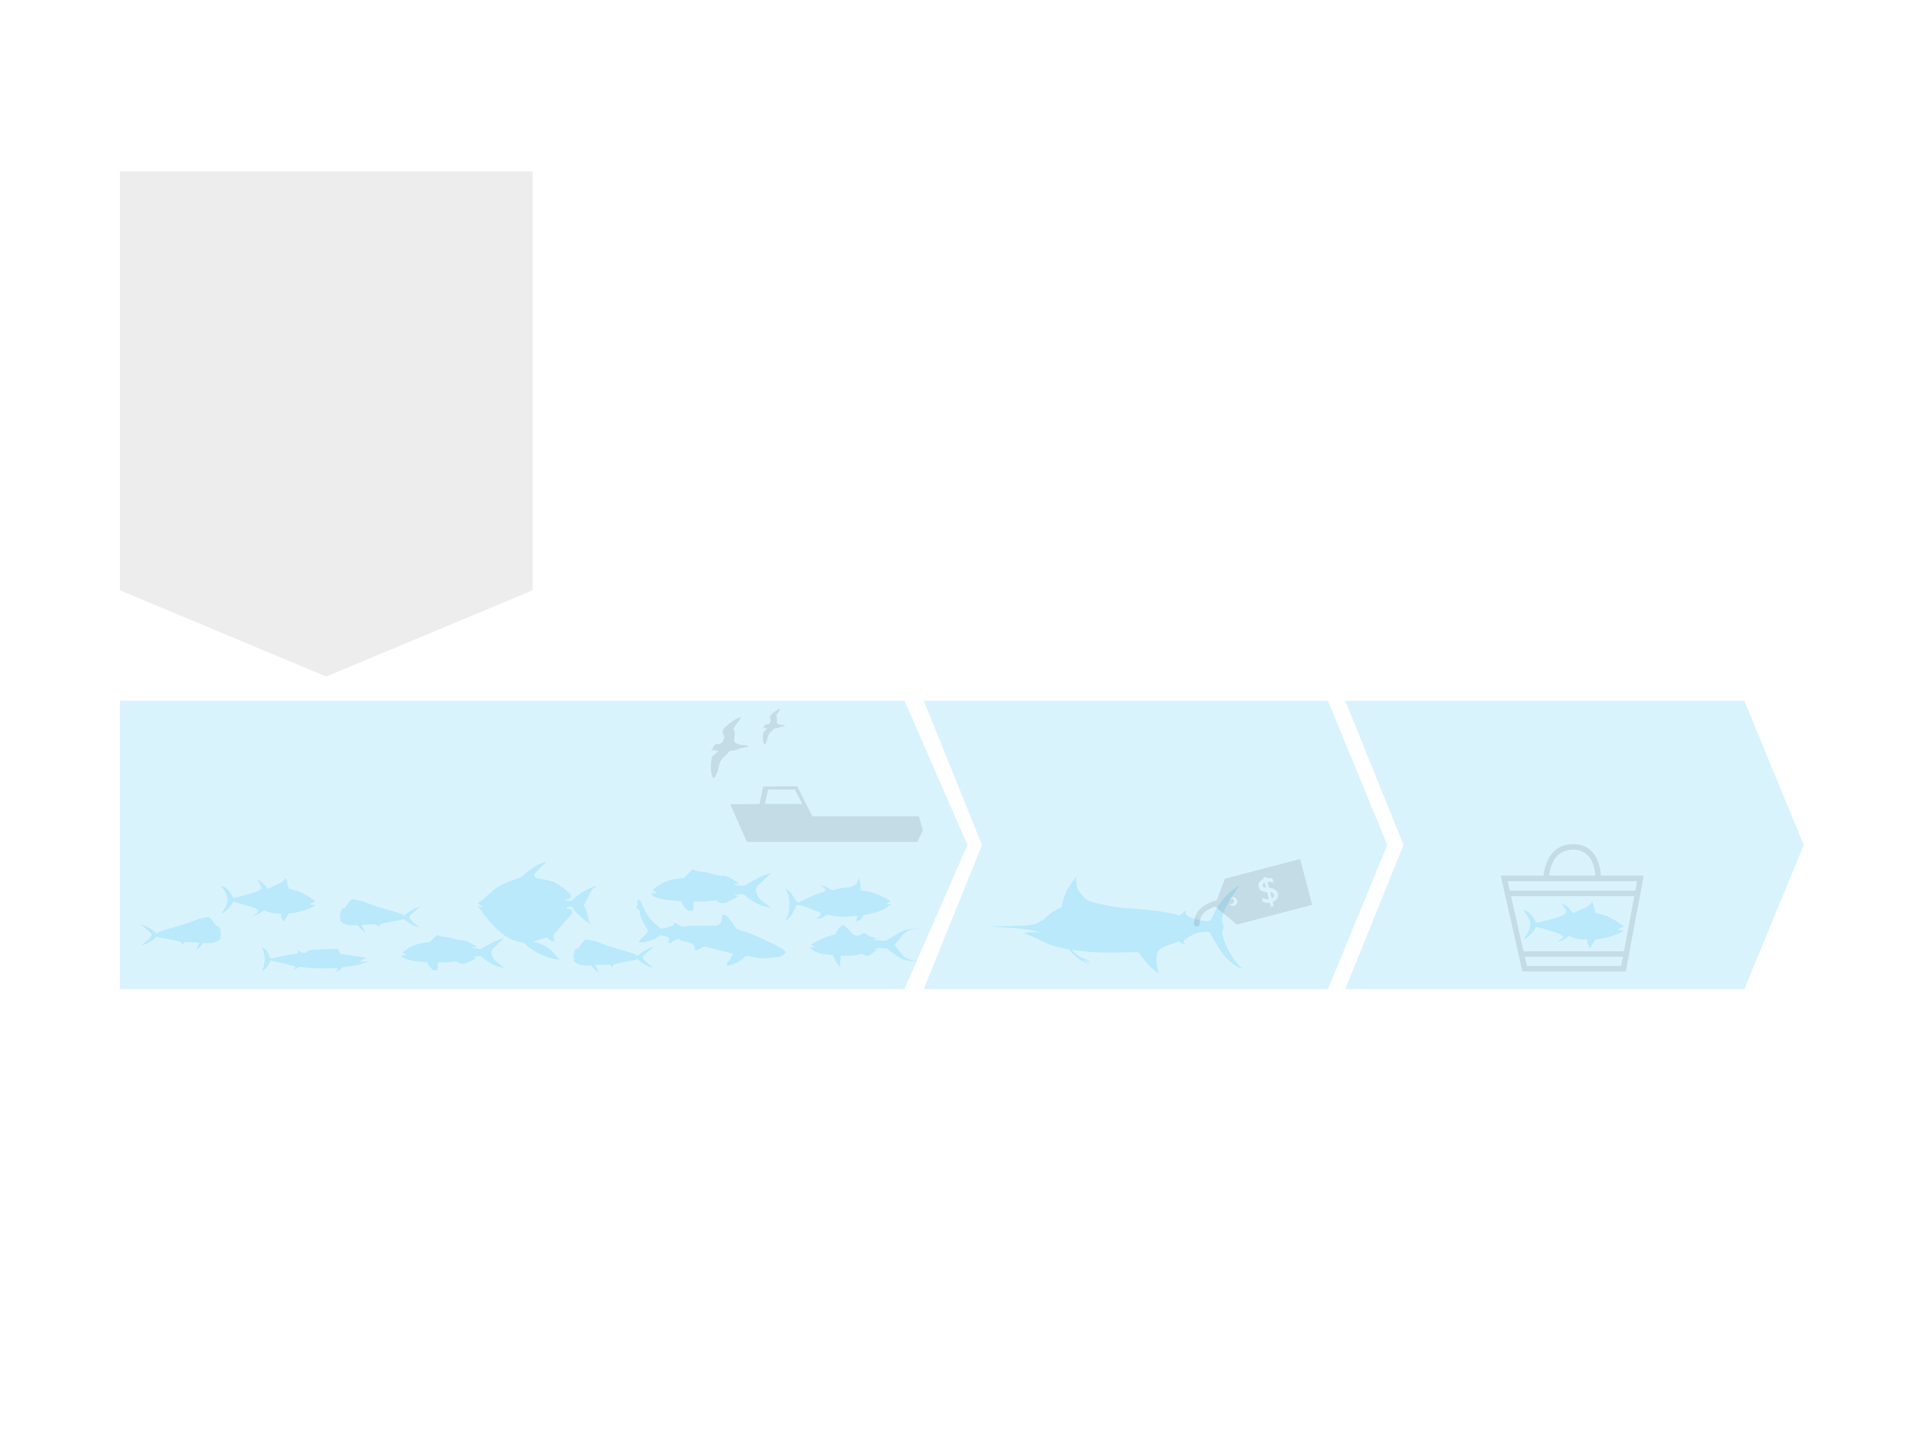
Federal Fishery Management and Seafood Regulation in Hawaii
Fishery Management
Fishery Scientists
(NOAA-PIFSC, and others)
Fishery Management Council
(WPRFMC)
Fishery Regulations
(NOAA Headquarters, NOAA-PIRO)
Fishery
(Well-managed Fish Stock and Ecosystem, and HI Longline Fishing Industry)
Fish Distribution
(Honolulu Fish Auction, Wholesalers)
Fish Consumption
(Retailers and Consumers)
Graphic by Imaginary Office.

Slide 39
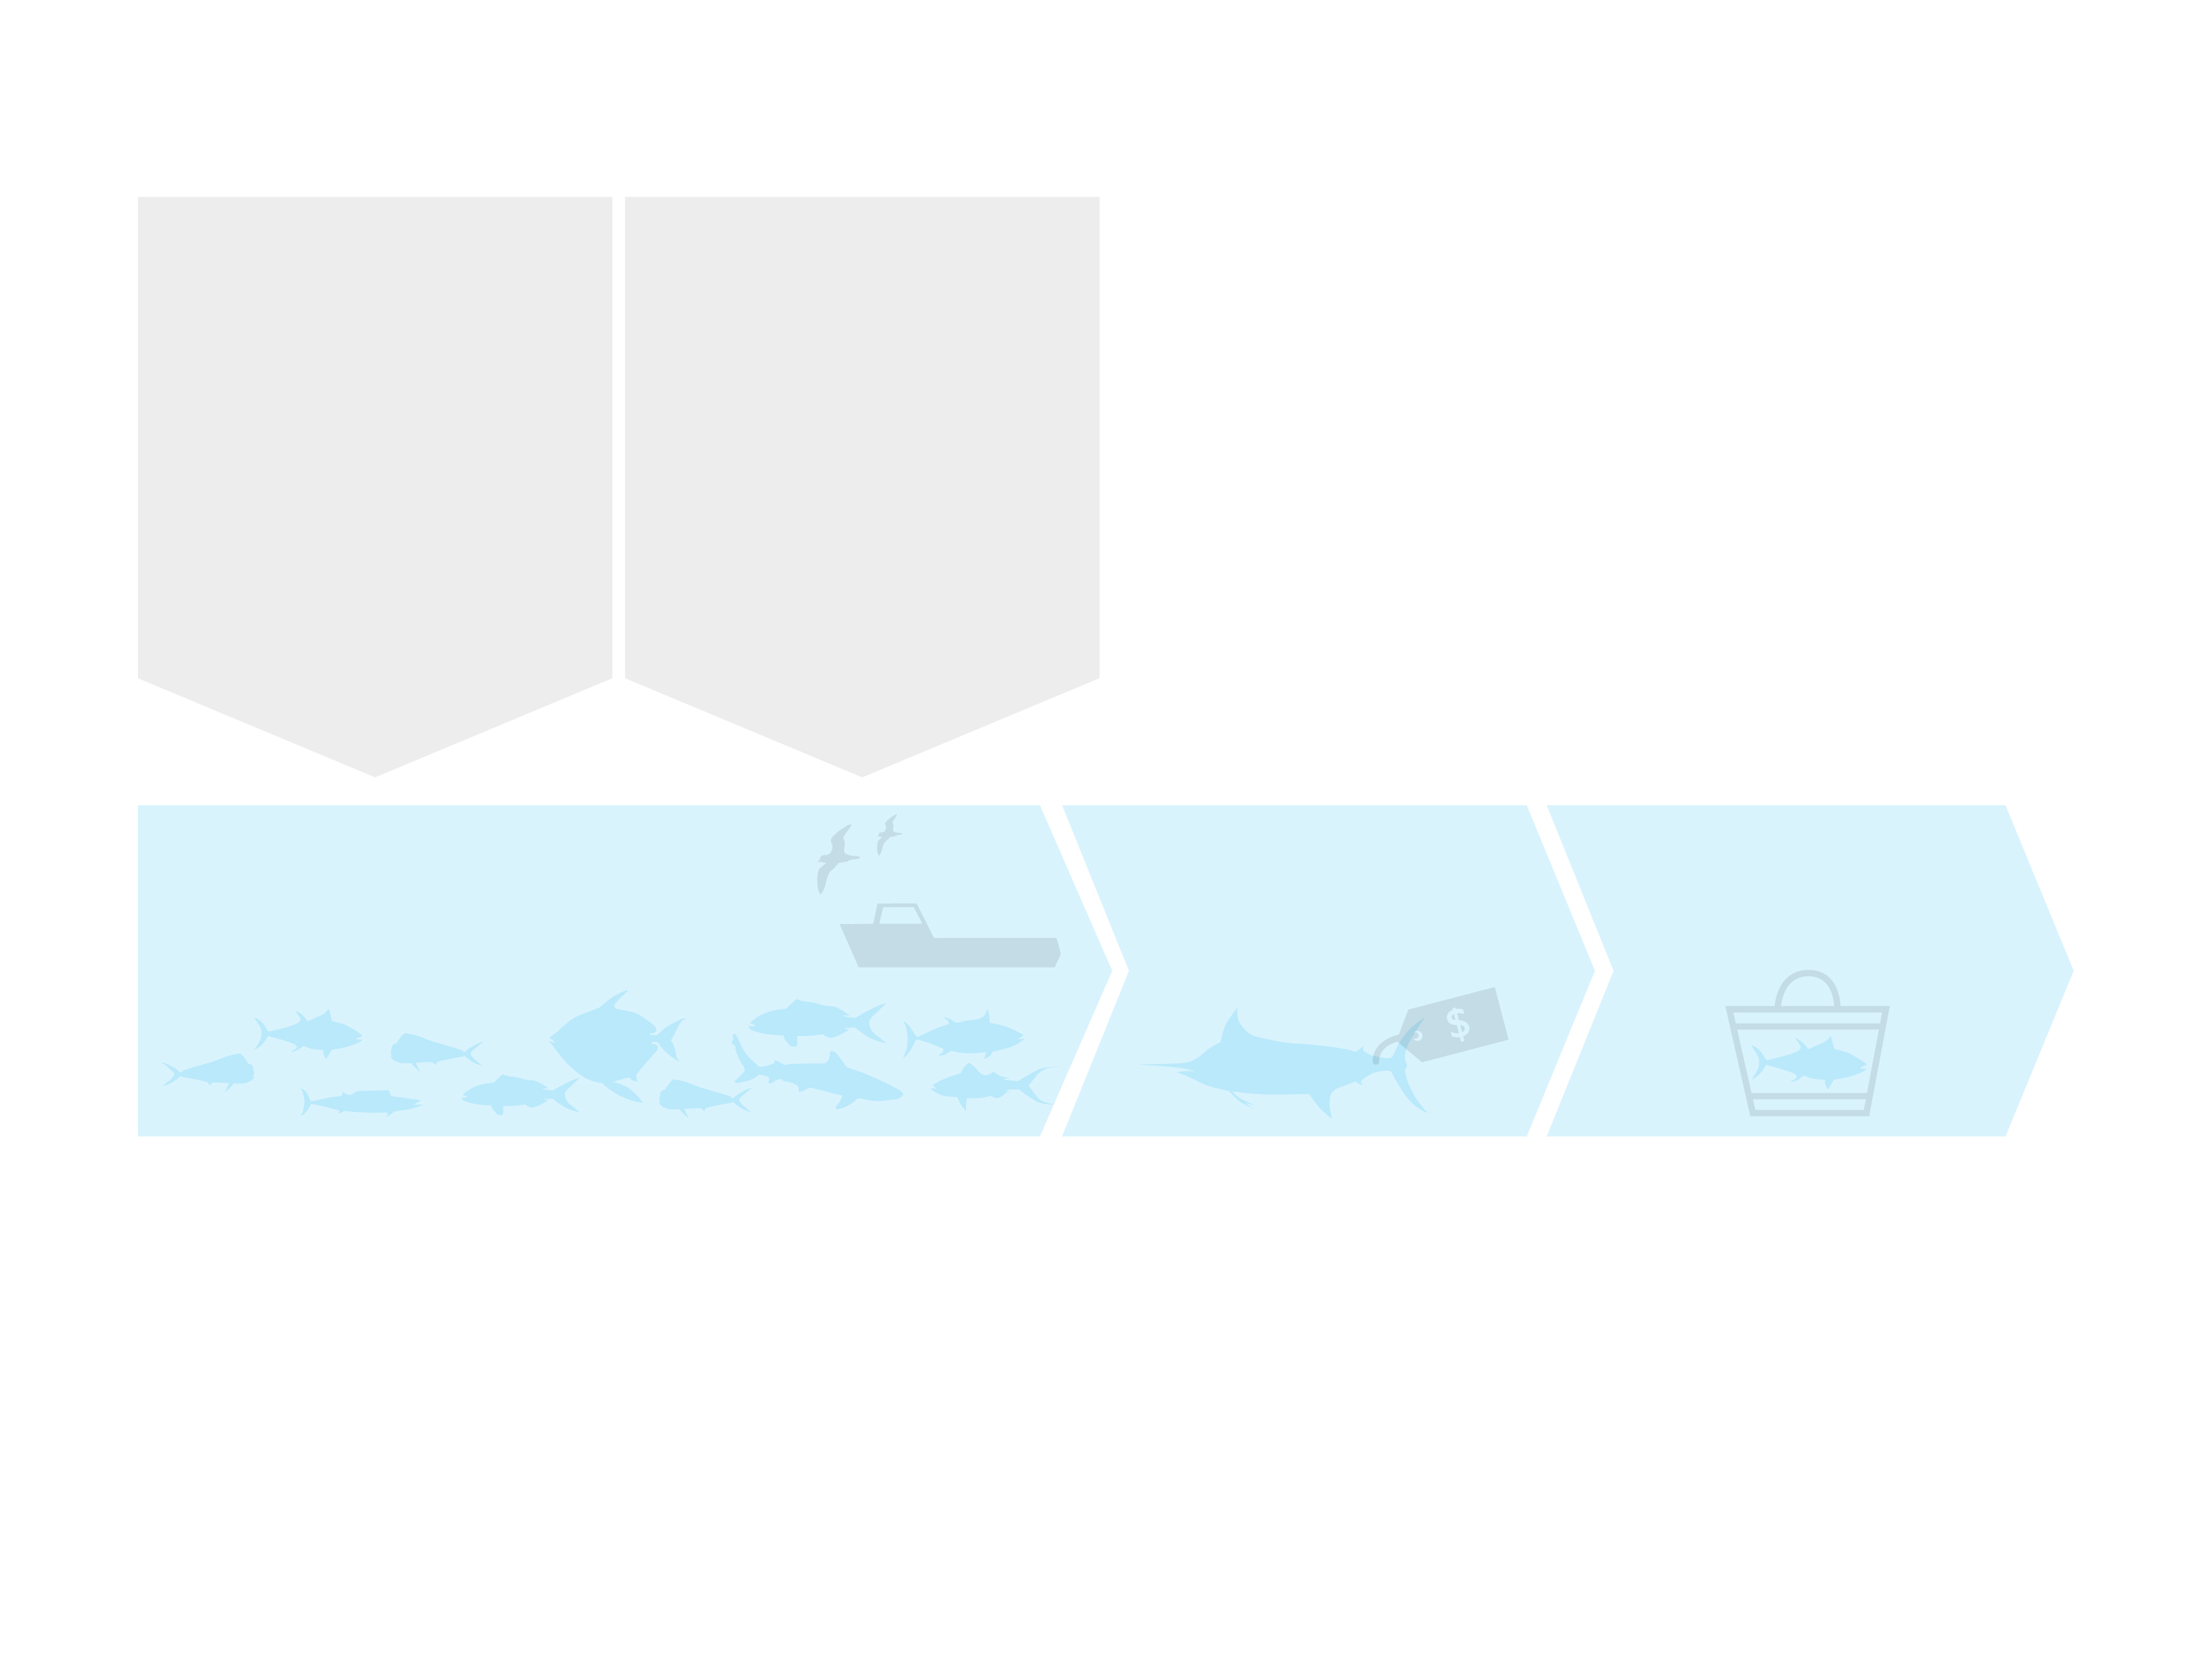
Federal Fishery Management and Seafood Regulation in Hawaii
Fishery Management
Fishery Scientists
(NOAA-PIFSC, and others)
Fishery Management Council
(WPRFMC)
Fishery Regulations
(NOAA Headquarters, NOAA-PIRO)
Other Regulations
For fishing industry and the environment
(USCG Fishing Vessel Safety and Environmental Regulations)
Fishery
(Well-managed Fish Stock and Ecosystem, and HI Longline Fishing Industry)
Fish Distribution
(Honolulu Fish Auction, Wholesalers)
Fish Consumption
(Retailers and Consumers)
Graphic by Imaginary Office.

Slide 40
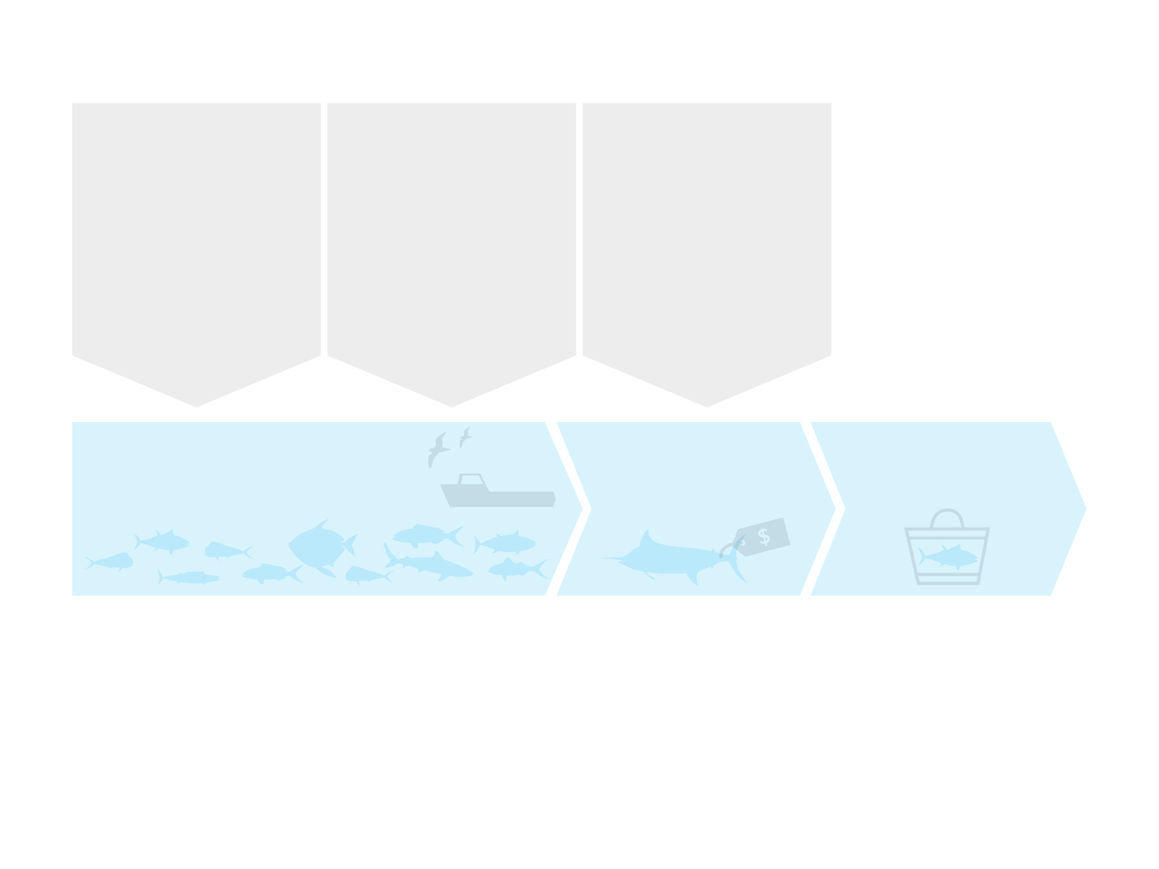
Federal Fishery Management and Seafood Regulation in Hawaii
Fishery Management
Fishery Scientists
(NOAA-PIFSC, and others)
Fishery Management Council
(WPRFMC)
Fishery Regulations
(NOAA Headquarters, NOAA-PIRO)
Other Regulations
For fishing industry and the environment
(USCG Fishing Vessel Safety and Environmental Regulations)
For seafood wholesalers and processors
(US-FDA Seafood HACCP and GMP regulations)
Fishery
(Well-managed Fish Stock and Ecosystem, and HI Longline Fishing Industry)
Fish Distribution
(Honolulu Fish Auction, Wholesalers)
Fish Consumption
(Retailers and Consumers)
Graphic by Imaginary Office.

Slide 41
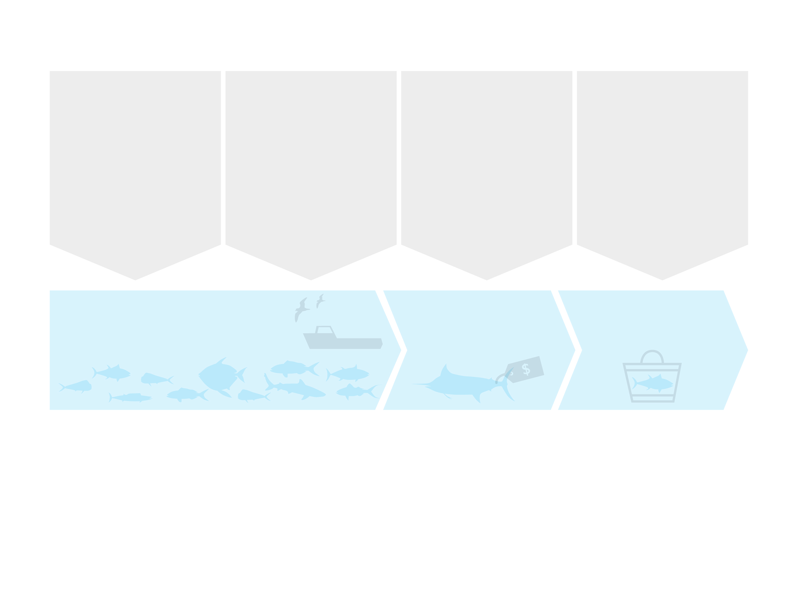
Federal Fishery Management and Seafood Regulation in Hawaii
Fishery Management
Fishery Scientists
(NOAA-PIFSC, and others)
Fishery Management Council
(WPRFMC)
Fishery Regulations
(NOAA Headquarters, NOAA-PIRO)
Other Regulations
For fishing industry and the environment
(USCG Fishing Vessel Safety and Environmental Regulations)
For seafood wholesalers and processors
(US-FDA Seafood HACCP and GMP regulations)
For seafood retailers
(State Health Regulations)
Fishery
(Well-managed Fish Stock and Ecosystem, and HI Longline Fishing Industry)
Fish Distribution
(Honolulu Fish Auction, Wholesalers)
Fish Consumption
(Retailers and Consumers)
Graphic by Imaginary Office.

Slide 42
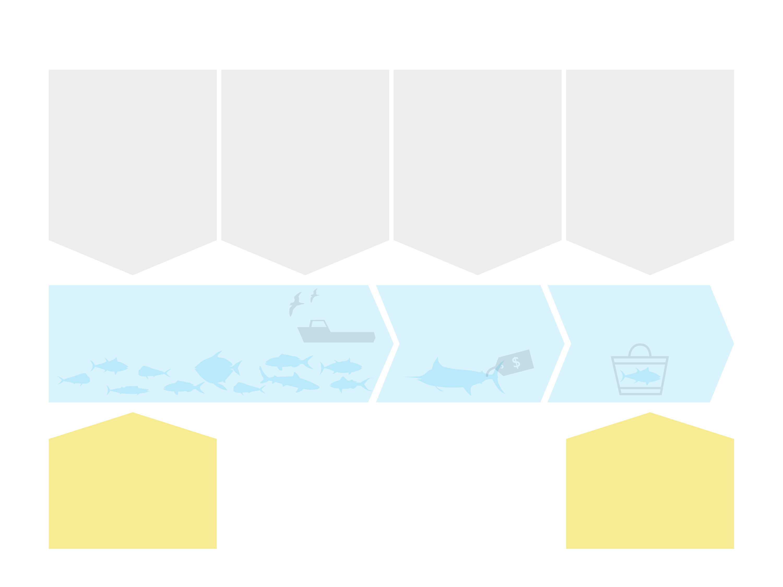
Federal Fishery Management and Seafood Regulation in Hawaii
Fishery Management
Fishery Scientists
(NOAA-PIFSC, and others)
Fishery Management Council
(WPRFMC)
Fishery Regulations
(NOAA Headquarters, NOAA-PIRO)
Other Regulations
For fishing industry and the environment
(USCG Fishing Vessel Safety and Environmental Regulations)
For seafood wholesalers and processors
(US-FDA Seafood HACCP and GMP regulations)
For seafood retailers
(State Health Regulations)
Fishery
(Well-managed Fish Stock and Ecosystem, and HI Longline Fishing Industry)
Fish Distribution
(Honolulu Fish Auction, Wholesalers)
Fish Consumption
(Retailers and Consumers)
Environmental NGOs
May take legal action against regulators
Environmental NGOs
Persuade retailers and consumers
Graphic by Imaginary Office.

Slide 43
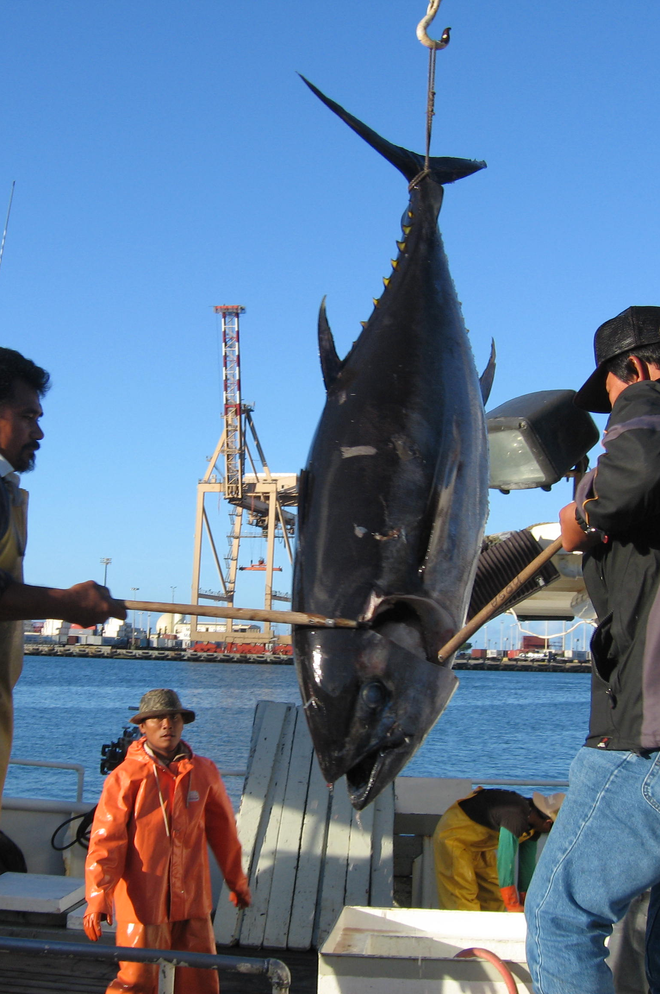
Fish Stock Status
Photo: John Kaneko

Slide 44
fish stock status
Stock Status of Fish Caught by Hawaii Longline Fisheries: Swordfish
Sustainably fished (overfishing not occurring)
Population not heavily impacted by fishing (not overfished)
Sustainable catch increase possible
Source: NOAA. www.fishwatch.gov Accessed April 1, 2015; Illustration: Les Hata

Slide 45
fish stock status
Stock Status of Fish Caught by Hawaii Longline Fisheries: Yellowfin Tuna
Sustainably fished (overfishing not occurring)
Fully exploited (not overfished)
Catch increase not sustainable
Source: NOAA. www.fishwatch.gov Accessed April 1, 2015: Illustration: Les Hata

Slide 46
fish stock status
Stock Status of Fish Caught by Hawaii Longline Fisheries: Bigeye Tuna
Pacific Bigeye not fished at sustainable levels (overfishing is occurring)
Likely overfished in the Western and Central Pacific Region
Not overfished in the Eastern Pacific
Overfishing eliminated in Hawaii fleet through strict and verifiable enforcement of Bigeye quota
Source: NOAA. www.fishwatch.gov Accessed April 1, 2015: Illustration: Les Hata

Slide 47
fish stock status
Stock Status of Fish Caught by Hawaii Longline Fisheries: Bigeye Tuna (cont’d)
Overfishing is occurring in international fleet, esp. in purse seine fishery
International catch reduction needed. Quotas in place.
Improvement in verifiable international compliance needed
Source: NOAA. www.fishwatch.gov Accessed April 1, 2015: Illustration: Les Hata

Slide 48
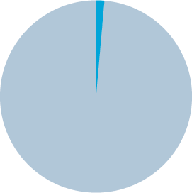
fish stock status
Hawaii Pelagic Fisheries as Percentage of Total Pacific Ocean Bigeye Tuna Catch (2013)
1.65%
Hawaii Longline Fishery
98.35%
Other Nations
Source: WCPFC 2013 Year Book. www.wcpfc.int/system/files/wcpfc_yb_2013.pdf

Slide 49
fish stock status
When Overfishing Occurs…
Do we close fisheries? No.
Do we stop consuming these fish? No.
We make Corrective Management Actions based on science and precautionary principle.

Slide 50
fish stock status
What are the threats to sustainable fisheries?
Uncontrolled growth of fishing capacity (number of vessels, hooks, nets, vessel size)
Uncontrolled increase of fish catch
Lack of science-based management (regulations, monitoring, enforcement)

Slide 51
fish stock status
Management Measures Needed to Manage International Fisheries
Reduction of fishing effort/catch ex. limited access program, and verifiable catch quotas
Improved stock assessments for management decisions ex. improved data collection and analysis
Improved monitoring ex. satellite systems, fishery observers, vessel logbooks, and port/market sampling

Slide 52
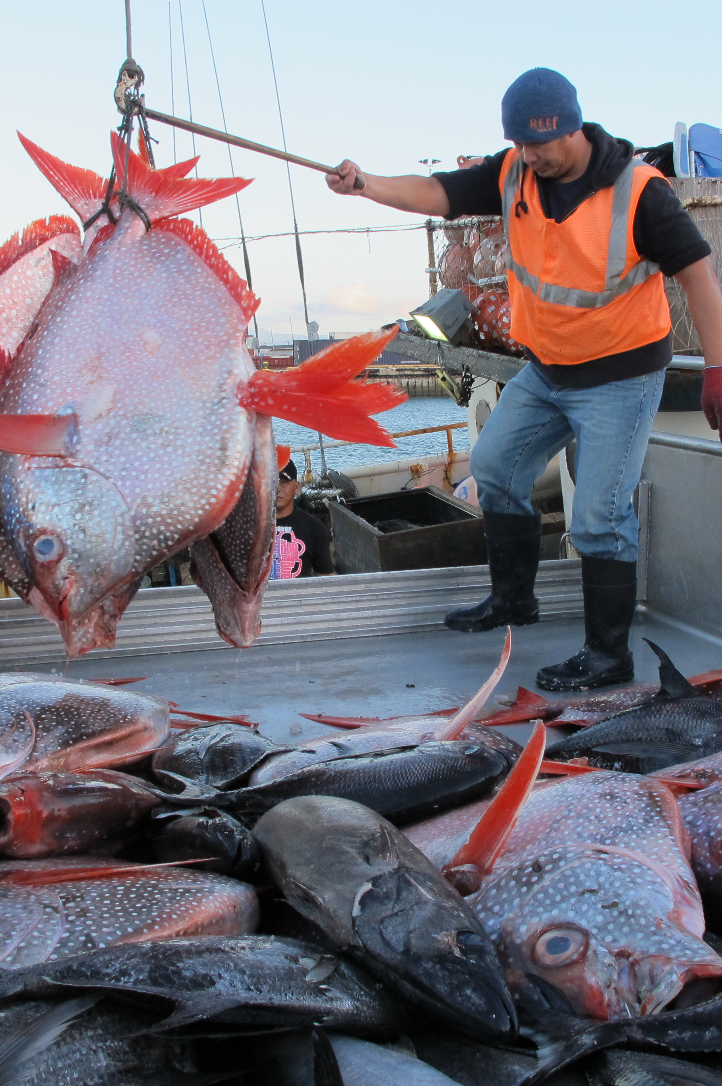
What About Hawaii’s Longline Fishery?
Photo: John Kaneko

Slide 53
Fishery facts
In 1991 the Hawaii Longline Fishery was the first pelagic fishery in the US to implement a Limited Entry System (with 164 permits, 125 active).
No vessels over 101ft allowed.
Growth of fleet size is capped.
Uncontrolled growth in this fishery has been eliminated in Hawaii.
Source: CFR Title 50: Wildlife and Fisheries, Chapter IV, Part 665 Fisheries of the Western Pacific, Subpart F Western Pacific Pelagic Fisheries.

Slide 54
Fishery facts
In 1991 the Hawaii Longline Fishery was the first pelagic fishery in US to require Mandatory Daily Logbook Reporting.
We know what our fishermen are doing at sea.
“We trust but verify.”
Source: CFR Title 50: Wildlife and Fisheries, Chapter IV, Part 665 Fisheries of the Western Pacific, Subpart F Western Pacific Pelagic Fisheries.

Slide 55
Fishery facts
In 1993 Fishery Observers were first placed on Hawaii longline vessels to monitor protected species interactions.
In 2004, the Hawaii Longline Fishery achieved the most extensive Observer program in the Pacific.
Observers play an important role in monitoring fishing activities and impacts at sea.
Source: CFR Title 50: Wildlife and Fisheries, Chapter IV, Part 665 Fisheries of the Western Pacific, Subpart F Western Pacific Pelagic Fisheries.

Slide 56
Fishery facts
In 2002 mandatory >20% Observer coverage on tuna trips.
In 2004 mandatory 100% Observer coverage of swordfish trips.
In 2012: WCPFC international goal is >5% Observer coverage by 2012.
Hawaii is way ahead of the rest.
Source: CFR Title 50: Wildlife and Fisheries, Chapter IV, Part 665 Fisheries of the Western Pacific, Subpart F Western Pacific Pelagic Fisheries.

Slide 57
Fishery facts
In 1993 the Hawaii Longline Fishery was the first US fishery to require Vessel Monitoring Systems (VMS).
With satellite tracking, we know where our boats are at all times.
Source: CFR Title 50: Wildlife and Fisheries, Chapter IV, Part 665 Fisheries of the Western Pacific, Subpart F Western Pacific Pelagic Fisheries.

Slide 58
Fishery facts
In 2009 Pacific Bigeye tuna quota in place.
Quota is strictly enforced in Hawaii.
Overfishing of Bigeye has been eliminated within the Hawaii Longline Fishery.
Source: CFR Title 50: Wildlife and Fisheries, Chapter IV, Part 665 Fisheries of the Western Pacific, Subpart F Western Pacific Pelagic Fisheries.

Slide 59
Fishery facts
In 2009 the Hawaii Longline Fishery was the only fleet in the Pacific with the capacity and commitment to monitor catch and enforce the Bigeye tuna quota in real time.
The fishery was closed on December 29 for the rest of 2009.
The only longline fishery in the Pacific that adhered to the Bigeye quota.
Source: CFR Title 50: Wildlife and Fisheries, Chapter IV, Part 665 Fisheries of the Western Pacific, Subpart F Western Pacific Pelagic Fisheries.

Slide 60
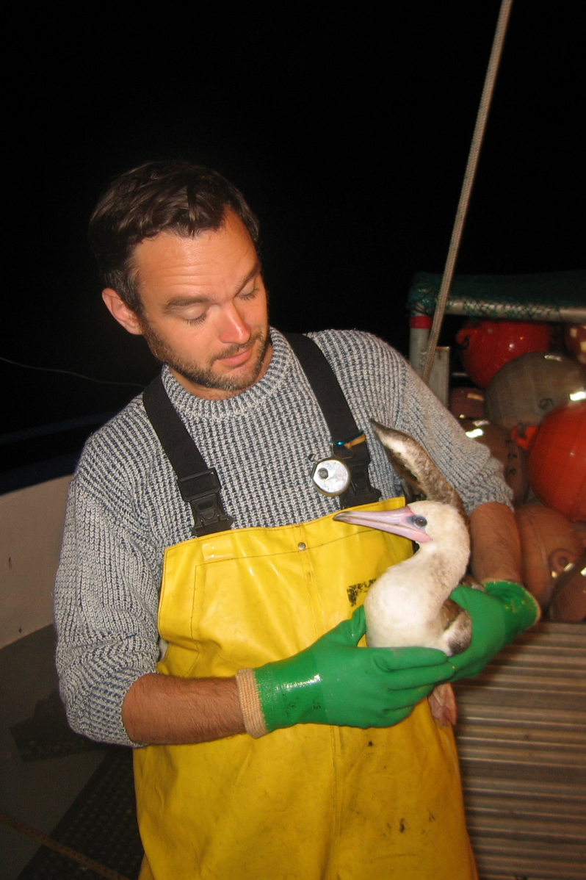
Reduction of Fishery Impacts on Protected Species
Photo: NOAA Observer Program

Slide 61
Fishery impacts on protected species
Sea Turtle Conservation Measures
Intensive observer coverage (100% for swordfish trips, >20% for tuna trips)
Mandatory Protected Species Training for vessel operators annually
Mandatory set of equipment on board to safely handle turtles, birds and mammals
Only circle hooks and mackerel type bait. No J-hooks or squid allowed.
Hard cap on annual sea turtle interactions for the swordfish fishery enforced in real time
Source: CFR Title 50: Wildlife and Fisheries, Chapter IV, Part 665 Fisheries of the Western Pacific, Subpart F Western Pacific Pelagic Fisheries.

Slide 62
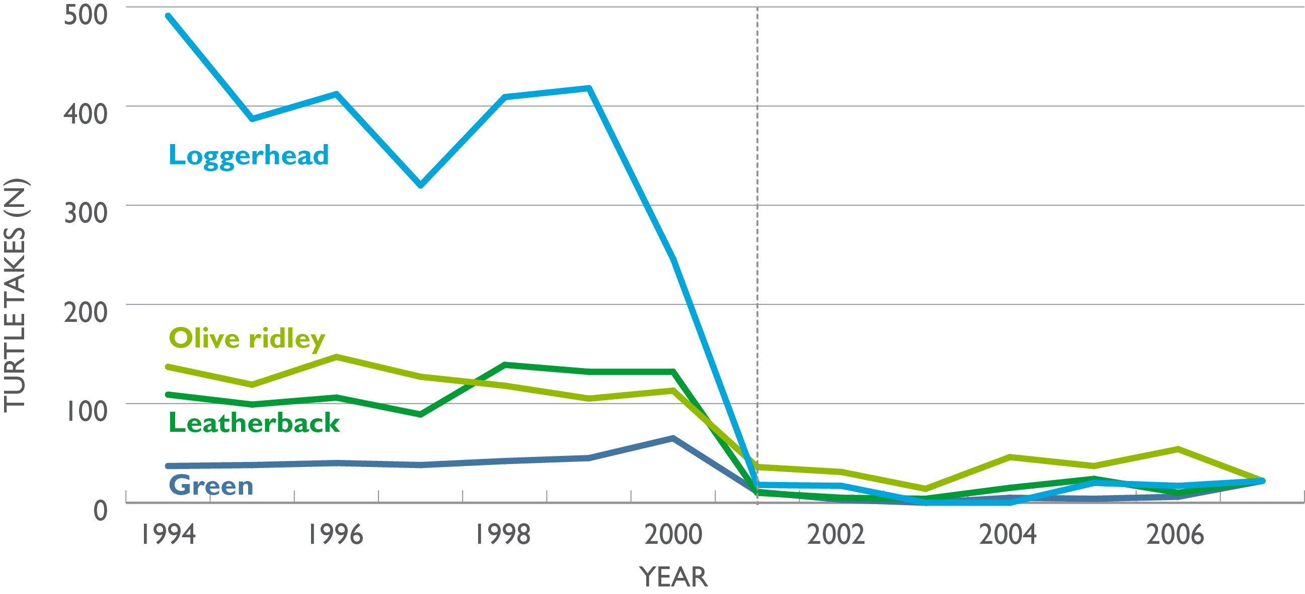
Fishery impacts on protected species
Hawaii Shallow-set LL Fishery: Turtle Interactions 1994-2009
2001 Drop in turtle takes
Note: Prior to 2001, turtle interactions are extrapolations (expansions) from limited observer coverage. After 2001, turtle interactions are based on 100% observer coverage.
Data Source: NOAA Fisheries

Slide 63
Fishery impacts on protected species
Annual Cap on Sea Turtle Interactions
The Hawaii Longline Fishery for swordfish operates under an annual cap on turtle interactions.
“Interactions” range from harmless entanglements to mortalities.
26 leatherbacks allowed per year is sustainable.
34 loggerheads allowed per year is sustainable.
Source: CFR Title 50: Wildlife and Fisheries, Chapter IV, Part 665 Fisheries of the Western Pacific, Subpart F Western Pacific Pelagic Fisheries.

Slide 64
Fishery facts
Sea Turtles:
26 leatherback interactions per year allowed by NOAA. Our fishery averaged 7.6 turtles per year.
34 loggerhead interactions per year allowed by NOAA. Our fishery averaged 8.5 turtles per year.
Greater than 90% reduction in sea turtle bycatch documented.
Source: CFR Title 50: Wildlife and Fisheries, Chapter IV, Part 665 Fisheries of the Western Pacific, Subpart F Western Pacific Pelagic Fisheries.

Slide 65
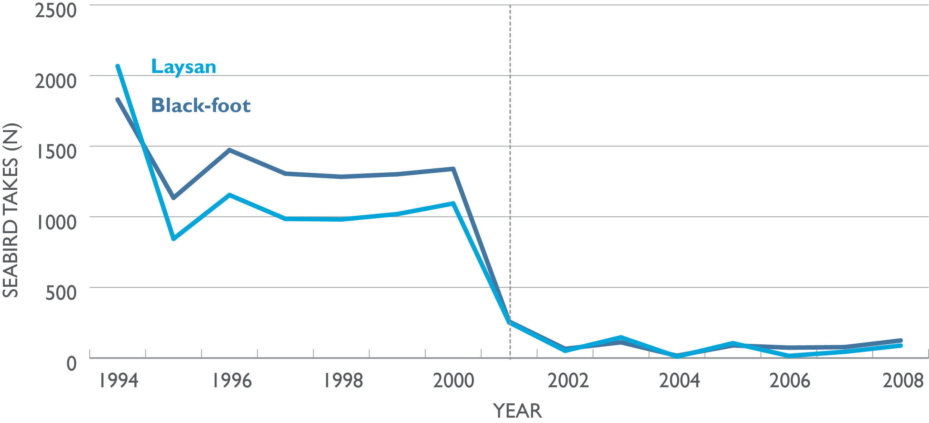
Fishery impacts on protected species
Hawaii LL Fishery: Seabird Interactions 1994-2008
2001 Drop in seabird takes
Note: Prior to 2001, seabird interactions are extrapolations (expansions) from limited observer coverage. After 2001, seabird interactions are based on 100% observer coverage.
Data Source: NOAA Fisheries

Slide 66
Fishery facts
Seabirds:
In 2001 bycatch reduction measures in place.
Include protected species handling training, bird-scaring curtains, “side setting,” blue-dyed bait, setting after dark, strategic offal discharge.
96% reduction in seabird bycatch documented.
Source: CFR Title 50: Wildlife and Fisheries, Chapter IV, Part 665 Fisheries of the Western Pacific, Subpart F Western Pacific Pelagic Fisheries.

Slide 67
Fishery facts
Marine Mammals:
Interactions are rare events based on observer coverage. 50nm exclusion zones extending from shore eliminated interactions (ex. monk seals).
Fishery scientists are now investigating false killer whale interactions and the use of weaker hooks.
“Doing the right thing.”
Source: CFR Title 50: Wildlife and Fisheries, Chapter IV, Part 665 Fisheries of the Western Pacific, Subpart F Western Pacific Pelagic Fisheries.

Slide 68
Fishery facts
Fish bycatch (or discards):
Multi-species pelagic longline fishery.
True bycatch is limited.
Regulatory discards mainly blue sharks.
89% reduction in blue shark mortality.
94-96% are released alive.
Source: Walsh, W. A. , K.A. Bigelow and K.L. Sender. 2009. Decreases in shark catches and mortalities in the Hawaii-based longline fishery as documented by fishery observers. Marine and Coastal Fisheries. 1(1).

Slide 69
Fishery facts
In 2000, federal law banned shark finning in the Hawaii fishery.
State of Hawaii prohibits possession of shark fins.
Source: CFR Title 50: Wildlife and Fisheries, Chapter IV, Part 665 Fisheries of the Western Pacific, Subpart F Western Pacific Pelagic Fisheries; Hawaii Revised Statutes § 188-40.7 Shark fins; prohibited.

Slide 70
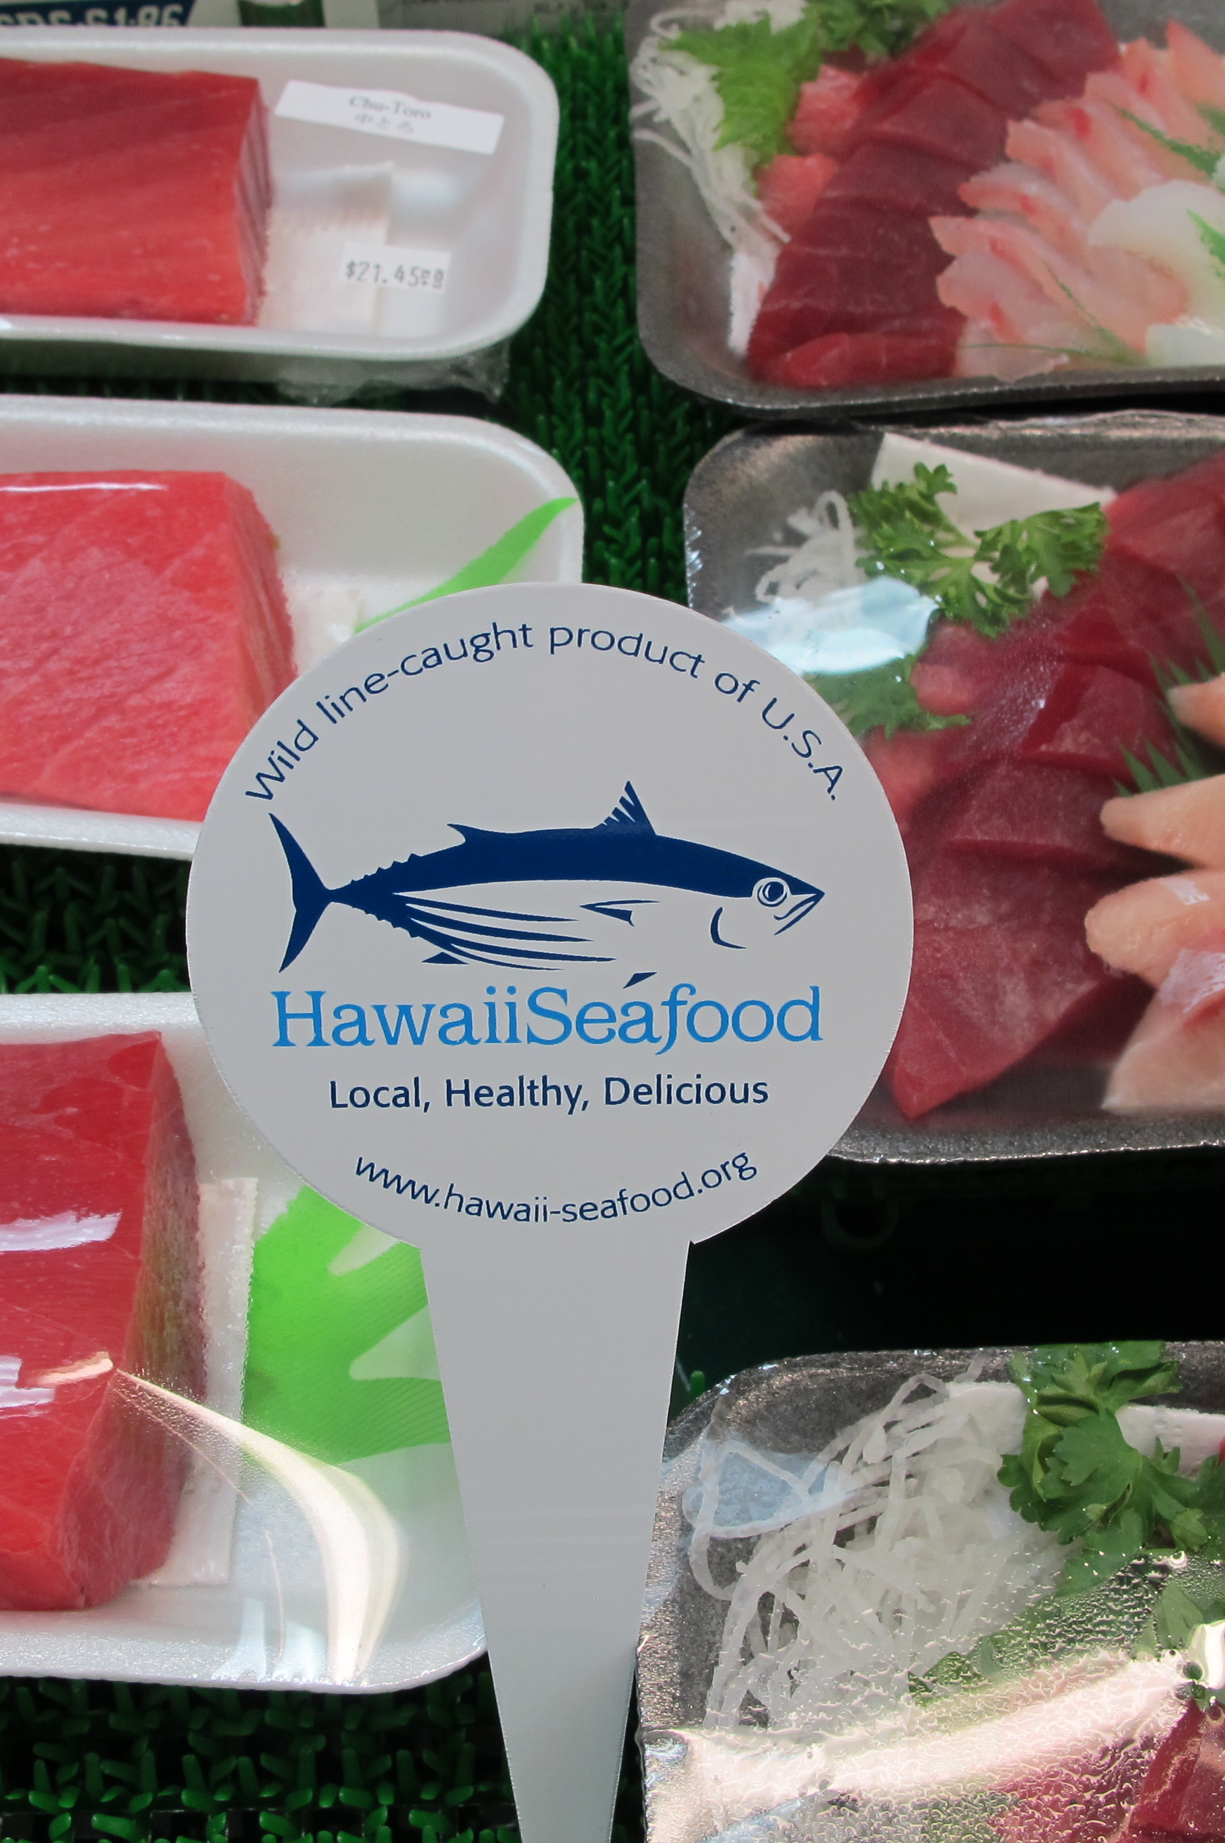
Is Hawaii Longline-Caught Seafood Sustainable?
Photo: John Kaneko

Slide 71
CONCLUSION
Is Hawaii Longline-caught Seafood Sustainable?
Yes. Based on Fishery Management
Yes. Based on Fish Stock Status
Yes. Based on control of Ecosystem Impacts

Slide 72
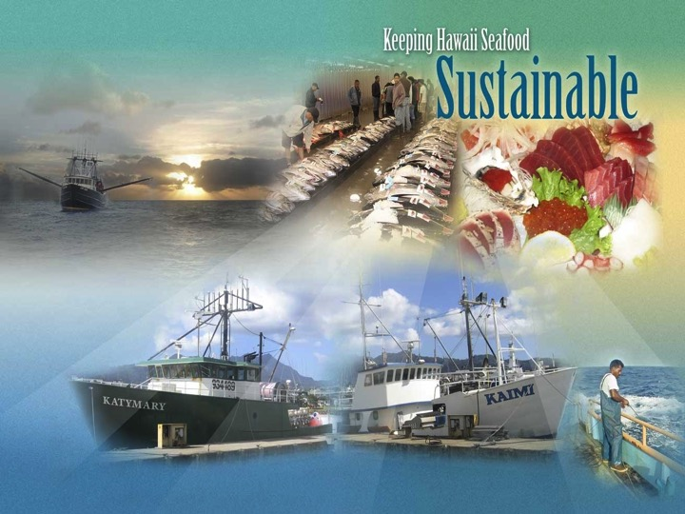
CONCLUSION
Hawaii Seafood Sustainability Platform
Consists of a 2-page Sustainability Statement supported by:
a 20-page booklet with references to scientific literature and resources
a Hawaii Seafood website with additional background and supporting information www.hawaii-seafood.org
Source: Kaneko, J.J. and P. K. Bartram, 2014. Keeping Hawaii Seafood Sustainable second edition. Prepared for NOAA Award No. NA10NMF4520344.

Slide 73

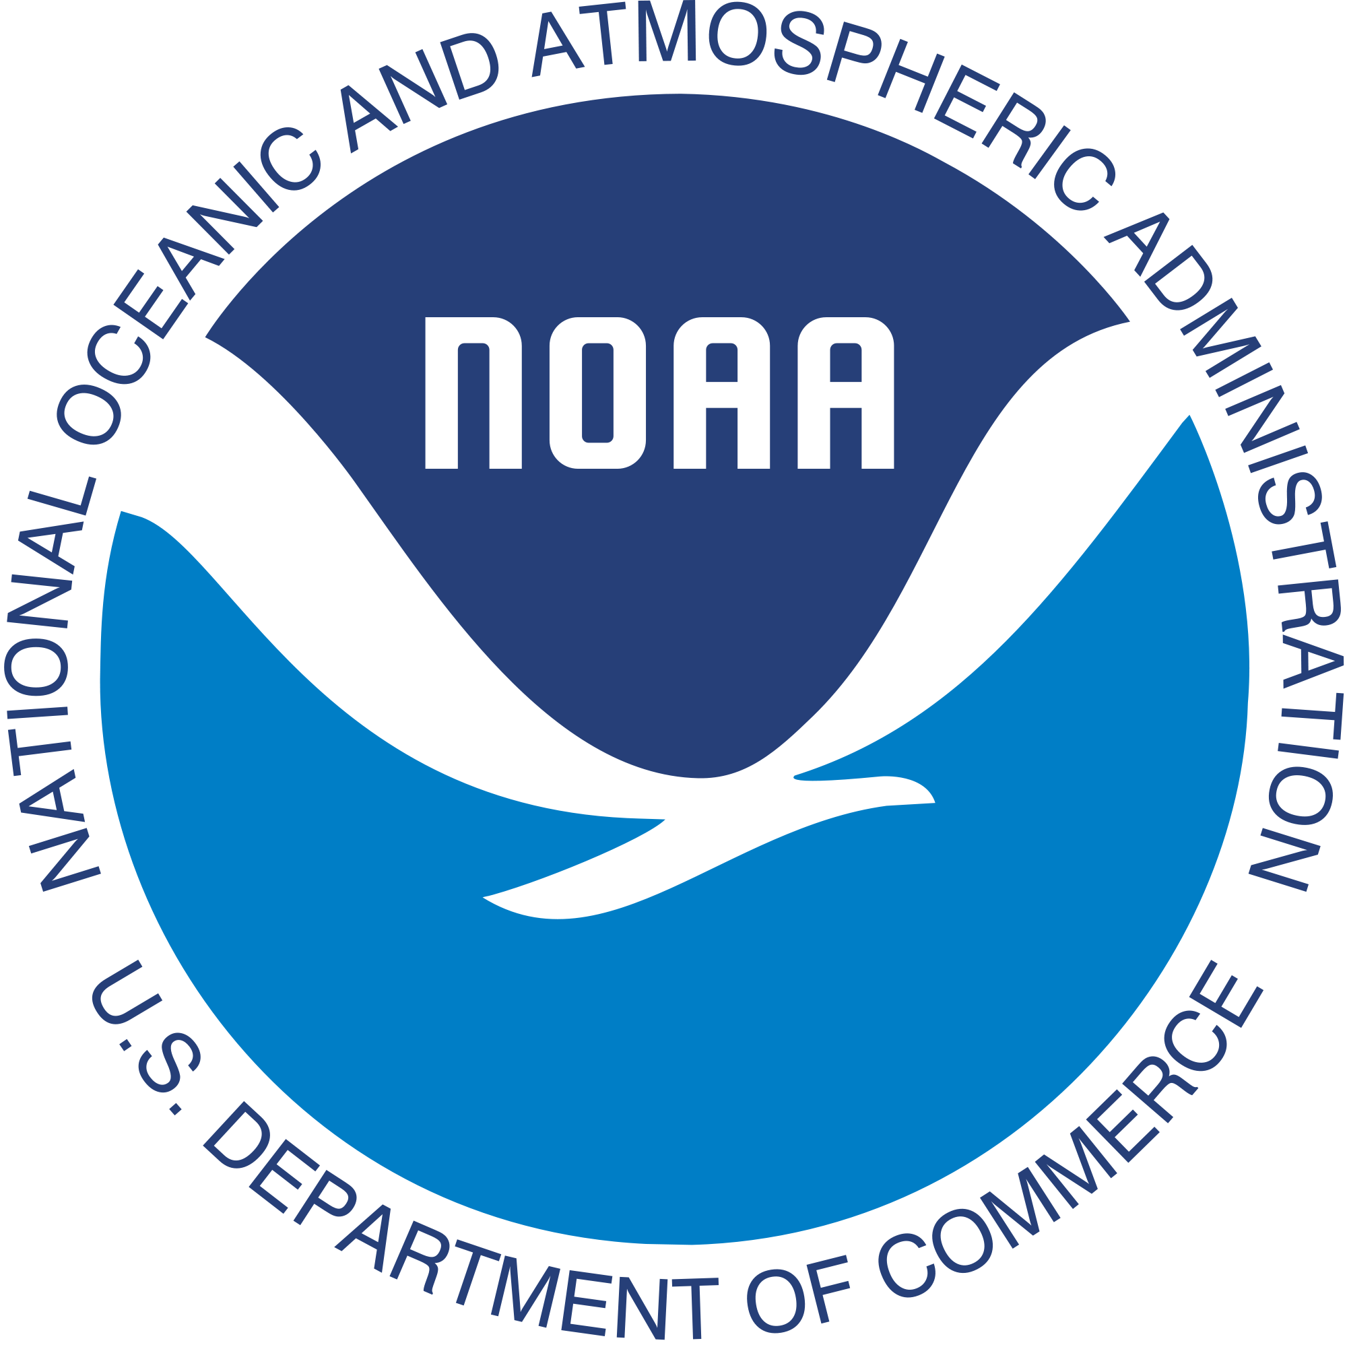
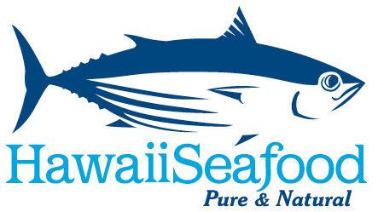

What Makes Hawaii Seafood Sustainable?
Written by John Kaneko MS, DVM, Hawaii Seafood Council, Honolulu, Hawaii
July 2015
With support from the Harold K.L Castle Foundation
and the
National Oceanic
and Atmospheric Administration
Photo: John Kaneko

