Slide 1
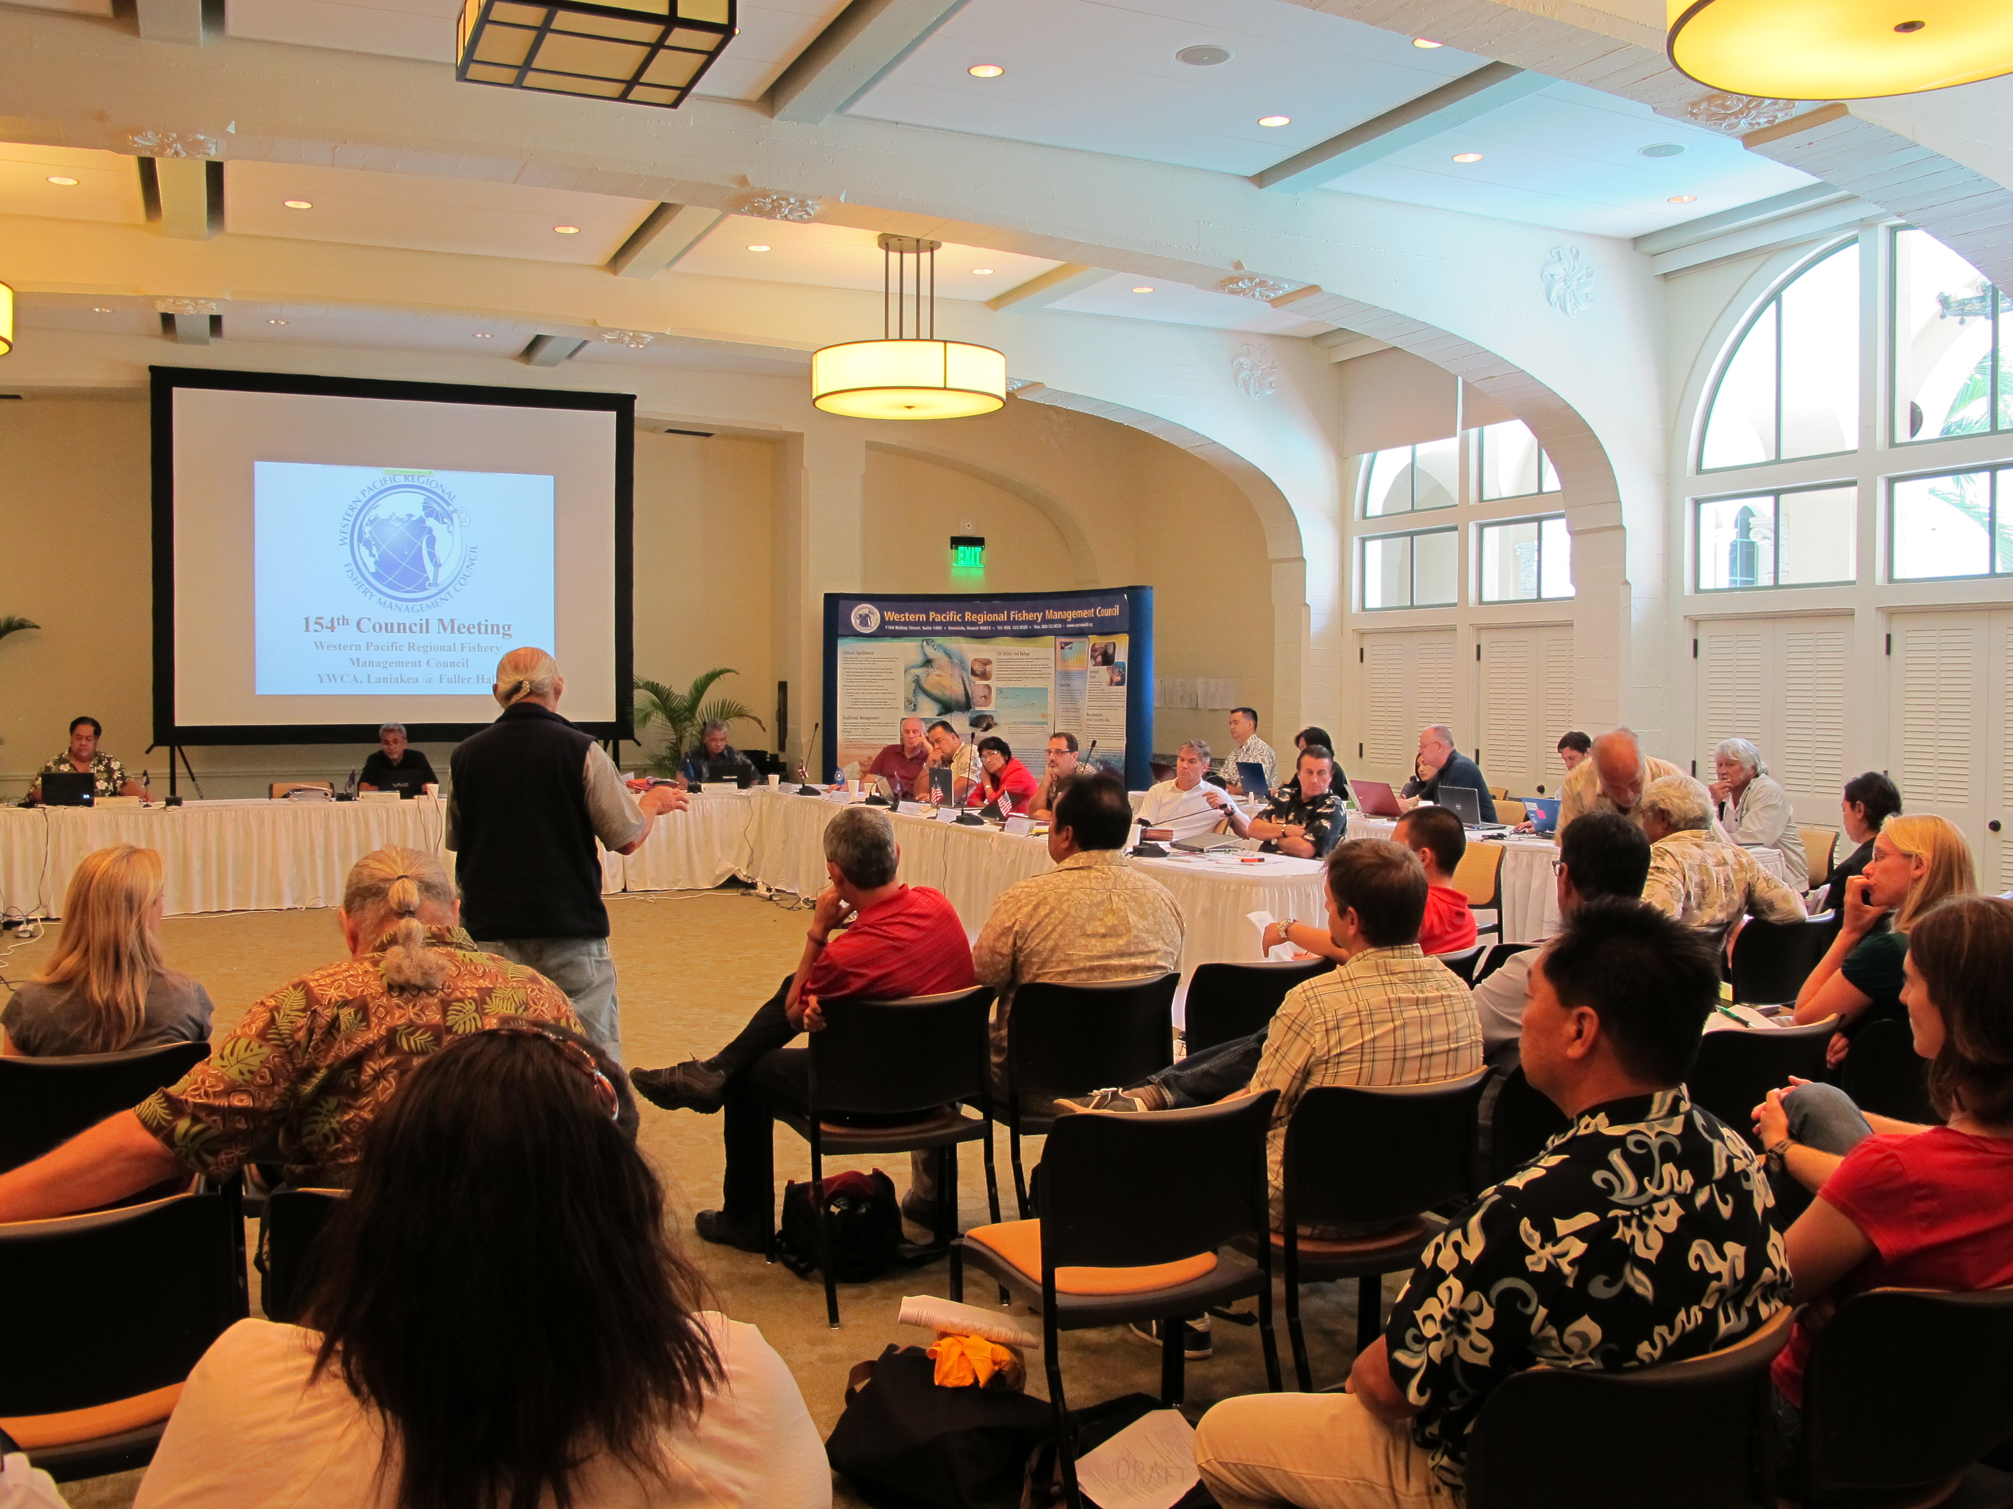

How are Hawaii Fisheries Managed?
John Kaneko MS, DVM
Hawaii Seafood Council
Photo: John Kaneko

Slide 2
HOW ARE HAWAII FisherIES MANAGED?
Fishery Management
Sustainable wild seafood comes from responsible fisheries that are managed for sustainability.
Understanding how fisheries are managed is key to evaluating the sustainability of fisheries and the seafood they produce.
Fisheries Management and therefore sustainability requires a Continual Improvement Process.

Slide 3
HOW ARE HAWAII FisherIES MANAGED?
Comparison of Federal and State Fishery Management Process in Hawaii
 | Federal | State of Hawaii
Primary Agencies? | NOAA Fisheries (Pacific Islands Region) and Western Pacific Regional Fishery Management Council (WPRFMC) | Department of Land and Natural Resources, Division of Aquatic Resources (DLNR/DAR)
Jurisdiction? | Fishing outside of state waters from 3-200 nm within US EEZ. Beyond 200 nm, Hawaii vessels comply with federal & international regulations under 2 Regional Fishery Management Organizations (WCPFC & IATTC). | Fishing within state marine waters from shoreline out to 3 nm.
Overarching Mandate? | Magnuson Stevens Fishery Conservation and Management Act (MSA) | Description of role included in state constitution.
Fishery Council? | Yes. Eight Regional Councils established by MSA cover all US marine fisheries. WPRFMC manages fisheries in Hawaii, American Samoa, Guam and Northern Mariana Islands. | None

Slide 4
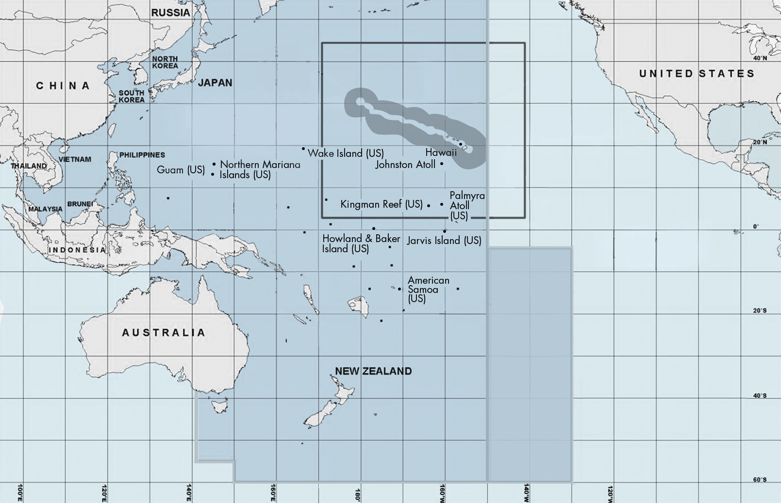
Management of Hawaii’s Pelagic Fisheries in the Pacific Ocean
Nearshore Exclusion Zone (50-75nm)
EEZ Zone Around Hawaii
Range of Hawaii fleet
SHARED IATTC AND WCPFC ZONE
WCPFC ZONE
IATTC ZONE

Slide 5
HOW ARE HAWAII FisherIES MANAGED?
Comparison of Federal and State Fishery Management Process in Hawaii cont’d
 | Federal | State of Hawaii
Fishery Management Plan? | Fishery Management Plans (FMP) are required by MSA. An FMP is a “living” document detailing the fishery and existing and proposed management actions vetted through the Council Process. | None
How are regulations established? | The Council Process continually maintains and amends the FMP in response to new science and changes in the fishery. Scientific and diverse stakeholder input is mandated to inform the Council in a public process. Proposed regulations are reviewed by NOAA and approved by the US Secretary of Commerce. This makes continual improvements in adaptive fishery management a requirement. | There are 2 ways. The Administrative Rules process allows DLNR to create, vet and propose new regulations to be reviewed and adopted by the Lt. Governor. The Legislative process allows new regulations to be proposed, vetted and adopted by the State House and Senate and signed by the Governor. This pathway does not require DLNR input.

Slide 6
HOW ARE Hawaii FisherIES MANAGED?
Ideal Fishery Management System
Fishery Management Plan
Established Reference Points for sustainable catch limits and stock level
Receives regular Scientific Advice
Effective Monitoring and Control
Responsive Corrective Management Actions
Destructive Fishing Methods not used
Discards (bycatch) minimized
Ecosystem issues addressed
Continuous Improvement Process imbedded

Slide 7
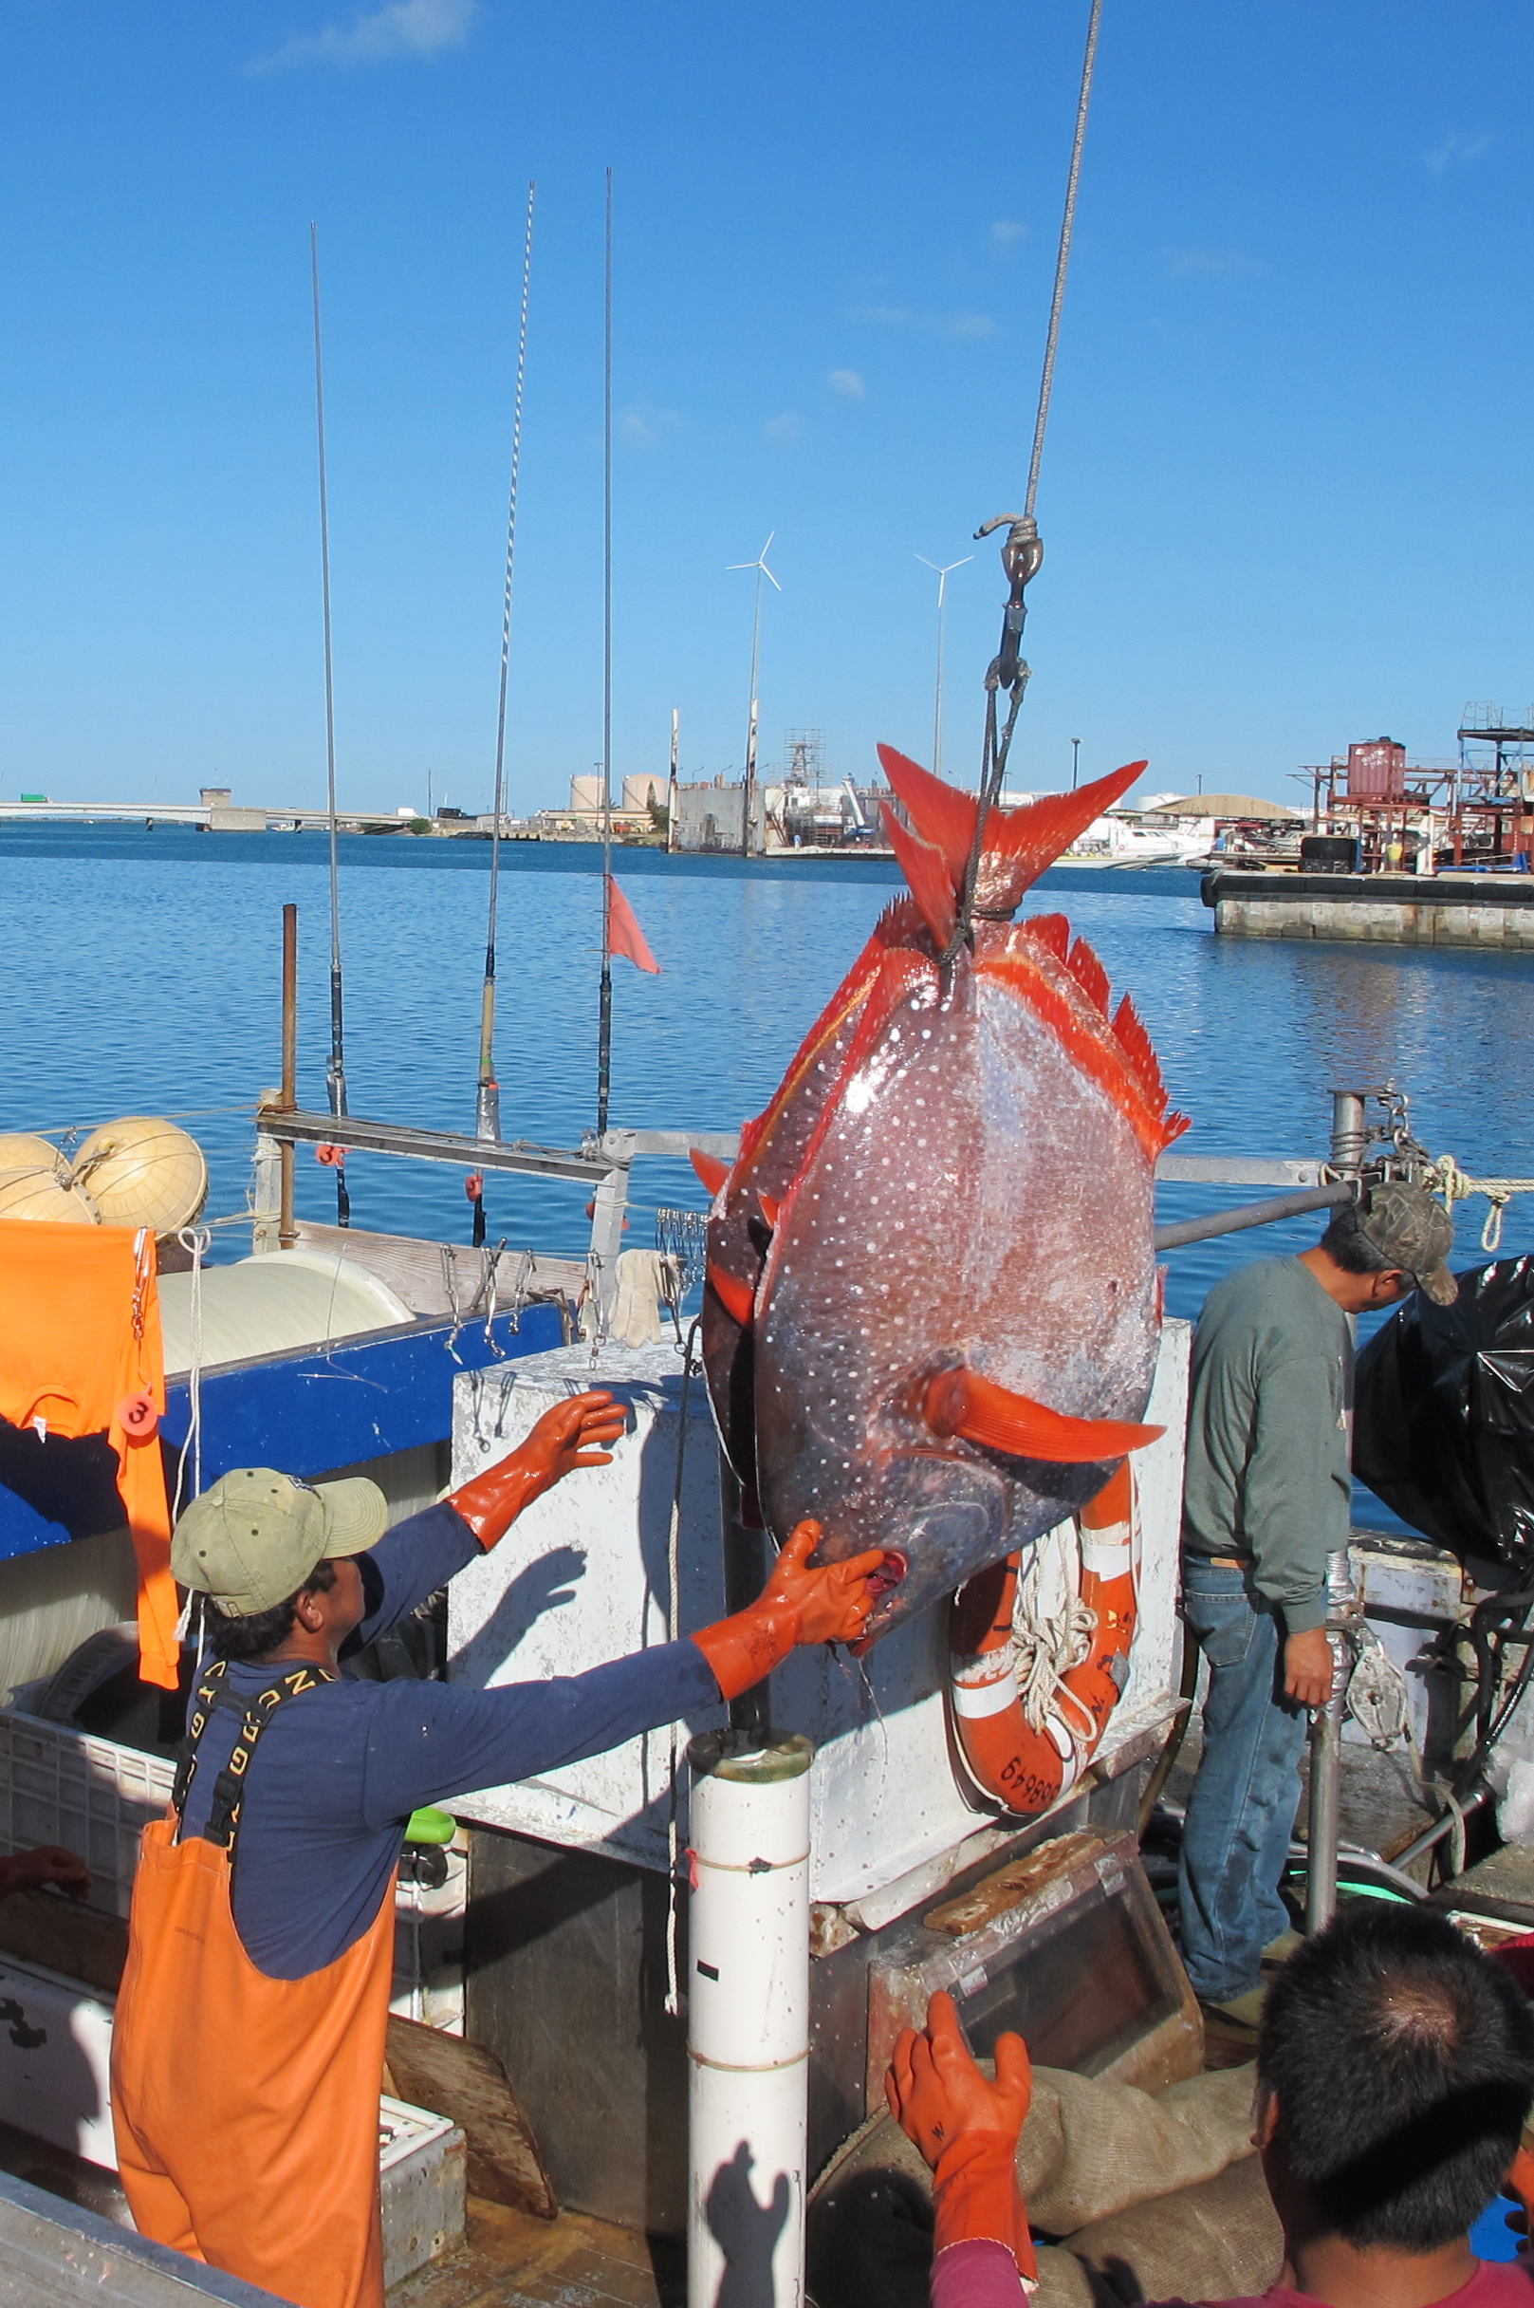
FeDERAL FISHERY MANAGEMENT Of Hawaii Fisheries
NOAA and the Fishery Council Process
Photo: John Kaneko

Slide 8

Federal Fishery Management System (science-based management)
Well-Managed Fish
Stock and Ecosystem
Graphic by Imaginary Office.

Slide 9
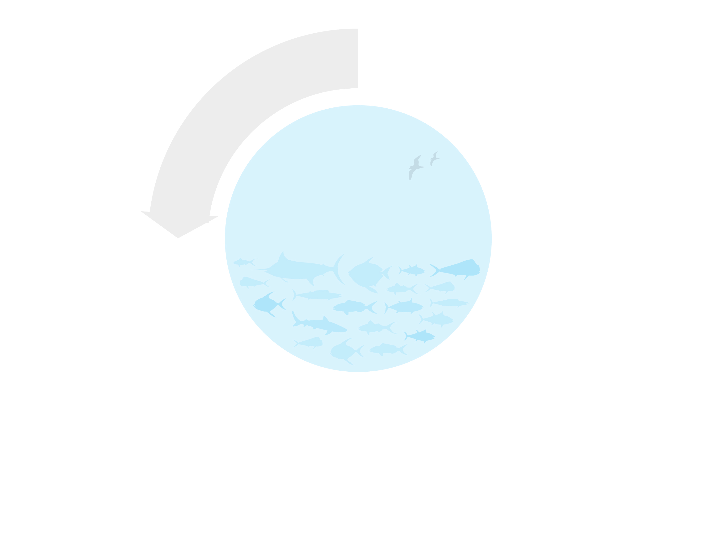

Federal Fishery Management System (science-based management)
Fishermen
(Hawaii Longline Fishing Industry)
Data
Well-Managed Fish
Stock and Ecosystem
Fishery
Scientists
(NOAA-PIFSC,
and others)
Graphic by Imaginary Office.

Slide 10
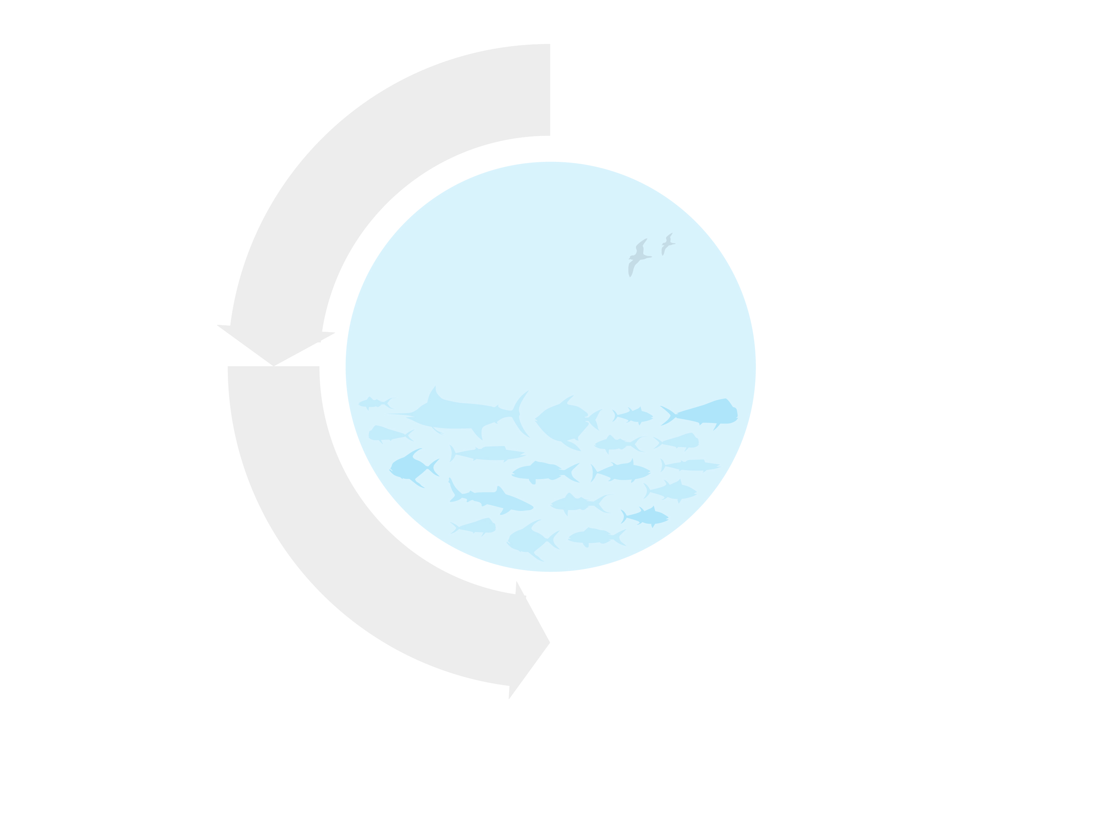
Federal Fishery Management System (science-based management)
Fishermen
(Hawaii Longline Fishing Industry)
Data
Well-Managed Fish
Stock and Ecosystem
Fishery
Scientists
(NOAA-PIFSC,
and others)
Field data, analysis,
and recommendations
Fishery
Management Council
(WPRFMC)
Graphic by Imaginary Office.

Slide 11
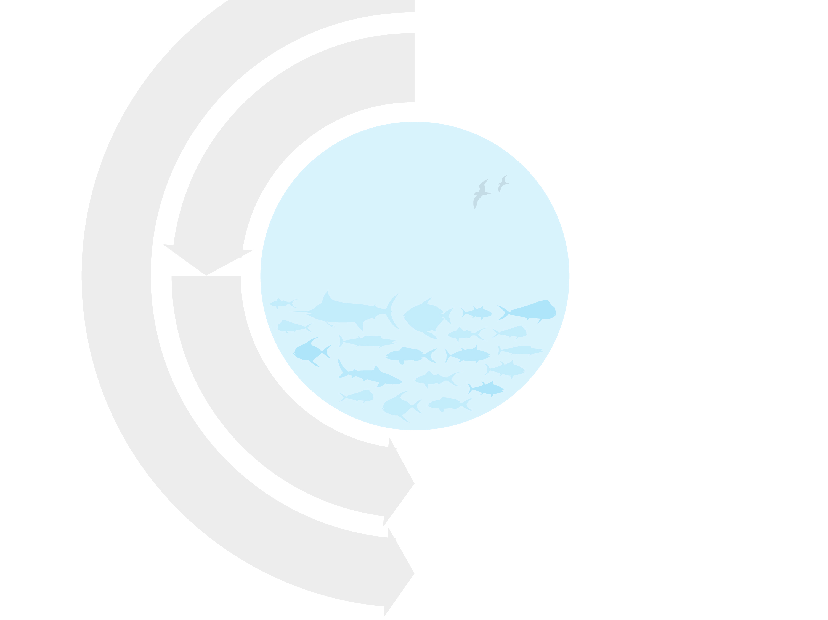

Federal Fishery Management System (science-based management)
Fishermen
(Hawaii Longline Fishing Industry)
Concerns
Data
Well-Managed Fish
Stock and Ecosystem
Other Stakeholders
Fishery
Scientists
(NOAA-PIFSC,
and others)
Concerns
Field data, analysis,
and recommendations
Advisory
Groups
Fishery
Management Council
(WPRFMC)
Concerns
Graphic by Imaginary Office.

Slide 12

Federal Fishery Management System (science-based management)
Fishermen
(Hawaii Longline Fishing Industry)
Concerns
Data
Well-Managed Fish
Stock and Ecosystem
Other Stakeholders
Fishery
Scientists
(NOAA-PIFSC,
and others)
Concerns
Field data, analysis,
and recommendations
Advisory
Groups
Fishery
Management Council
(WPRFMC)
Concerns
Fishery Management Plans (FMP’s) and Amendments
Graphic by Imaginary Office.

Slide 13
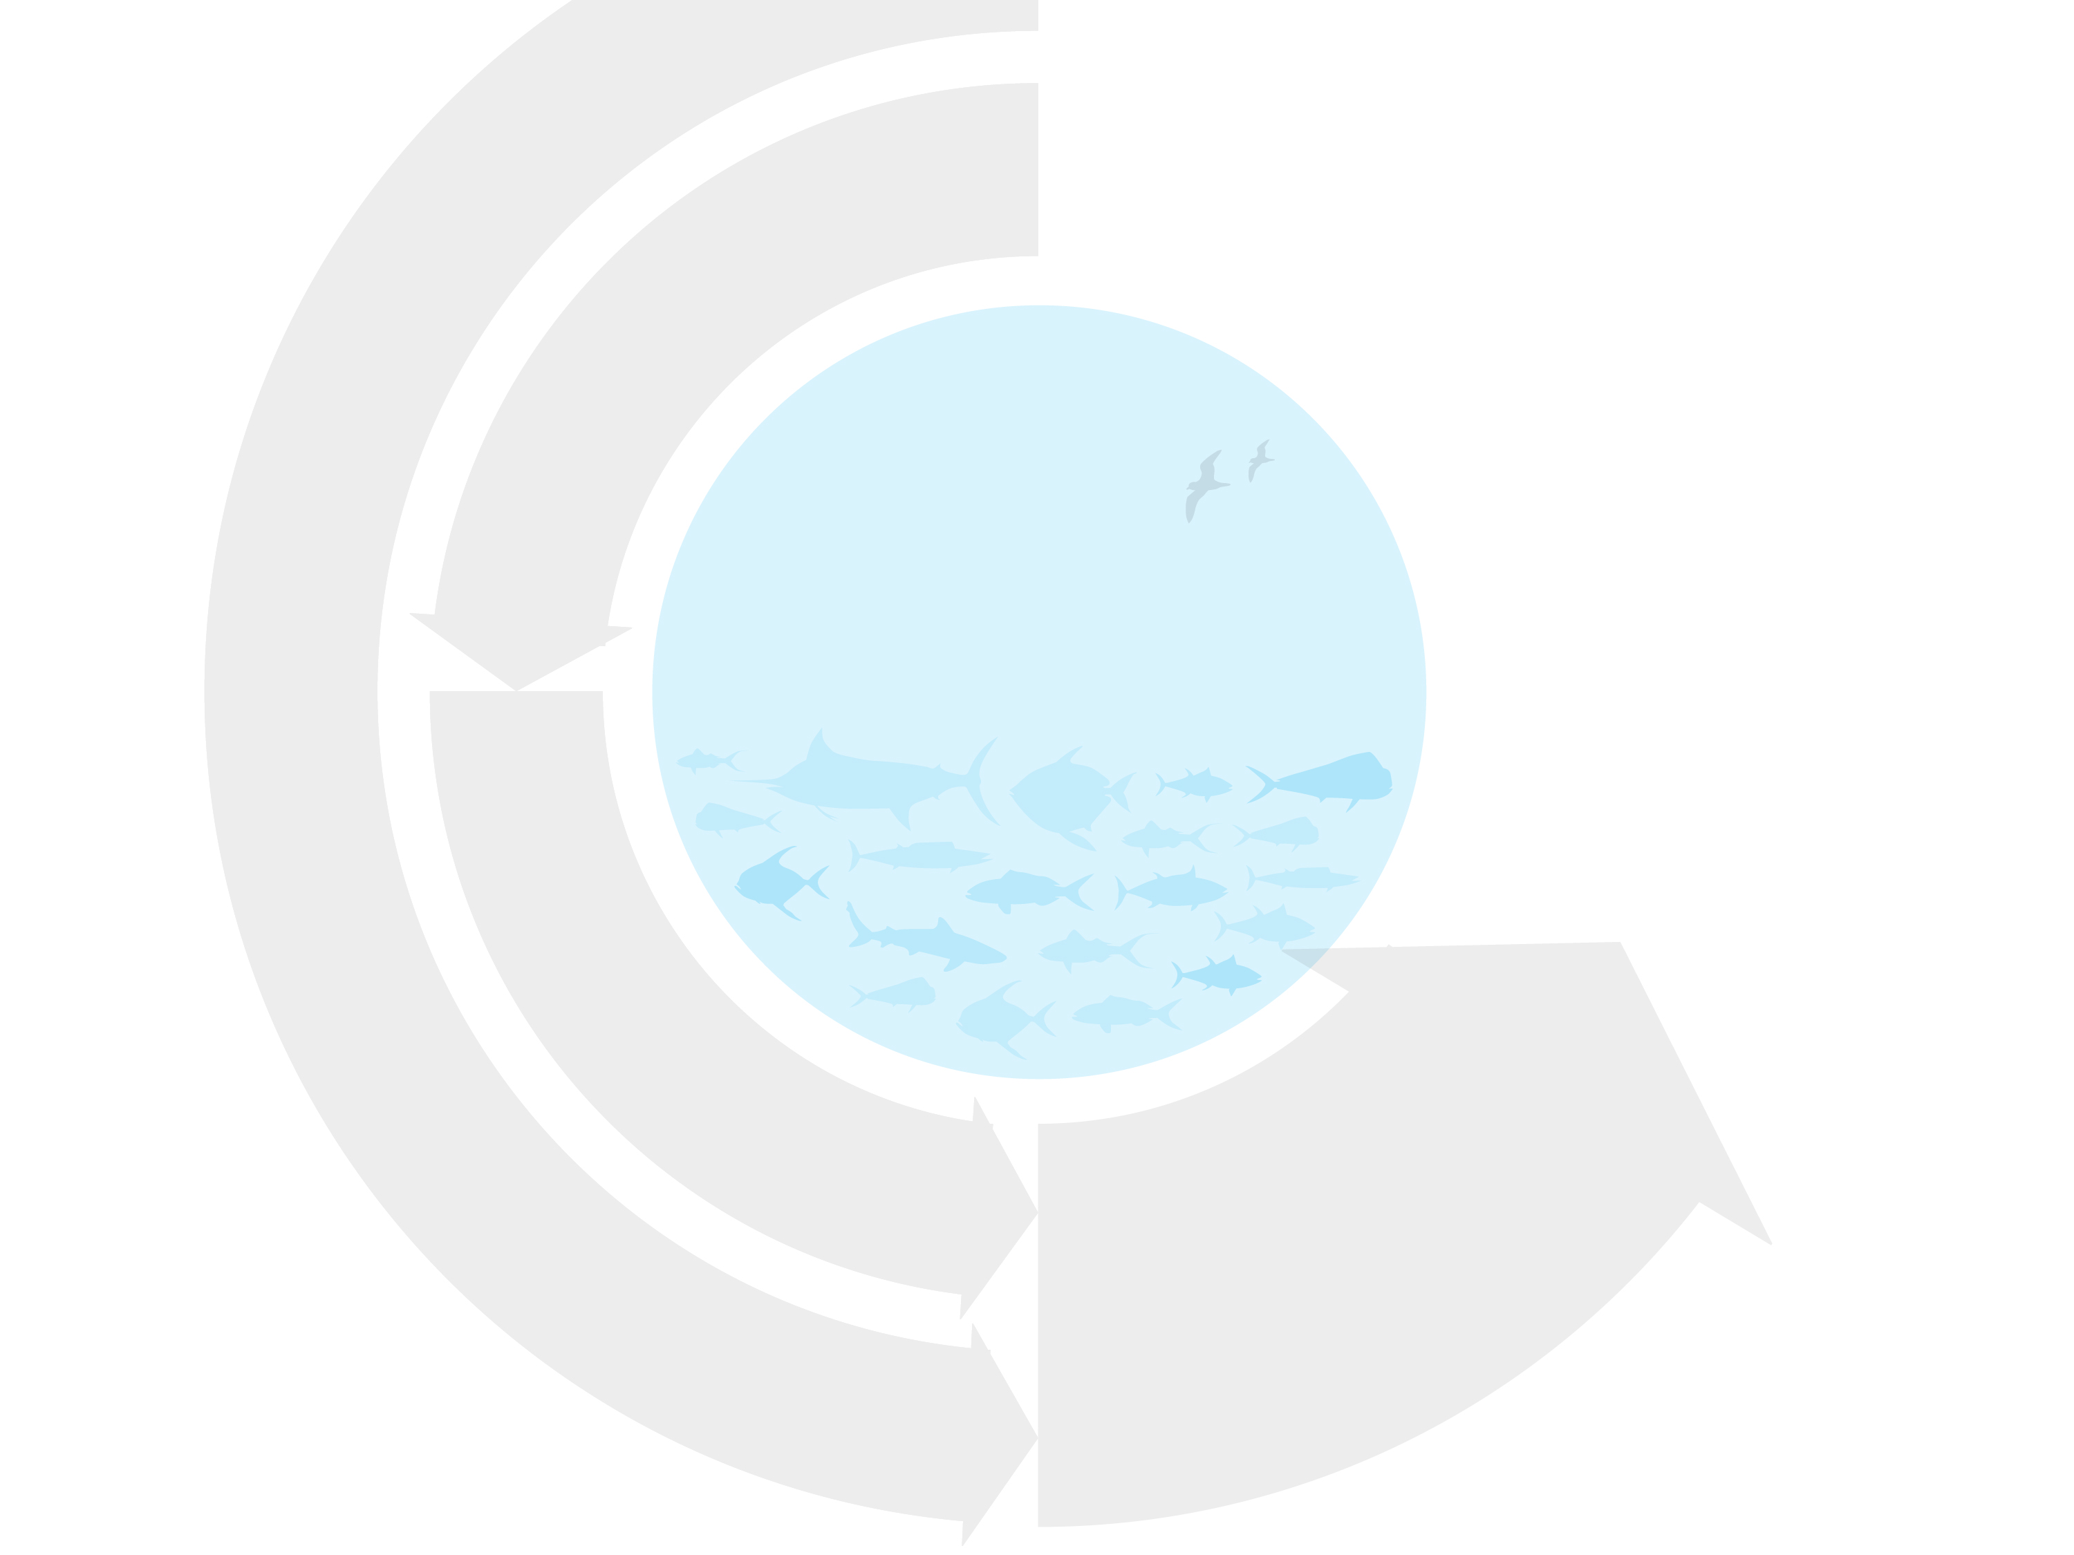

Federal Fishery Management System (science-based management)
Fishermen
(Hawaii Longline Fishing Industry)
Concerns
Data
Well-Managed Fish
Stock and Ecosystem
Fishery Regulators
(NOAA Headquarters, NOAA-PIRO)
Other Stakeholders
Fishery
Scientists
(NOAA-PIFSC,
and others)
Fishery regulations
Concerns
Field data, analysis,
and recommendations
Advisory
Groups
Fishery
Management Council
(WPRFMC)
Concerns
Fishery Management Plans (FMP’s) and Amendments
Graphic by Imaginary Office.

Slide 14
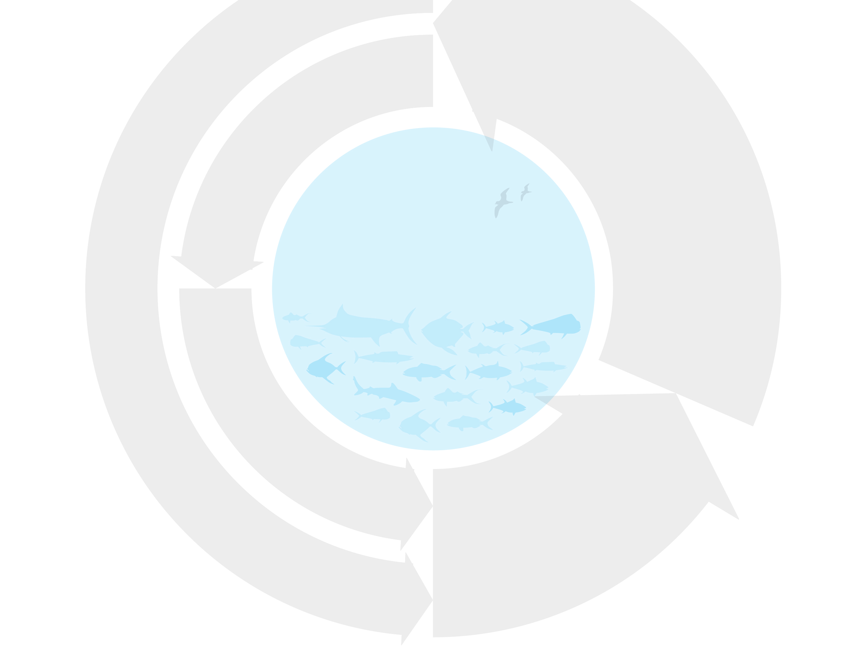
Federal Fishery Management System (science-based management)
Fishermen
(Hawaii Longline Fishing Industry)
Regulation Enforcers
(NOAA, US Coast Guard)
Concerns
Data
Fishing, vessel safety, and
environmental regulations
Well-Managed Fish
Stock and Ecosystem
Fishery Regulators
(NOAA Headquarters, NOAA-PIRO)
Other Stakeholders
Fishery
Scientists
(NOAA-PIFSC,
and others)
Fishery regulations
Concerns
Field data, analysis,
and recommendations
Advisory
Groups
Fishery
Management Council
(WPRFMC)
Concerns
Fishery Management Plans (FMP’s) and Amendments
Graphic by Imaginary Office.

Slide 15
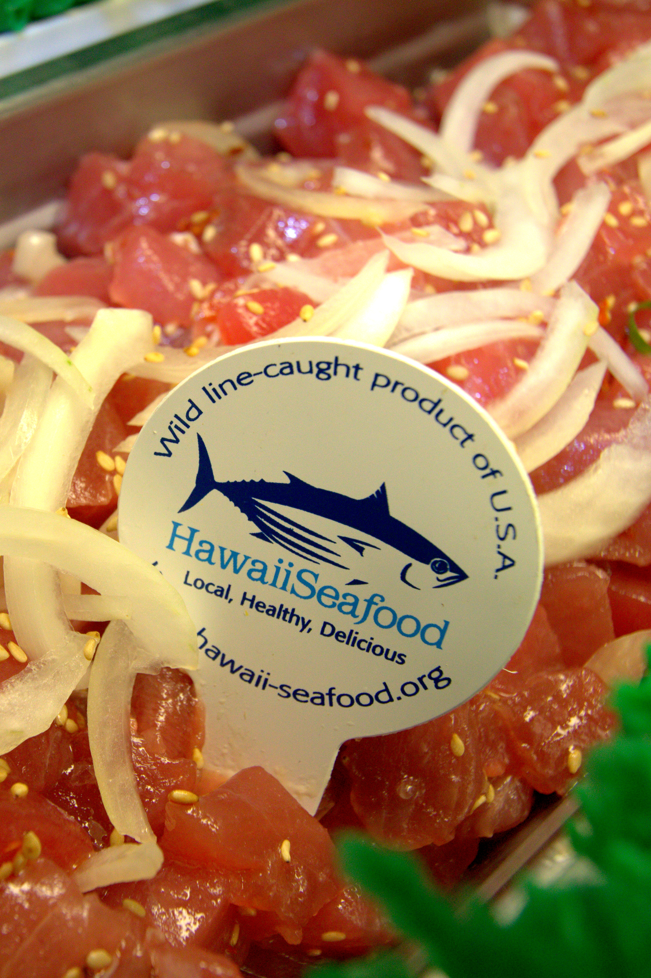
FISHERY and seafood regulation
NOAA manages fishing. FDA and the Hawaii Dept. of Health manage seafood safety and sanitation.
Photo: John Kaneko

Slide 16
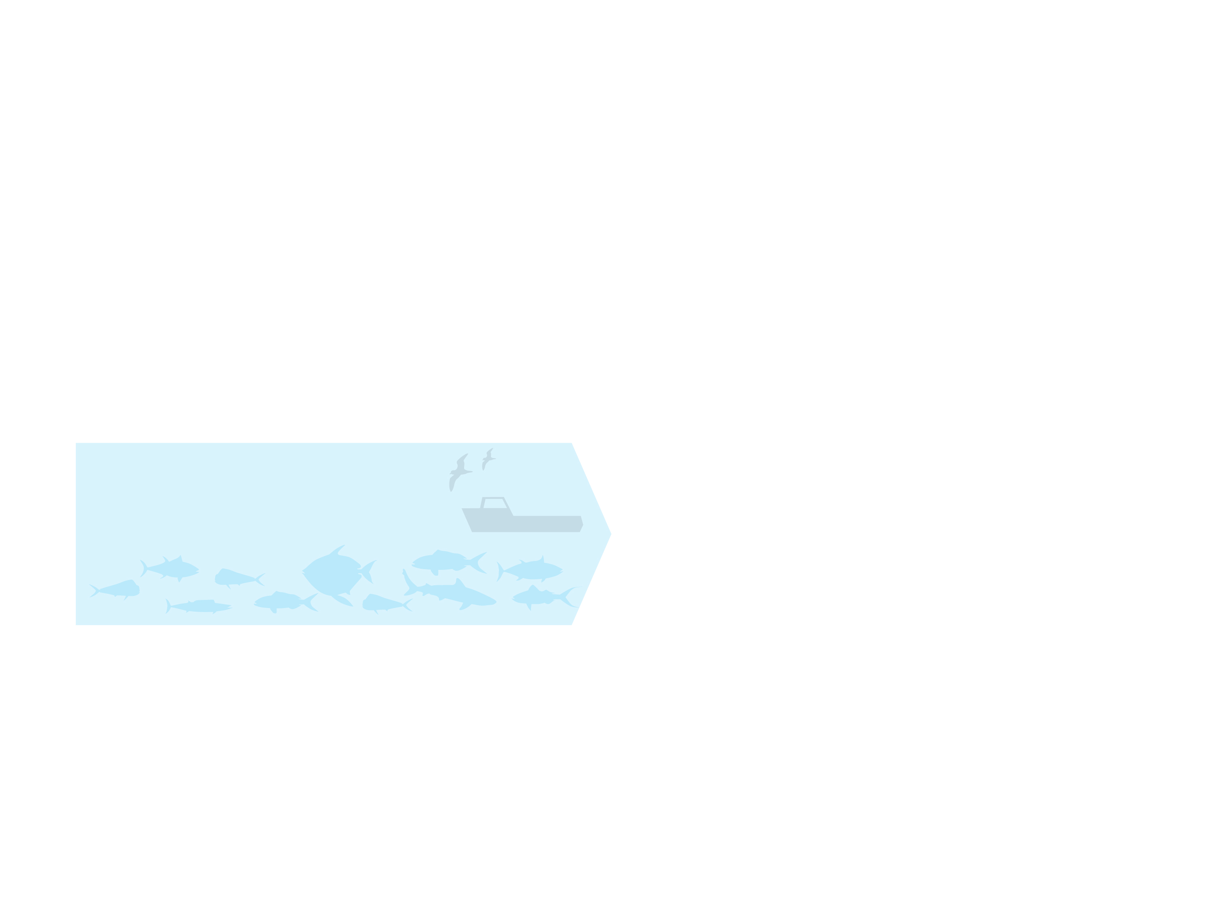
Federal Fishery Management and Seafood Regulation in Hawaii
Fishery
(Well-managed Fish Stock and Ecosystem, and HI Longline Fishing Industry)
Graphic by Imaginary Office.

Slide 17
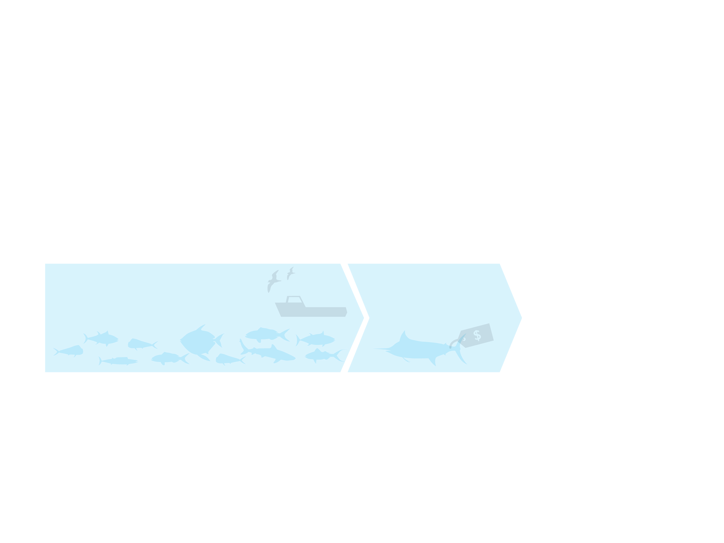
Federal Fishery Management and Seafood Regulation in Hawaii
Fishery
(Well-managed Fish Stock and Ecosystem, and HI Longline Fishing Industry)
Fish Distribution
(Honolulu Fish Auction, Wholesalers)
Graphic by Imaginary Office.

Slide 18
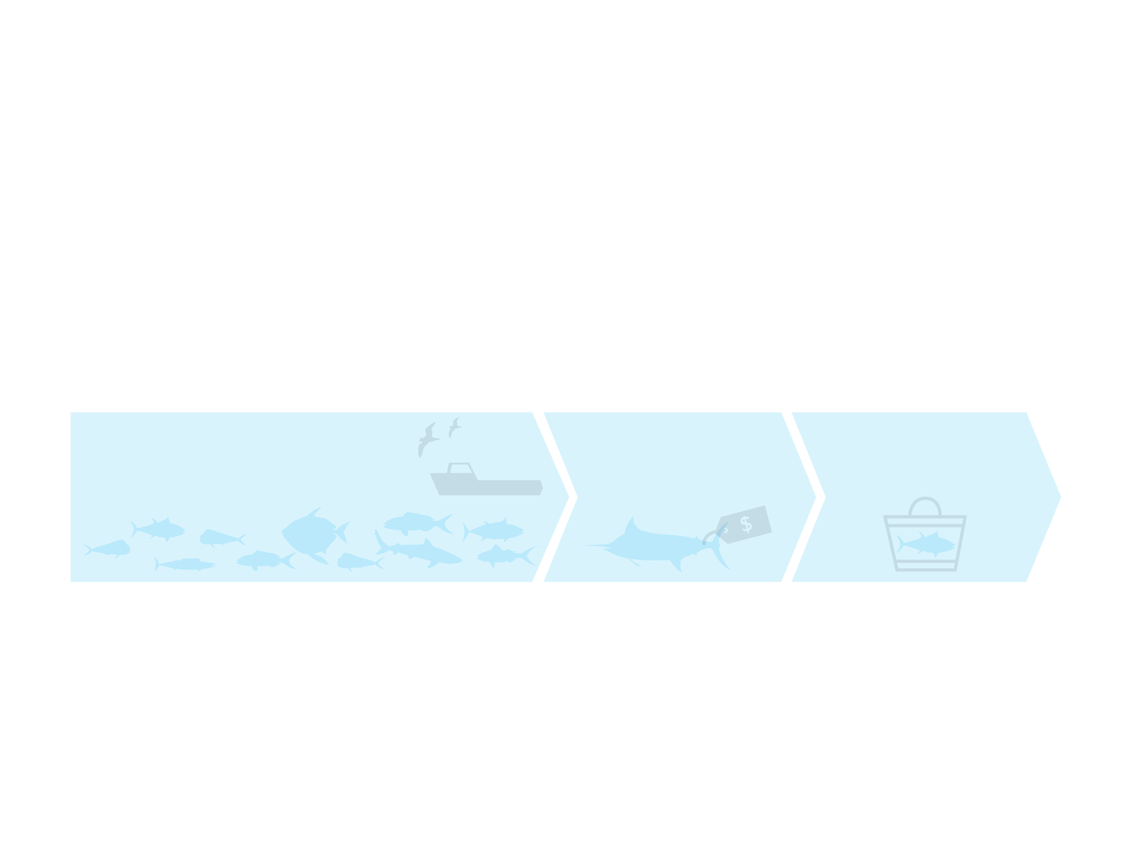
Federal Fishery Management and Seafood Regulation in Hawaii
Fishery
(Well-managed Fish Stock and Ecosystem, and HI Longline Fishing Industry)
Fish Distribution
(Honolulu Fish Auction, Wholesalers)
Fish Consumption
(Retailers and Consumers)
Graphic by Imaginary Office.

Slide 19
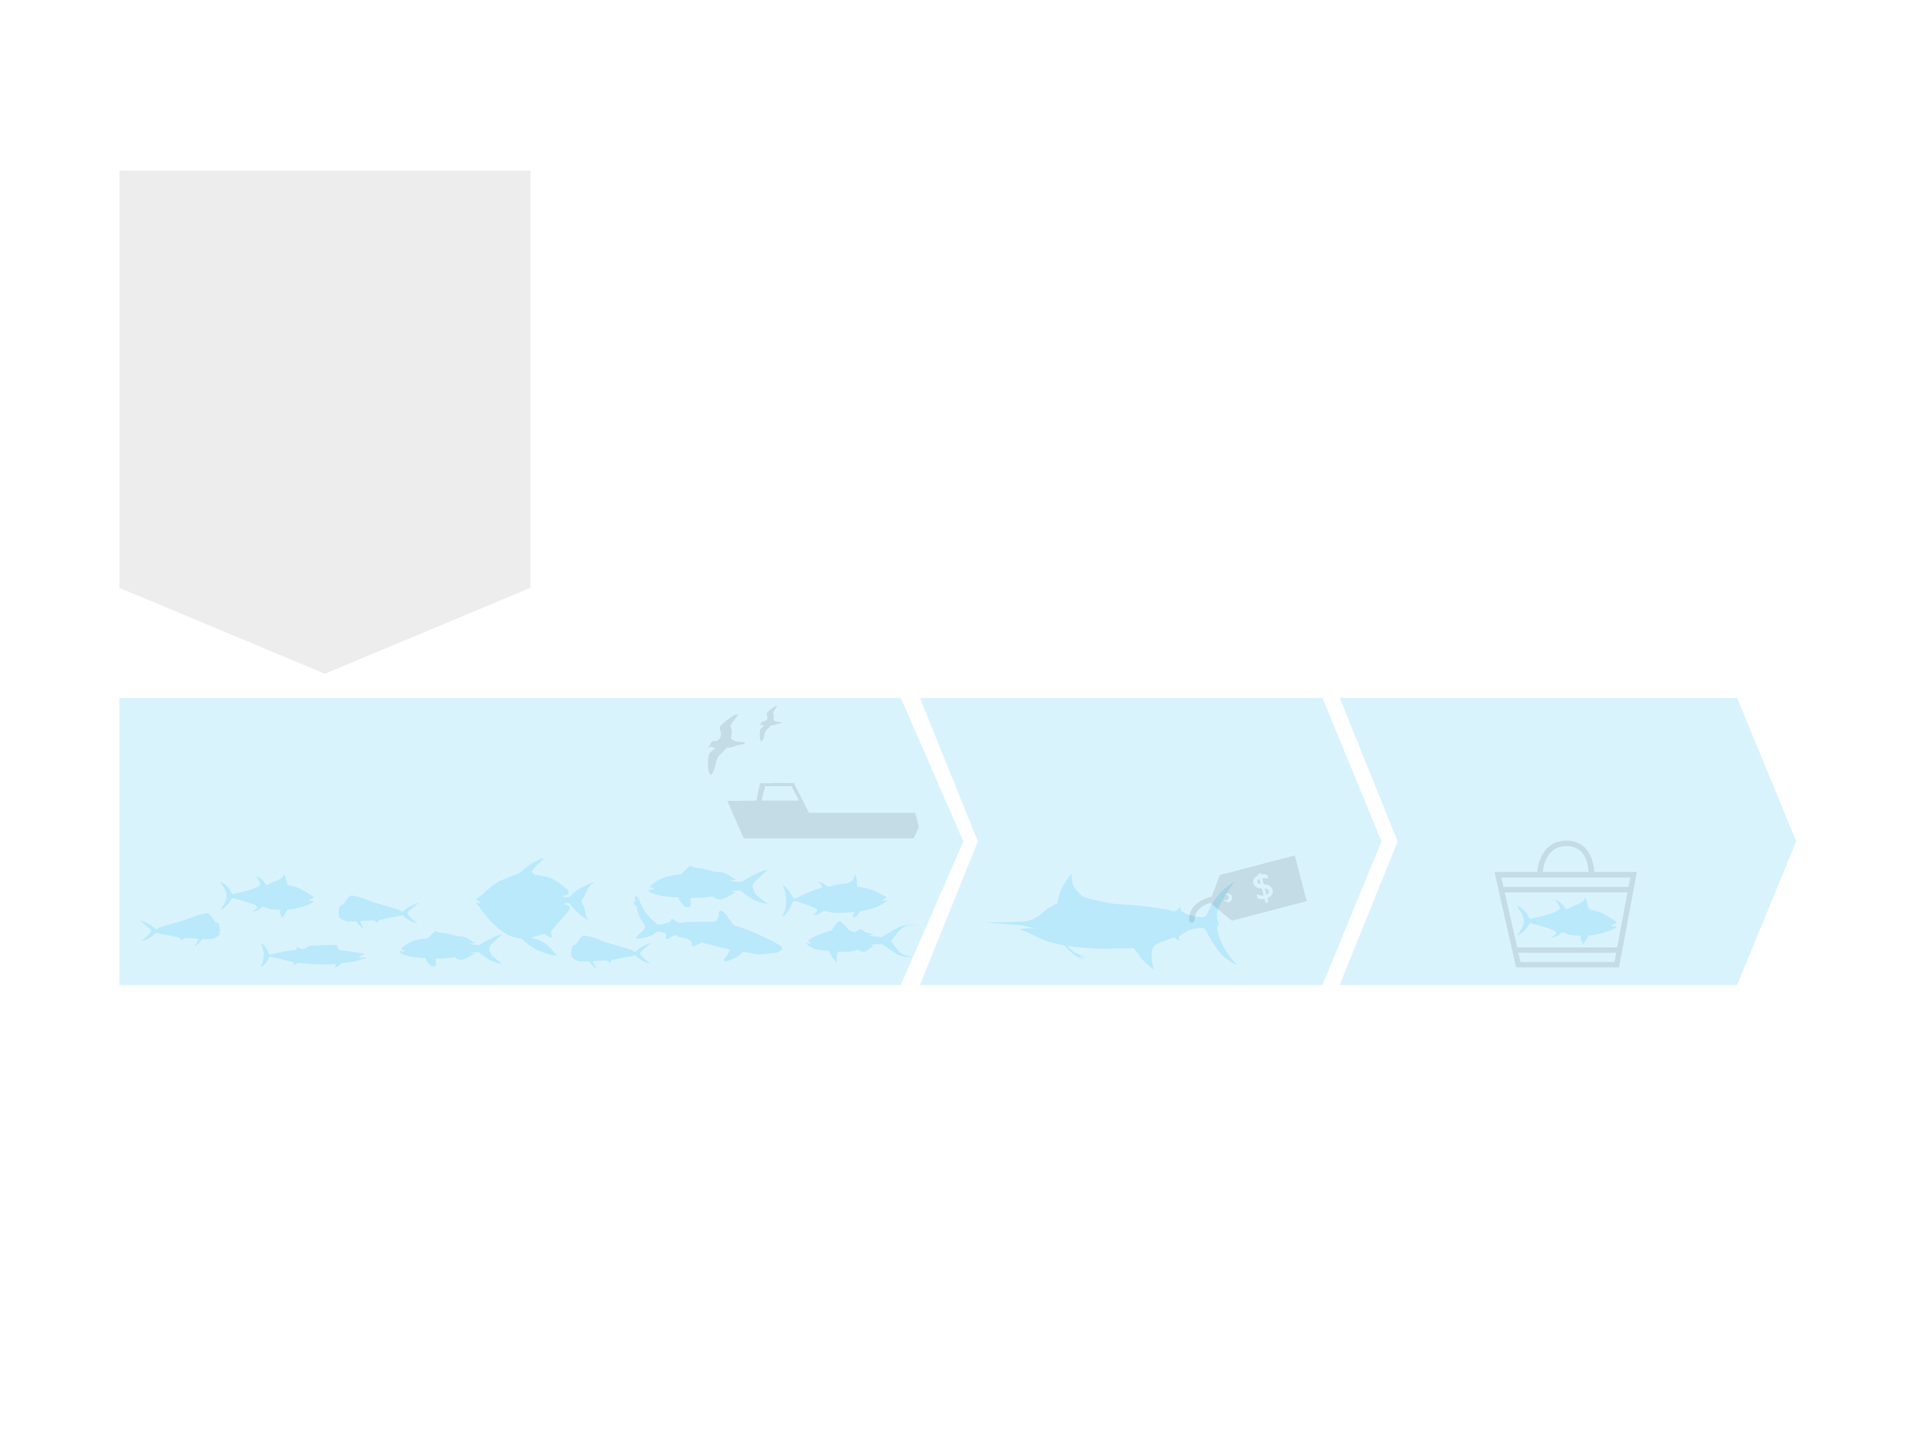
Federal Fishery Management and Seafood Regulation in Hawaii
Fishery Management
Fishery Scientists
(NOAA-PIFSC, and others)
Fishery Management Council
(WPRFMC)
Fishery Regulations
(NOAA Headquarters, NOAA-PIRO)
Fishery
(Well-managed Fish Stock and Ecosystem, and HI Longline Fishing Industry)
Fish Distribution
(Honolulu Fish Auction, Wholesalers)
Fish Consumption
(Retailers and Consumers)
Graphic by Imaginary Office.

Slide 20
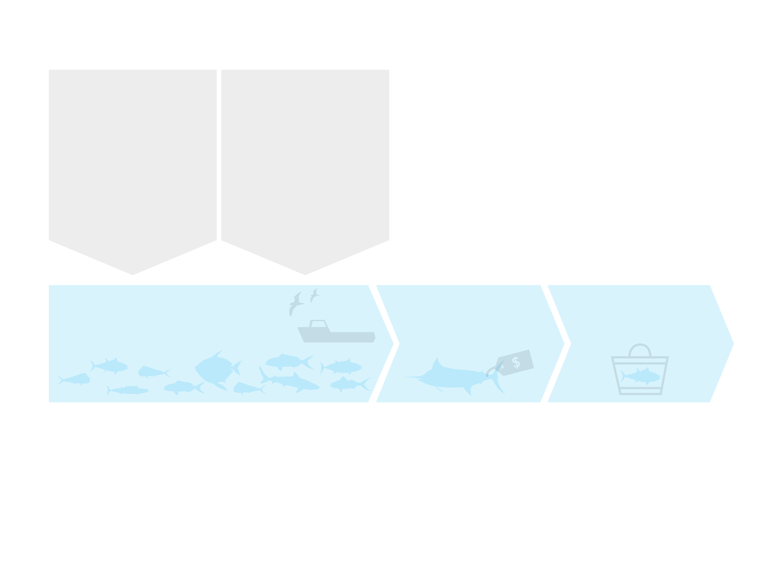
Federal Fishery Management and Seafood Regulation in Hawaii
Fishery Management
Fishery Scientists
(NOAA-PIFSC, and others)
Fishery Management Council
(WPRFMC)
Fishery Regulations
(NOAA Headquarters, NOAA-PIRO)
Other Regulations
For fishing industry and the environment
(USCG Fishing Vessel Safety and Environmental Regulations)
Fishery
(Well-managed Fish Stock and Ecosystem, and HI Longline Fishing Industry)
Fish Distribution
(Honolulu Fish Auction, Wholesalers)
Fish Consumption
(Retailers and Consumers)
Graphic by Imaginary Office.

Slide 21
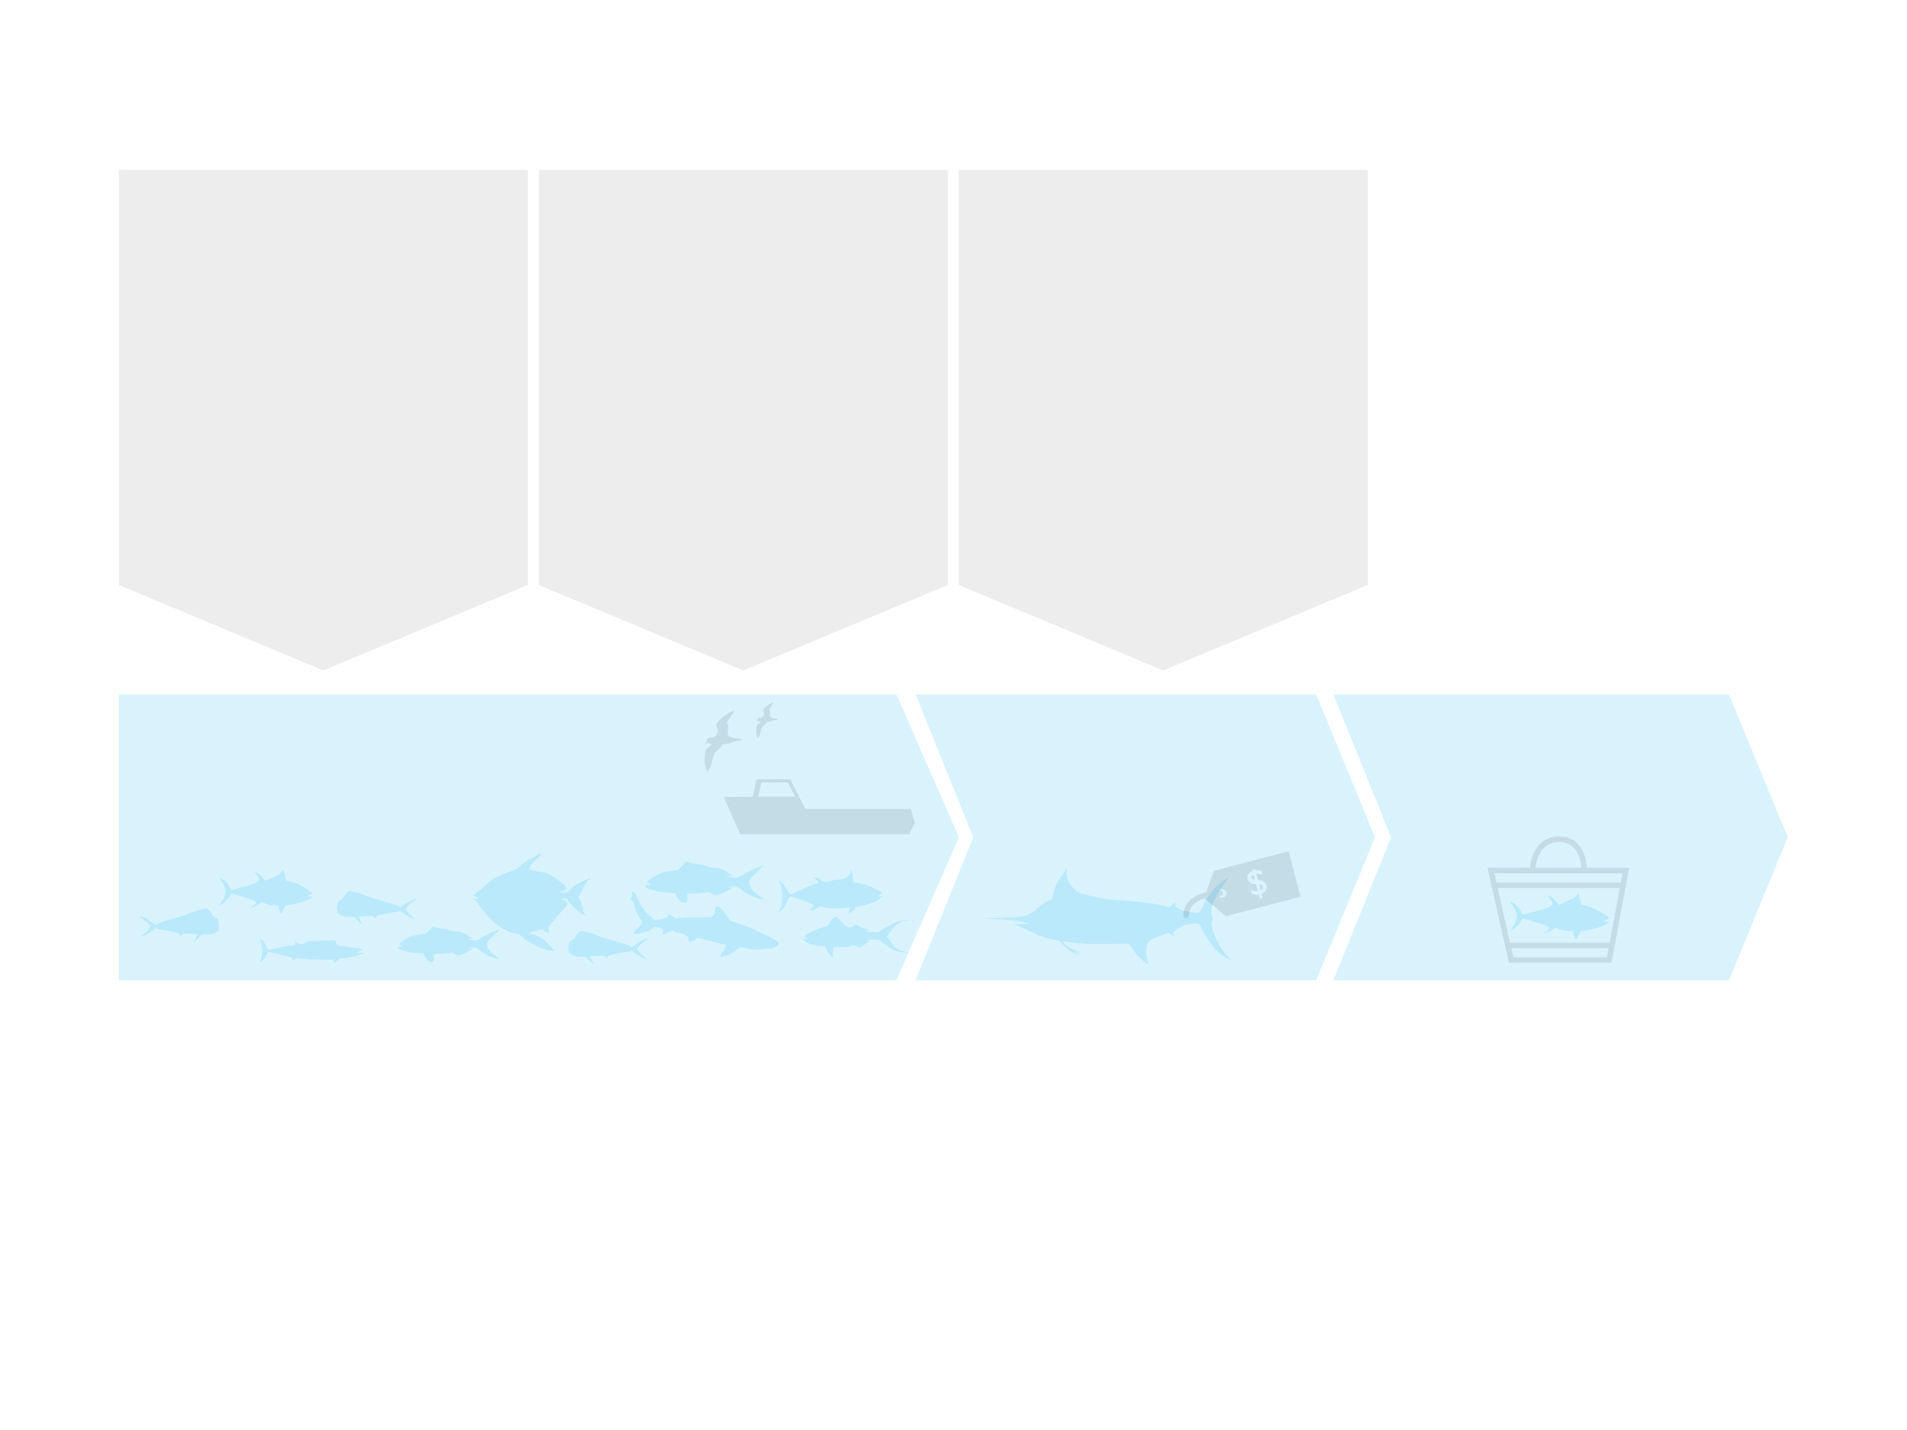
Federal Fishery Management and Seafood Regulation in Hawaii
Fishery Management
Fishery Scientists
(NOAA-PIFSC, and others)
Fishery Management Council
(WPRFMC)
Fishery Regulations
(NOAA Headquarters, NOAA-PIRO)
Other Regulations
For fishing industry and the environment
(USCG Fishing Vessel Safety and Environmental Regulations)
For seafood wholesalers and processors
(US-FDA Seafood HACCP and GMP regulations)
Fishery
(Well-managed Fish Stock and Ecosystem, and HI Longline Fishing Industry)
Fish Distribution
(Honolulu Fish Auction, Wholesalers)
Fish Consumption
(Retailers and Consumers)
Graphic by Imaginary Office.

Slide 22
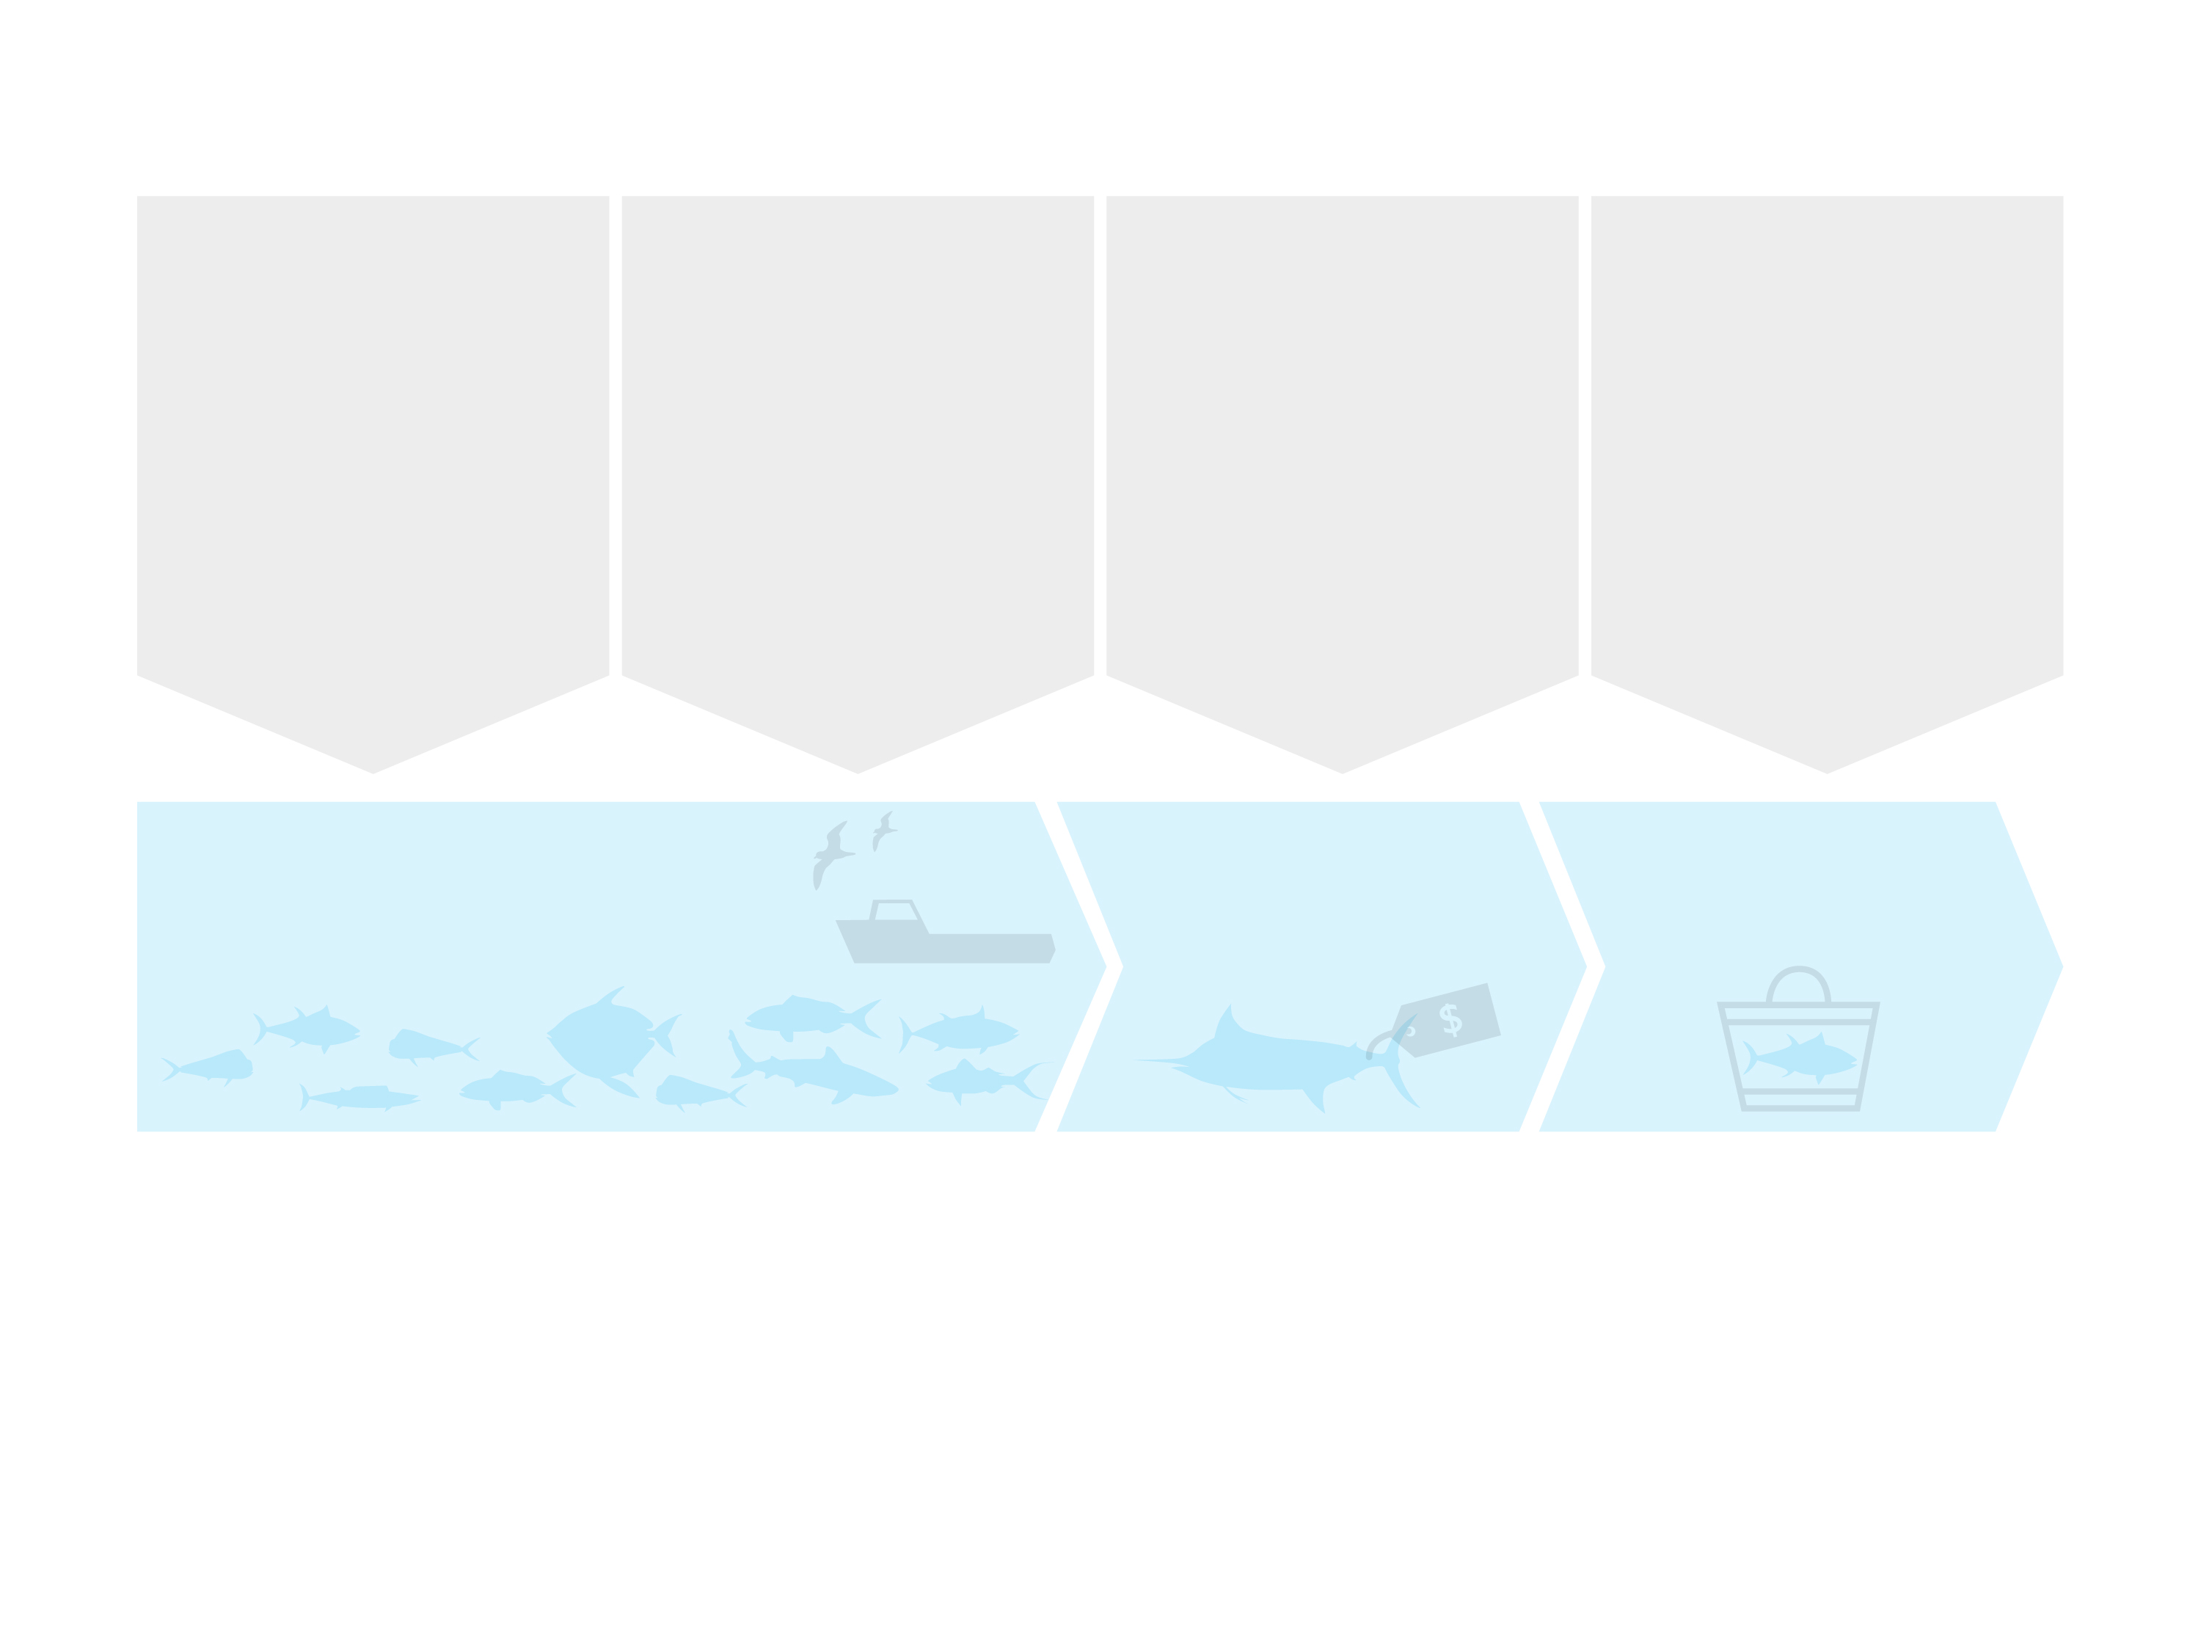
Federal Fishery Management and Seafood Regulation in Hawaii
Fishery Management
Fishery Scientists
(NOAA-PIFSC, and others)
Fishery Management Council
(WPRFMC)
Fishery Regulations
(NOAA Headquarters, NOAA-PIRO)
Other Regulations
For fishing industry and the environment
(USCG Fishing Vessel Safety and Environmental Regulations)
For seafood wholesalers and processors
(US-FDA Seafood HACCP and GMP regulations)
For seafood retailers
(State Health Regulations)
Fishery
(Well-managed Fish Stock and Ecosystem, and HI Longline Fishing Industry)
Fish Distribution
(Honolulu Fish Auction, Wholesalers)
Fish Consumption
(Retailers and Consumers)
Graphic by Imaginary Office.

Slide 23
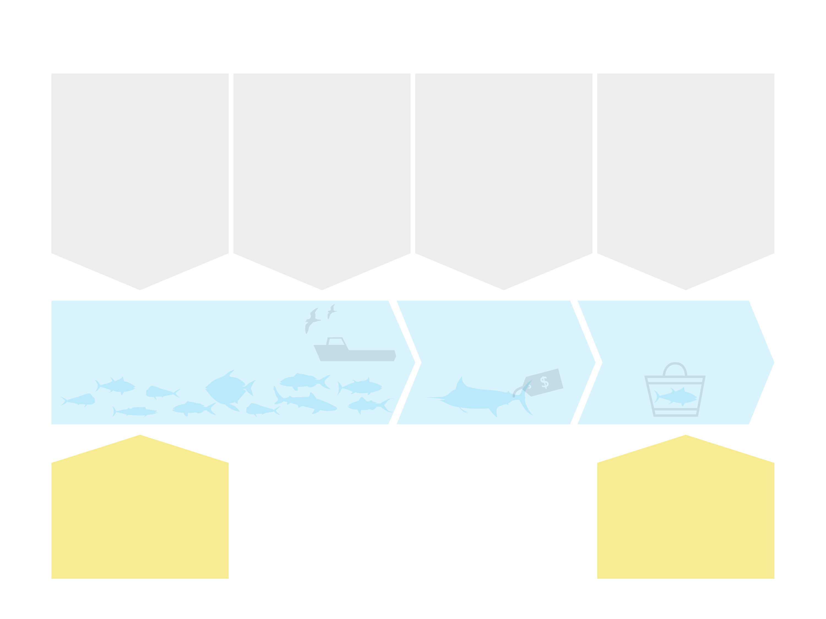
Federal Fishery Management and Seafood Regulation in Hawaii
Fishery Management
Fishery Scientists
(NOAA-PIFSC, and others)
Fishery Management Council
(WPRFMC)
Fishery Regulations
(NOAA Headquarters, NOAA-PIRO)
Other Regulations
For fishing industry and the environment
(USCG Fishing Vessel Safety and Environmental Regulations)
For seafood wholesalers and processors
(US-FDA Seafood HACCP and GMP regulations)
For seafood retailers
(State Health Regulations)
Fishery
(Well-managed Fish Stock and Ecosystem, and HI Longline Fishing Industry)
Fish Distribution
(Honolulu Fish Auction, Wholesalers)
Fish Consumption
(Retailers and Consumers)
Environmental NGOs
May take legal action against regulators
Environmental NGOs
Persuade retailers and consumers
Graphic by Imaginary Office.

Slide 24
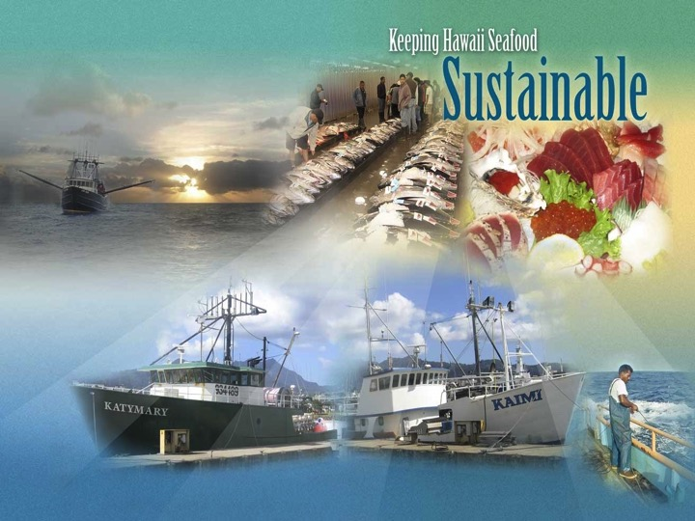
CONCLUSION
Fishery Management
Sustainability in Fisheries is the result of an on-going management process that is adaptive and based on sound science.
Hawaii’s fisheries in federal waters are managed under a Continual Improvement Process.
Source: Kaneko, J.J. and P. K. Bartram, 2014. Keeping Hawaii Seafood Sustainable second edition. Prepared for NOAA Award No. NA10NMF4520344. Available at www.hawaii-seafood.org

Slide 25
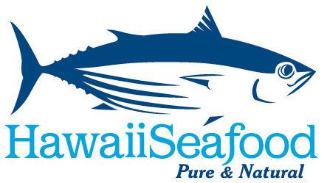


How are Hawaii Fisheries Managed?
Written by John Kaneko MS, DVM, Hawaii Seafood Council, Honolulu, Hawaii
July 2015
With support from the
Harold K.L Castle Foundation
Photo: John Kaneko

