Slide 1
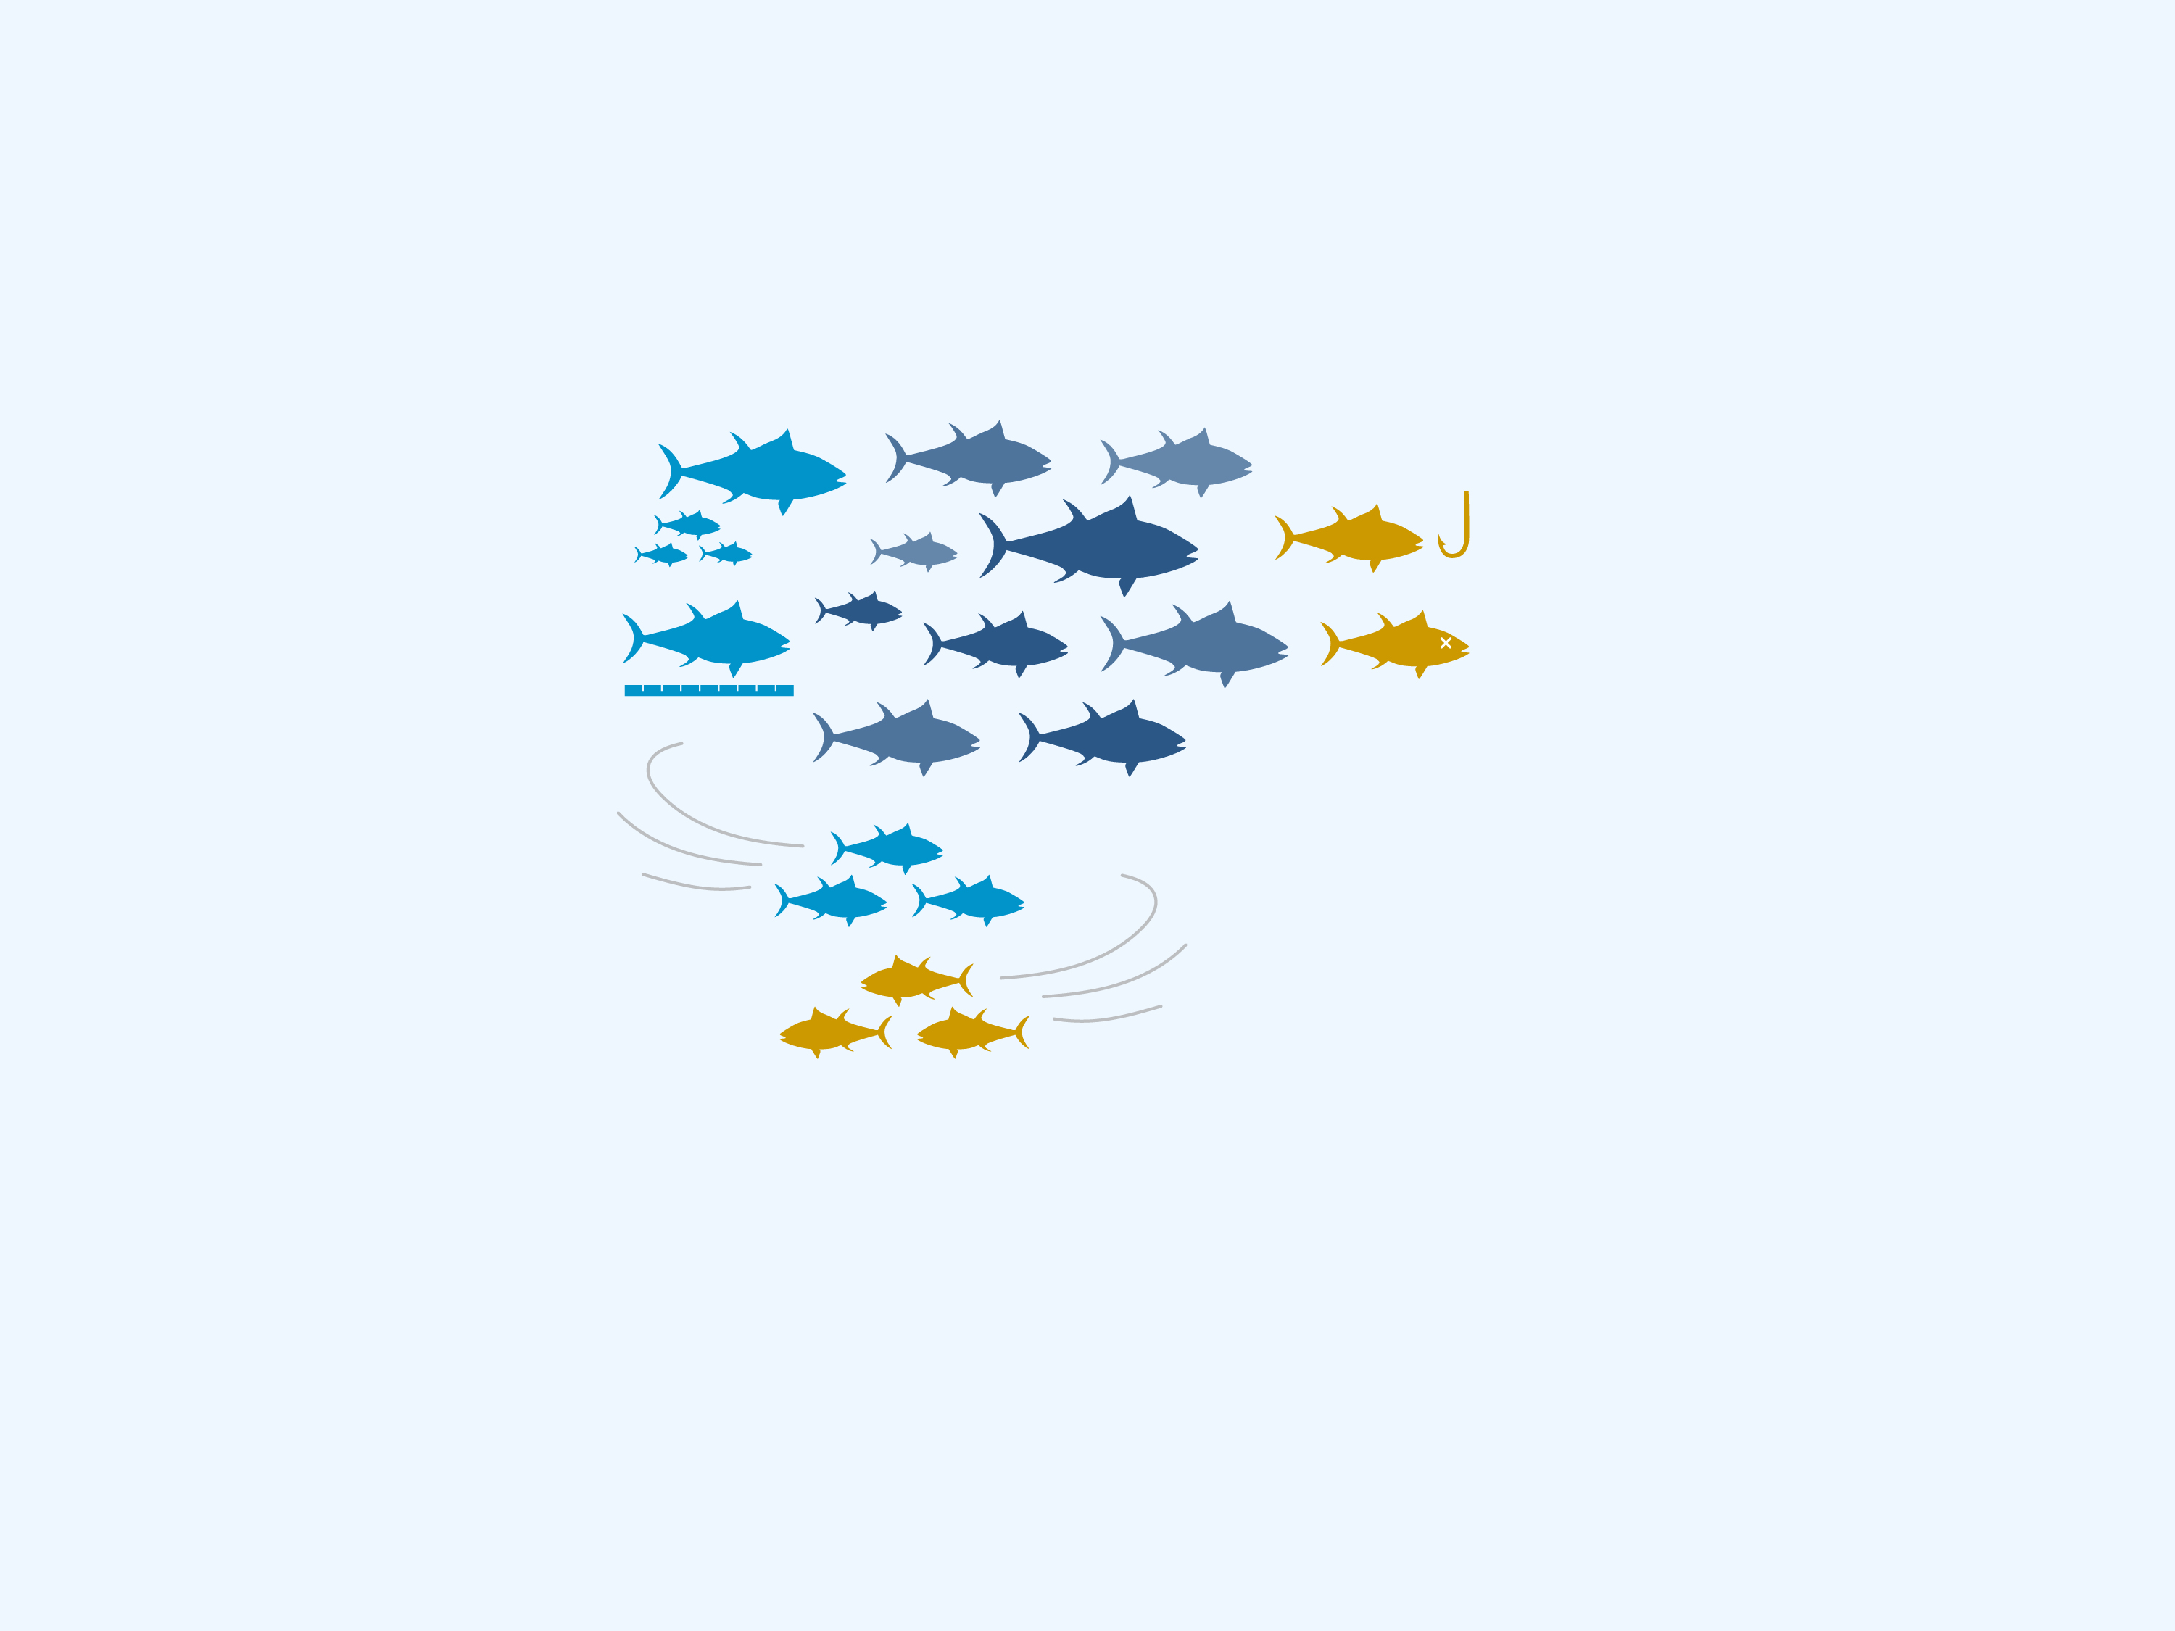

Fish Stock Assessment
John Kaneko MS, DVM
Hawaii Seafood Council
Graphic: Imaginary Office

Slide 2
Fish stock assessment
What do Fishery Managers do?
Fish populations are renewable resources that must be maintained at levels required to produce sustainable catch, known as Maximum Sustainable Yield (MSY).
Fishery Managers establish targets (reference points) for how much fish can be caught while maintaining fish populations at a level that will produce MSY year after year.

Slide 3
Fish stock assessment
What do Fishery Managers do?
Catching too many fish over time (chronic overfishing) results in:
reduction in the standing fish population and its ability to replenish itself
reduced capacity to produce MSY over time
may lead to depletion or “overfished” status
Eliminating overfishing
(ex. using catch quotas) allows the population to rebuild to sustainable levels.
Catch too little and MSY is not achieved and the potential catch goes unutilized.

Slide 4
Fish stock assessment
Sustainable Fisheries and Stock Assessments
At the core of sustainable fishery management is our understanding and estimates of the amount of fish in a population (or stock) over time.
Fishery managers regulate how much fish is taken to balance natural fluctuations and long-term sustainable use with sustainable fish stocks over time.
Fish populations fluctuate with:
impacts on the reproductive rate, growth, natural mortality, movement and environmental changes/cycles
fishing mortality as commercial and non-commercial catch removes fish from a stock

Slide 5
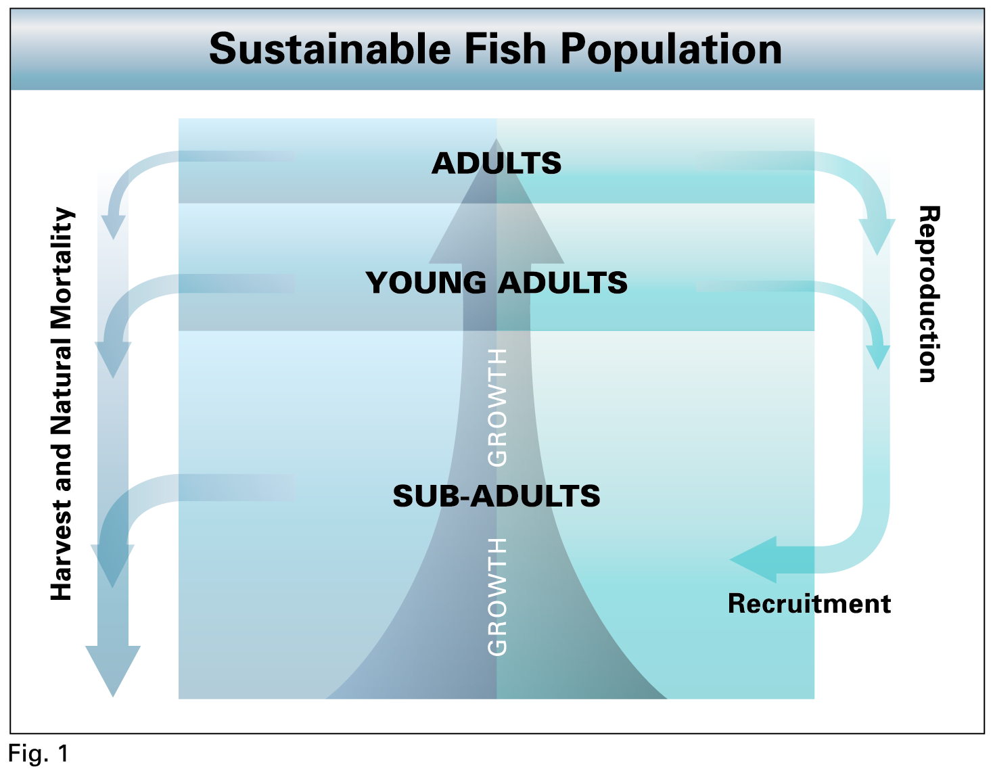
Fish stock assessment
Fish Population Dynamics
Fish Population Dynamics is the study of how fish populations change in abundance and size/age structure under the influence of biological and environmental factors and the impact of fishing mortality.
Source: Kaneko J.J. and P.K. Bartram. 2014. Keeping Hawaii Seafood Sustainable. Second Edition. Prepared under NOAA Award No. NA10NMF4520344. Graphic: Eric Woo Design

Slide 6
Fish stock assessment
Fish Population Models
Fish Population Models are complex computer models that apply information about a fishery to make estimates of fish population status and impacts
of fishing-mortality.
Fish Population Models allow scientists and managers to determine:
whether the fishery is operating sustainably
(not subjected to chronic overfishing)
whether the remaining
fish stock is sufficient to produce MSY over time
(not overfished)

Slide 7
Fish stock assessment
What is the purpose of Stock Assessment?
Determine the current status of the fish stock (population) in relationship to management targets. Monitor changes or trends over time.
Prevent overfishing. Determine how much fish can be caught while maintaining the sustainable target stock size. Adjust fishing mortality to adapt to changing stock status and environmental conditions.
Prevent depletion (overfished stocks). Determine if a fish stock is depleted (overfished), what must be done to rebuild it to sustainable stock level, and monitor the impacts of regulatory measures to rebuild and sustain the population over time.

Slide 8
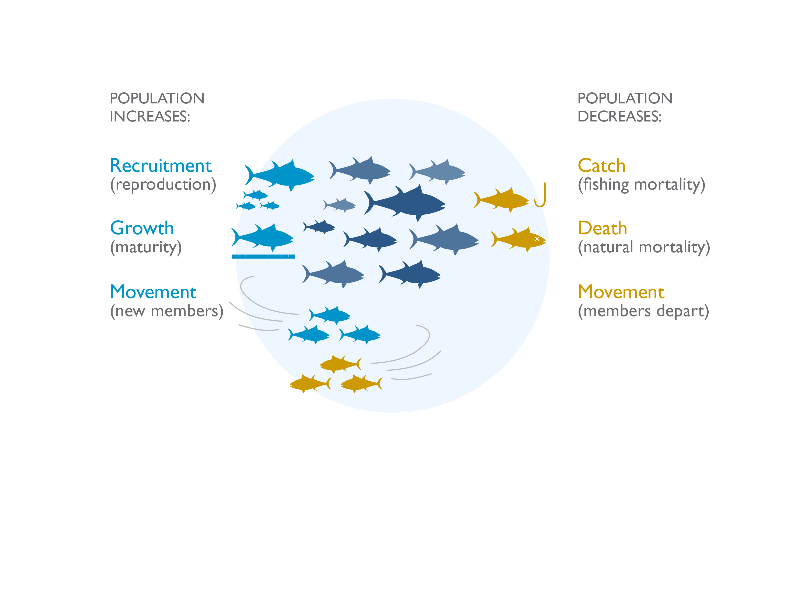
Basic Fish Population Model
Graphic by Imaginary Office.

Slide 9
Fish stock assessment
What are the types of inputs for a fish population model?
Fish Population models require large quantities of high-quality fishery data over time to detect population trends with confidence.
Abundance
(resource survey, fishery CPUE, age/size data)
Biology
(age, growth, maturity, reproduction)
Catch
(logbooks, observers,
age/size data)
Environment
(habitat, ecosystem, climate)

Slide 10
Fish stock assessment
What are the sources of information?
Professional fishermen are experts in finding and catching fish. Monitoring their total catch, the size frequency of what they catch and how much effort is required to make their catch is vitally important to estimating population trends over time.
Fishery-dependent data are generated by monitoring and reporting by commercial fishermen.
Fishery-independent data are collected and analyzed by fishery scientists.

Slide 11
Fish stock assessment
What are the fish population model outputs?
Two determinations
are primary drivers of fishery management:
Is it in an overfished condition? (estimates of the fish population status)
Is overfishing occurring? (Is the fish catch exceeding the target level that will maintain the fish population?)

Slide 12
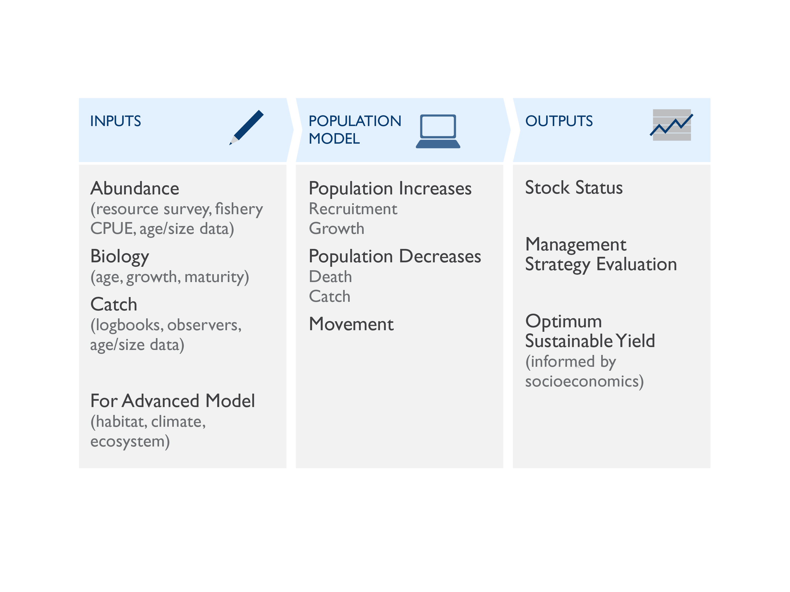
Fish Stock Assessment and Fishery Management

Slide 13
Fish stock assessment
Science-based Fisheries Management
Fisheries managers must have:
good estimates of the status of fish stocks under management,
established reference points for the size of the population that is sustainable over time,
a reference point for how much fish can be caught without reducing the fish population below the population reference point (amount) over time.

Slide 14
Fish stock assessment
Science-based Fisheries Management
Over time, fish populations can be sustained by:
improving our scientific understanding of the ecosystem and environmental factors that impact
fish populations
adapting to new information
adjusting fishery management measures to keep the fishery operating within sustainable limits over the long term.
Sustainable fisheries management is an on-going process that is science-based, adaptive and precautionary.

Slide 15



Fish Stock Assessment
Written by John Kaneko MS, DVM, Hawaii Seafood Council, Honolulu, Hawaii
July 2015
With support from the
Harold K.L Castle Foundation
Graphic: Imaginary Office

