Slide 1
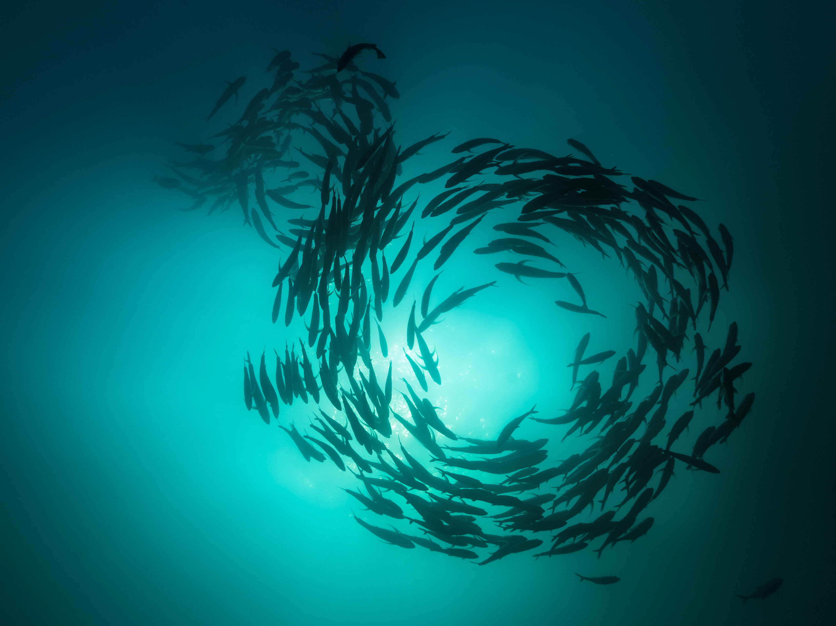

Fish Ecology and Habitat
John Kaneko MS, DVM
Hawaii Seafood Council
Photo: Octavio Aburto-Oropeza/Marine Photobank

Slide 2
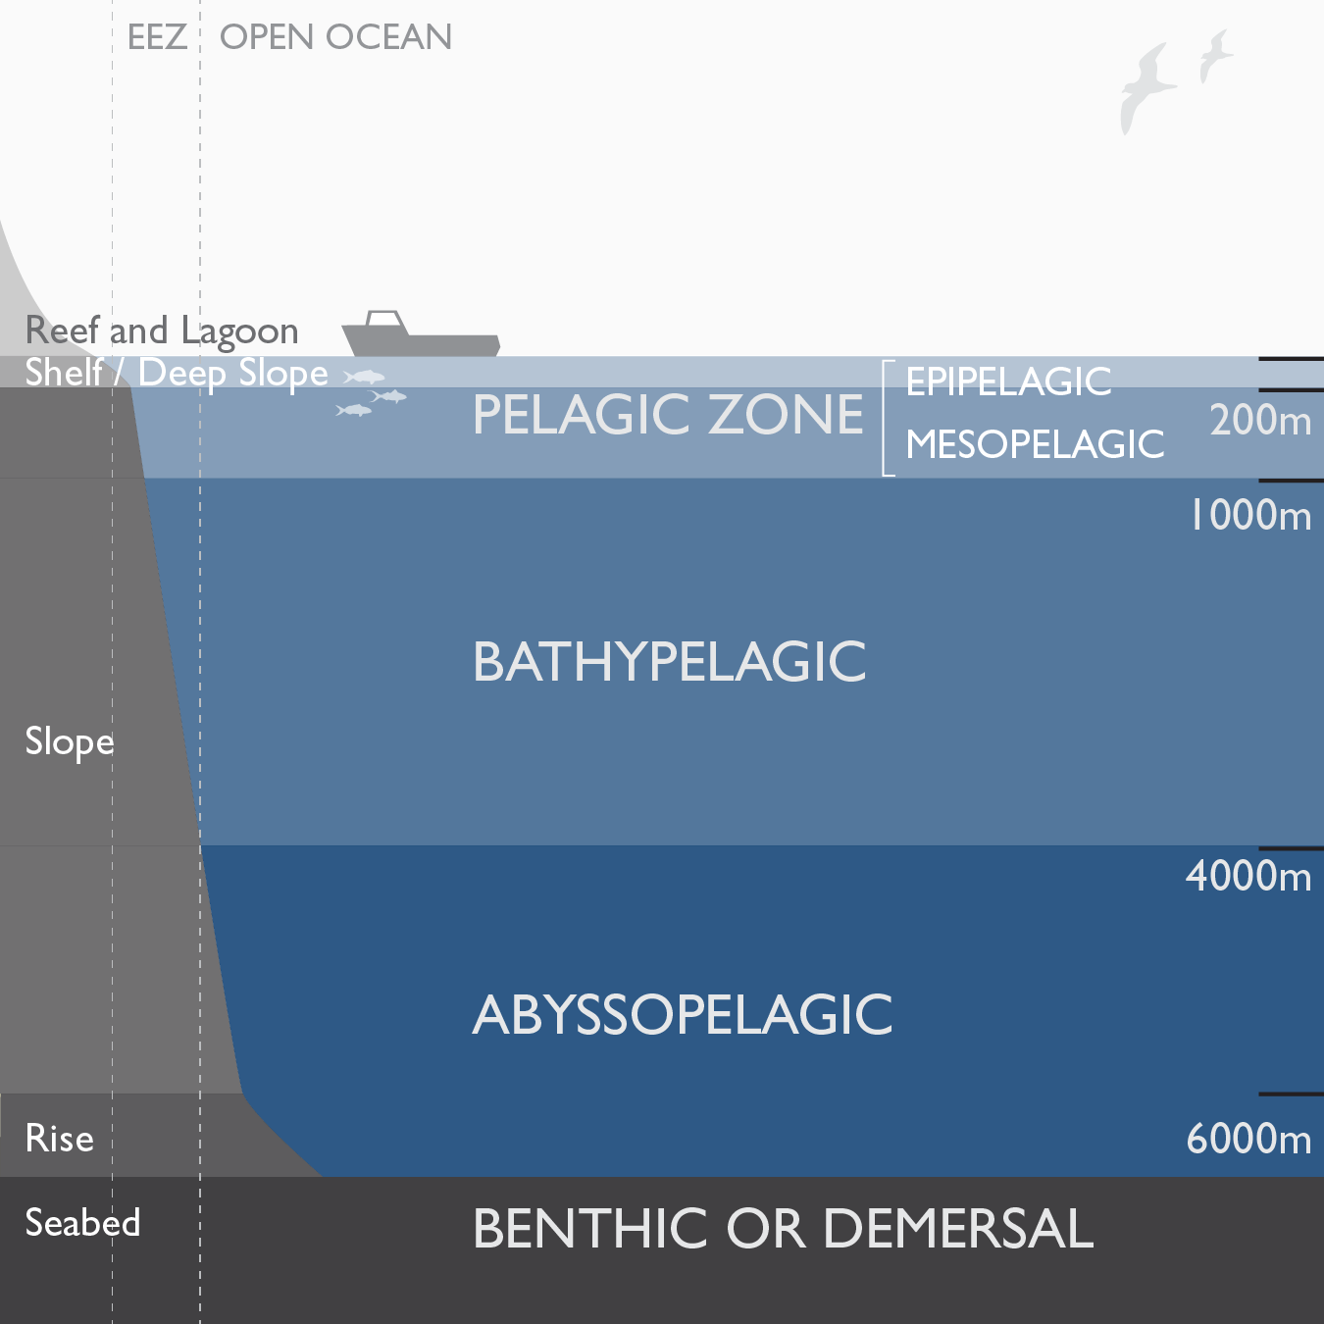
fish ecology and habitat
Marine Fish Ecology and Habitat Include:
Pelagic
(Epipelagic, Mesopelagic)
Bathypelagic
Benthic or Demersal
Coral Reef
Deep Slope
Estuarine
Graphic by Imaginary Office.

Slide 3
fish ecology and habitat
Pelagic Zone
Open ocean. Not associated with substrate.
Within the water column and not the seafloor.
Generally from the surface to a depth of 1,000m.
The pelagic zone is divided into zones at depths defined by water temperature, sunlight penetration, and other characteristics.
Graphic by Imaginary Office.

Slide 4
fish ecology and habitat
Pelagic Zone: Epipelagic
From the surface to
200m depth where sunlight penetrates.
Water temperatures
are higher compared with
greater depths.
Trolling gear, handline gear and pelagic longline gear place hooks to catch fish within the epipelagic zone.
Graphic by Imaginary Office.

Slide 5
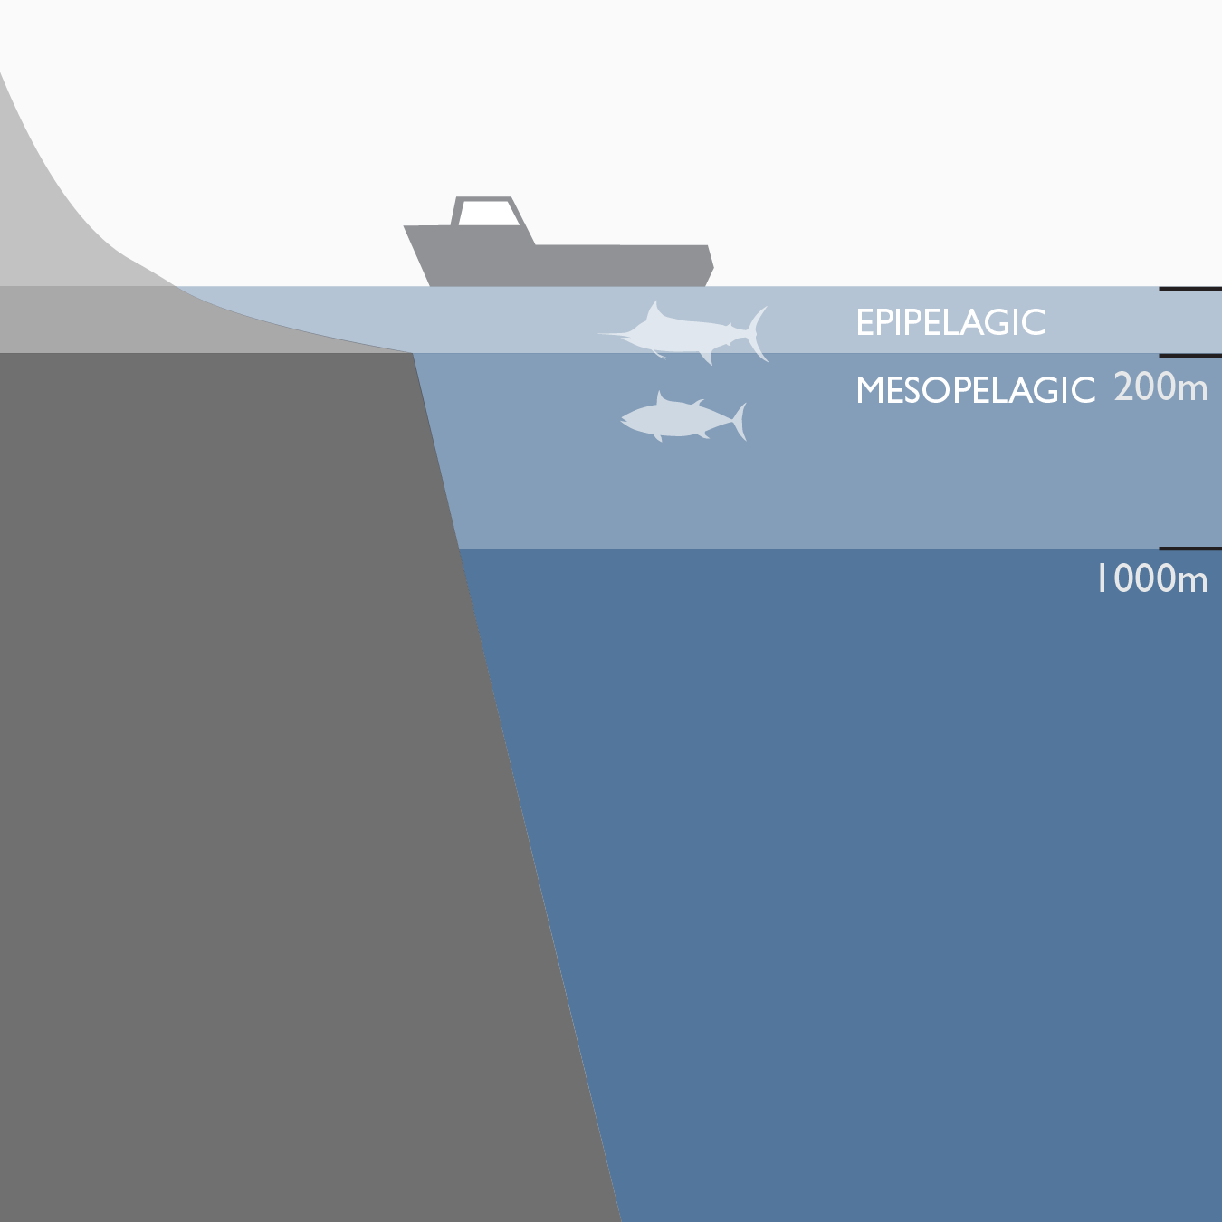
fish ecology and habitat
Pelagic Zone: Epipelagic
Shallow-set longline (swordfish) gear places hooks within the upper 100m.
Deep-set longline (bigeye tuna) gear places hooks between 70 and 350m with deeper hooks in the mesopelagic zone.
Graphic by Imaginary Office.

Slide 6
fish ecology and habitat
Pelagic Zone: Mesopelagic
Extends from 200m to
1,000m depth.
The thermocline may occur in this zone. It is characterized by a steep drop in water temperature with increasing depth and differs in depth across the ocean.
Graphic by Imaginary Office.

Slide 7
fish ecology and habitat
Pelagic Zone: Mesopelagic
The thermocline may straddle the epipelagic and mesopelagic zones. It is a barrier between the upper mixed layer and the relatively calm waters below.
Deep-set longline fishing method in Hawaii sets the shallowest hooks at 70m in the epipelagic zone and the deepest hooks at about 350m in the mesopelagic zone.
Graphic by Imaginary Office.

Slide 8
fish ecology and habitat
Bathypelagic
Extends from 1,000 to 4,000m depth.
Well below the reach of pelagic longline fishing gear.
Below that is the abyssopelagic zone characterized by very cold water and no sunlight penetration.
Graphic by Imaginary Office.

Slide 9
fish ecology and habitat
Benthic or Demersal Zone
Pertains to habitat on the seafloor or bottom substrate.
Benthic or demersal fish live in close relation with the bottom.
Deepwater shrimp (amaebi) are found between 350 and 850 m.
Graphic by Imaginary Office.

Slide 10
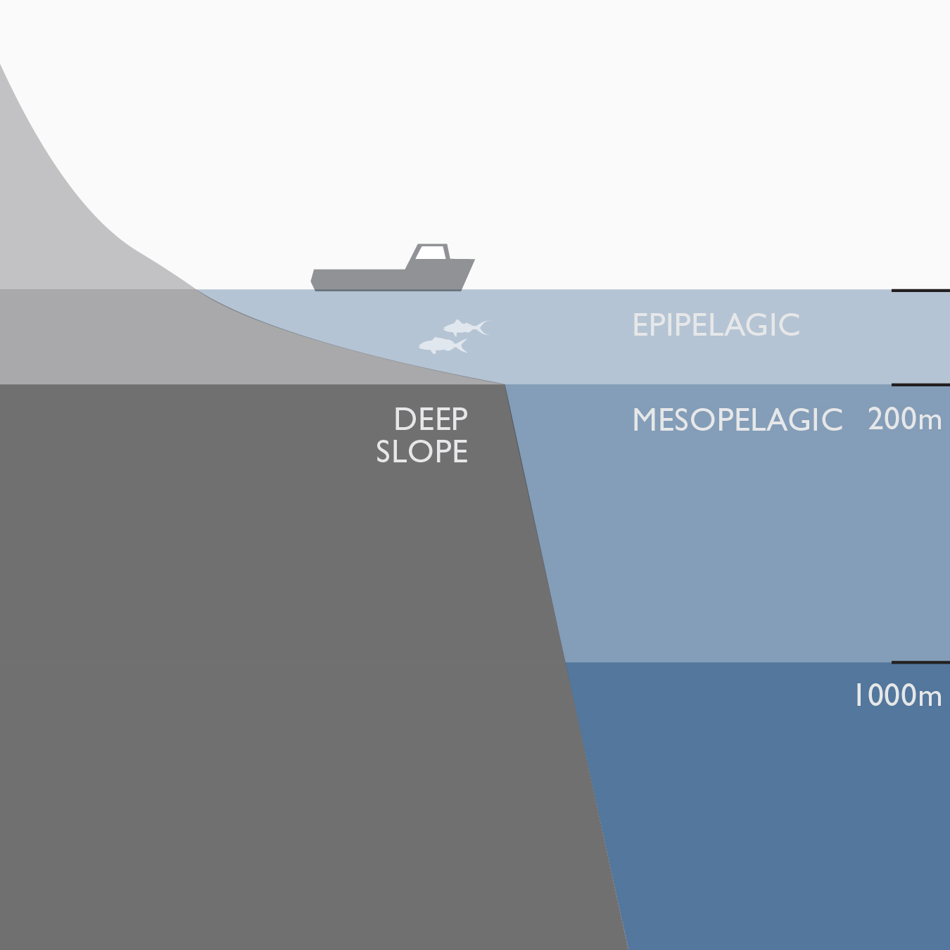
fish ecology and habitat
Deep Slope
Vertical habitat along the substrate from 40m to 500m.
In Hawaii, the deep slope is characterized by a steep
(often vertical) slope providing a narrow band of habitat at that depth around each of
the islands.
Species include onaga (longtailed red snapper), opakapaka (pink snapper), hapuupuu (sea bass).
Graphic by Imaginary Office.

Slide 11
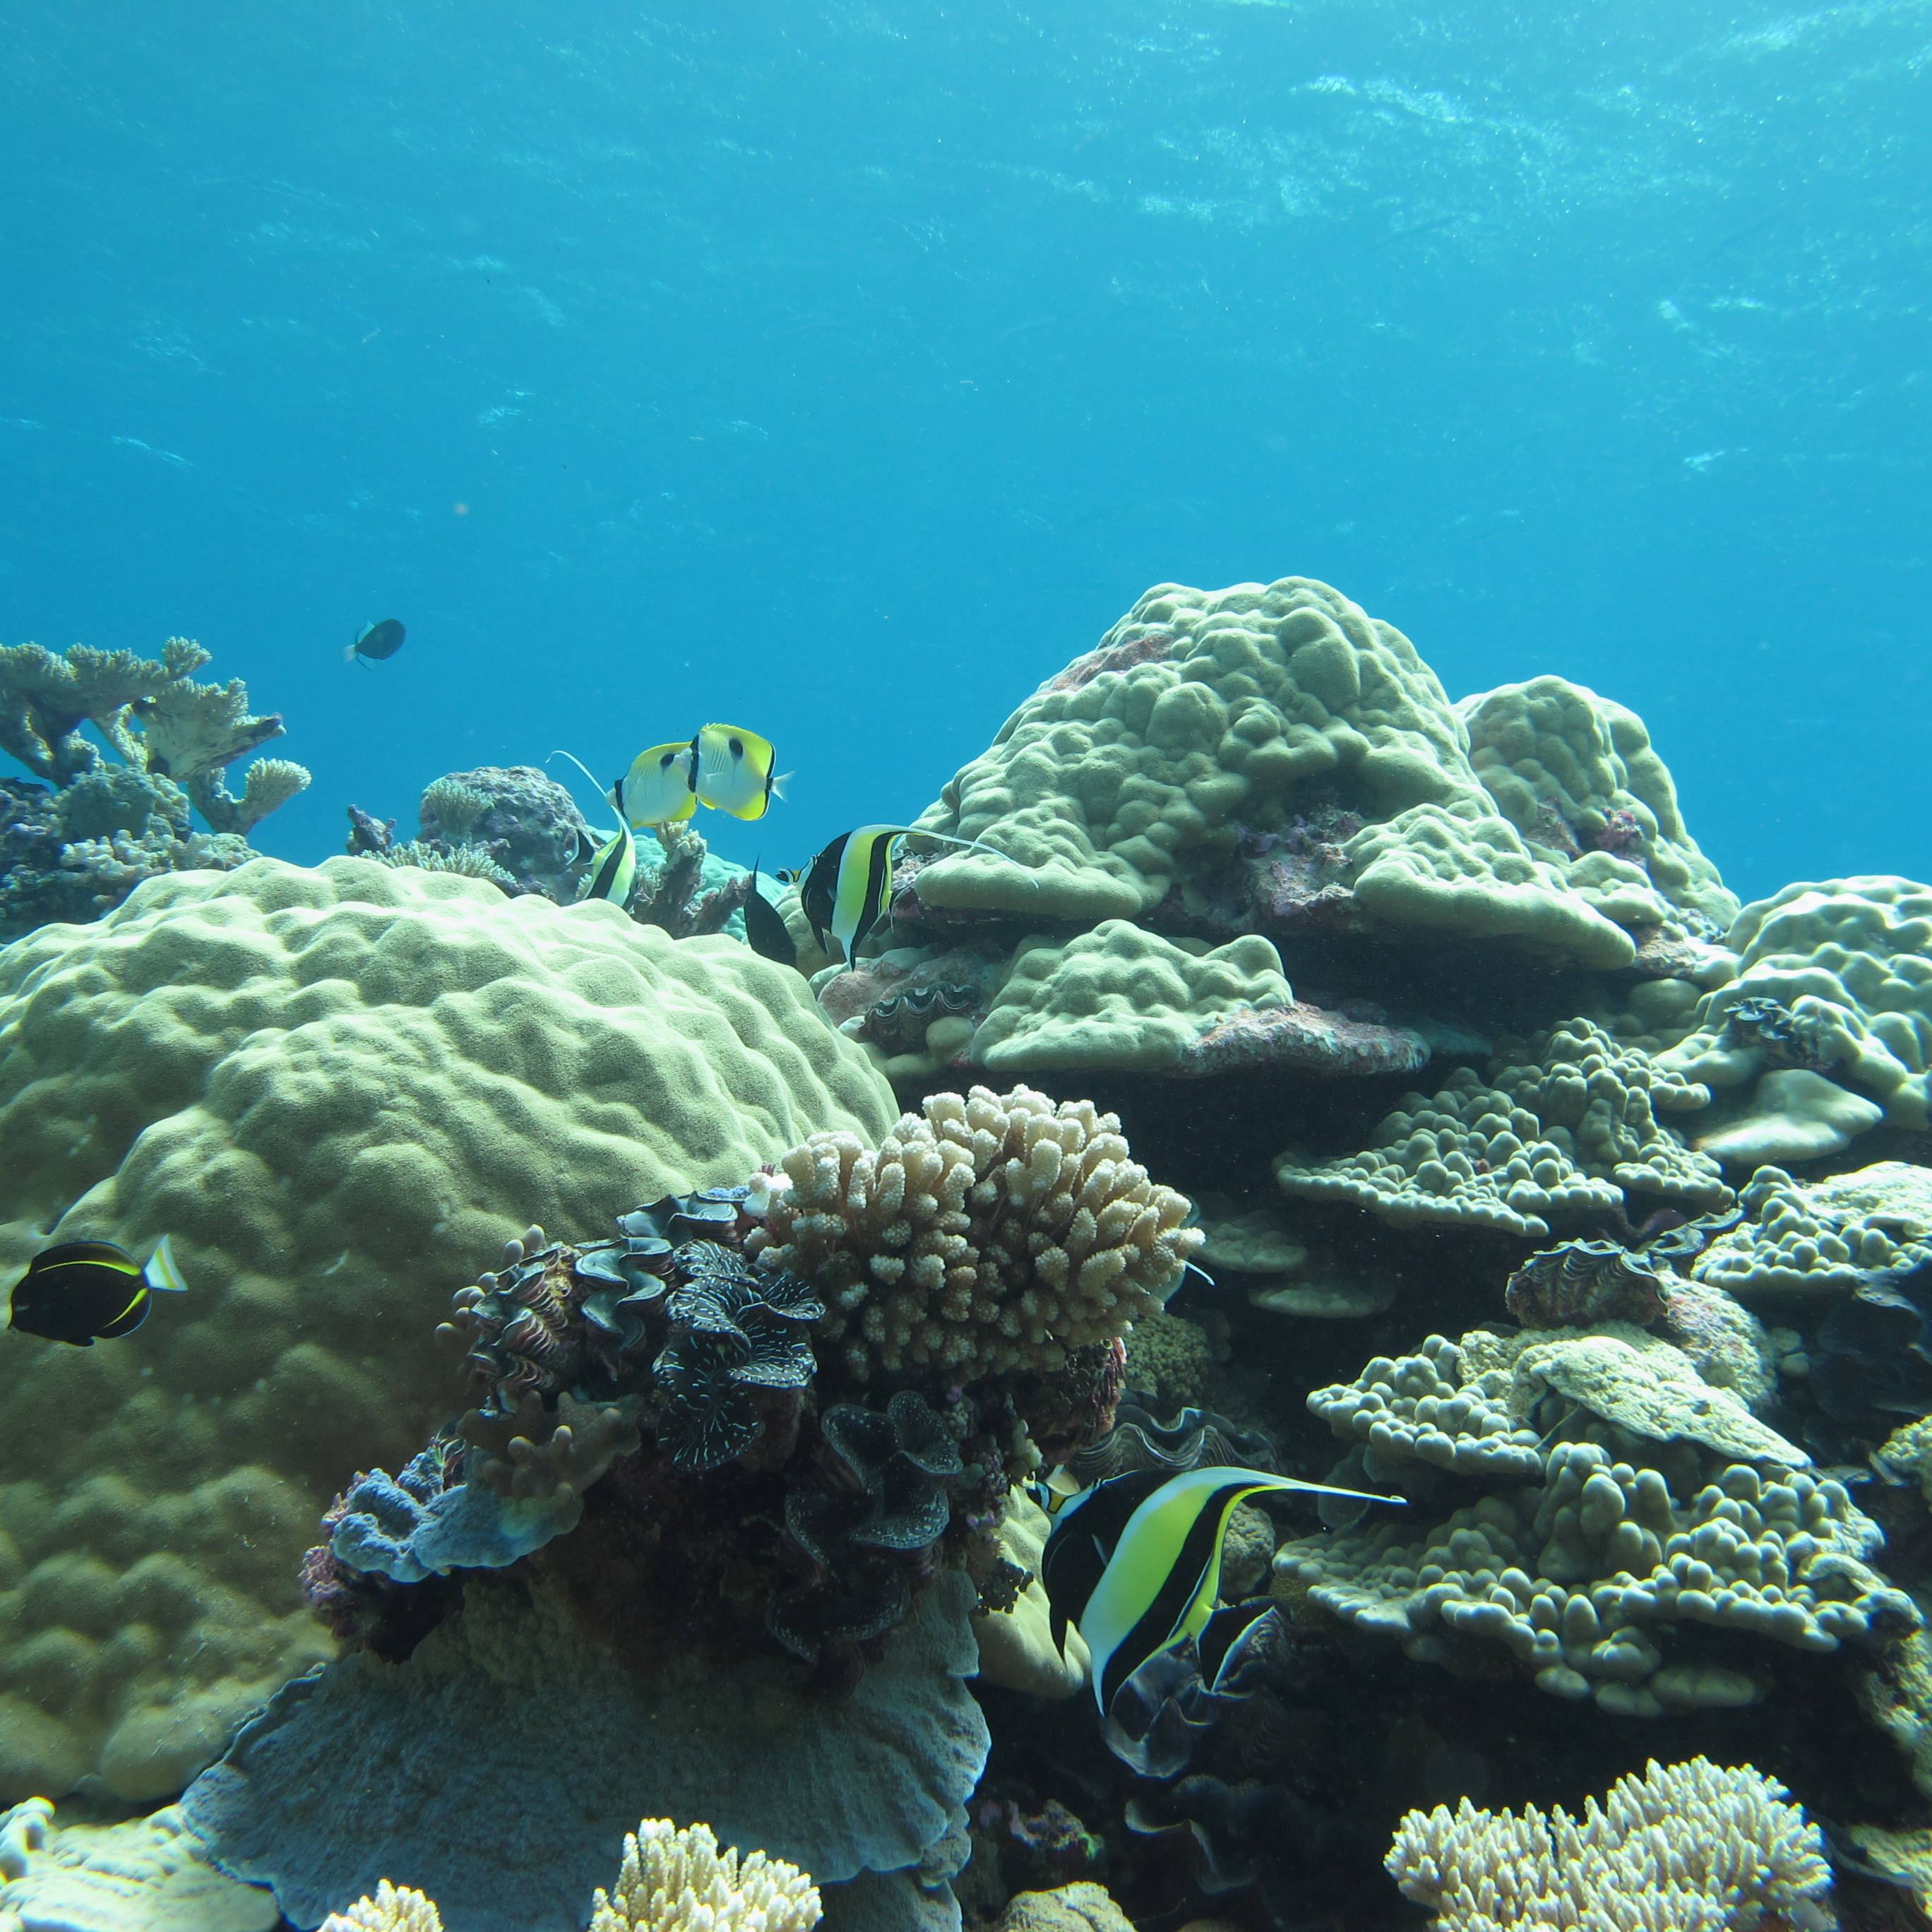
fish ecology and habitat
Coral Reef
Coral reefs are made up of limestone (calcium carbonate) structures produced by colonies of coral polyps (cnidarians) that have a symbiotic relationship with algae species (zooxanthellae).
The coral polyps form colonies that provide a habitat and substrate for the algae.
Photo: Amanda Pollock/USFWS

Slide 12
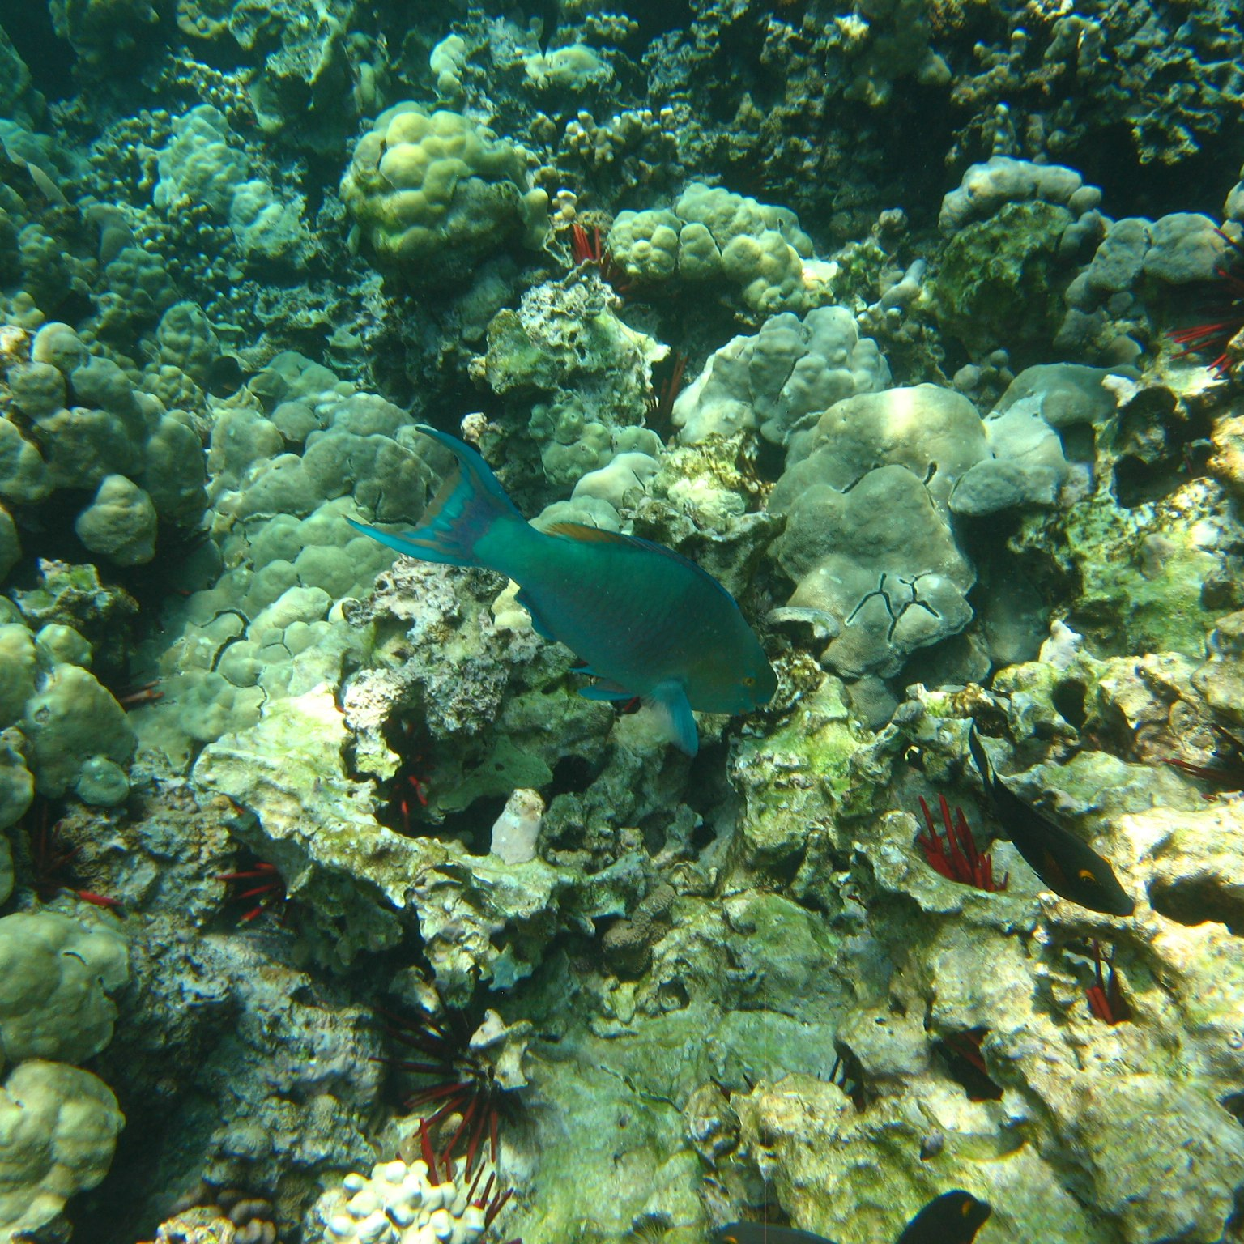
fish ecology and habitat
Coral Reef
The algae in turn provide nutrients for the coral polyps derived from photosynthesis.
Species of reef fish include
uhu (parrotfish), palani (surgeonfish), kumu (goatfish).
Photo: Troy McKaskle (cc)

Slide 13
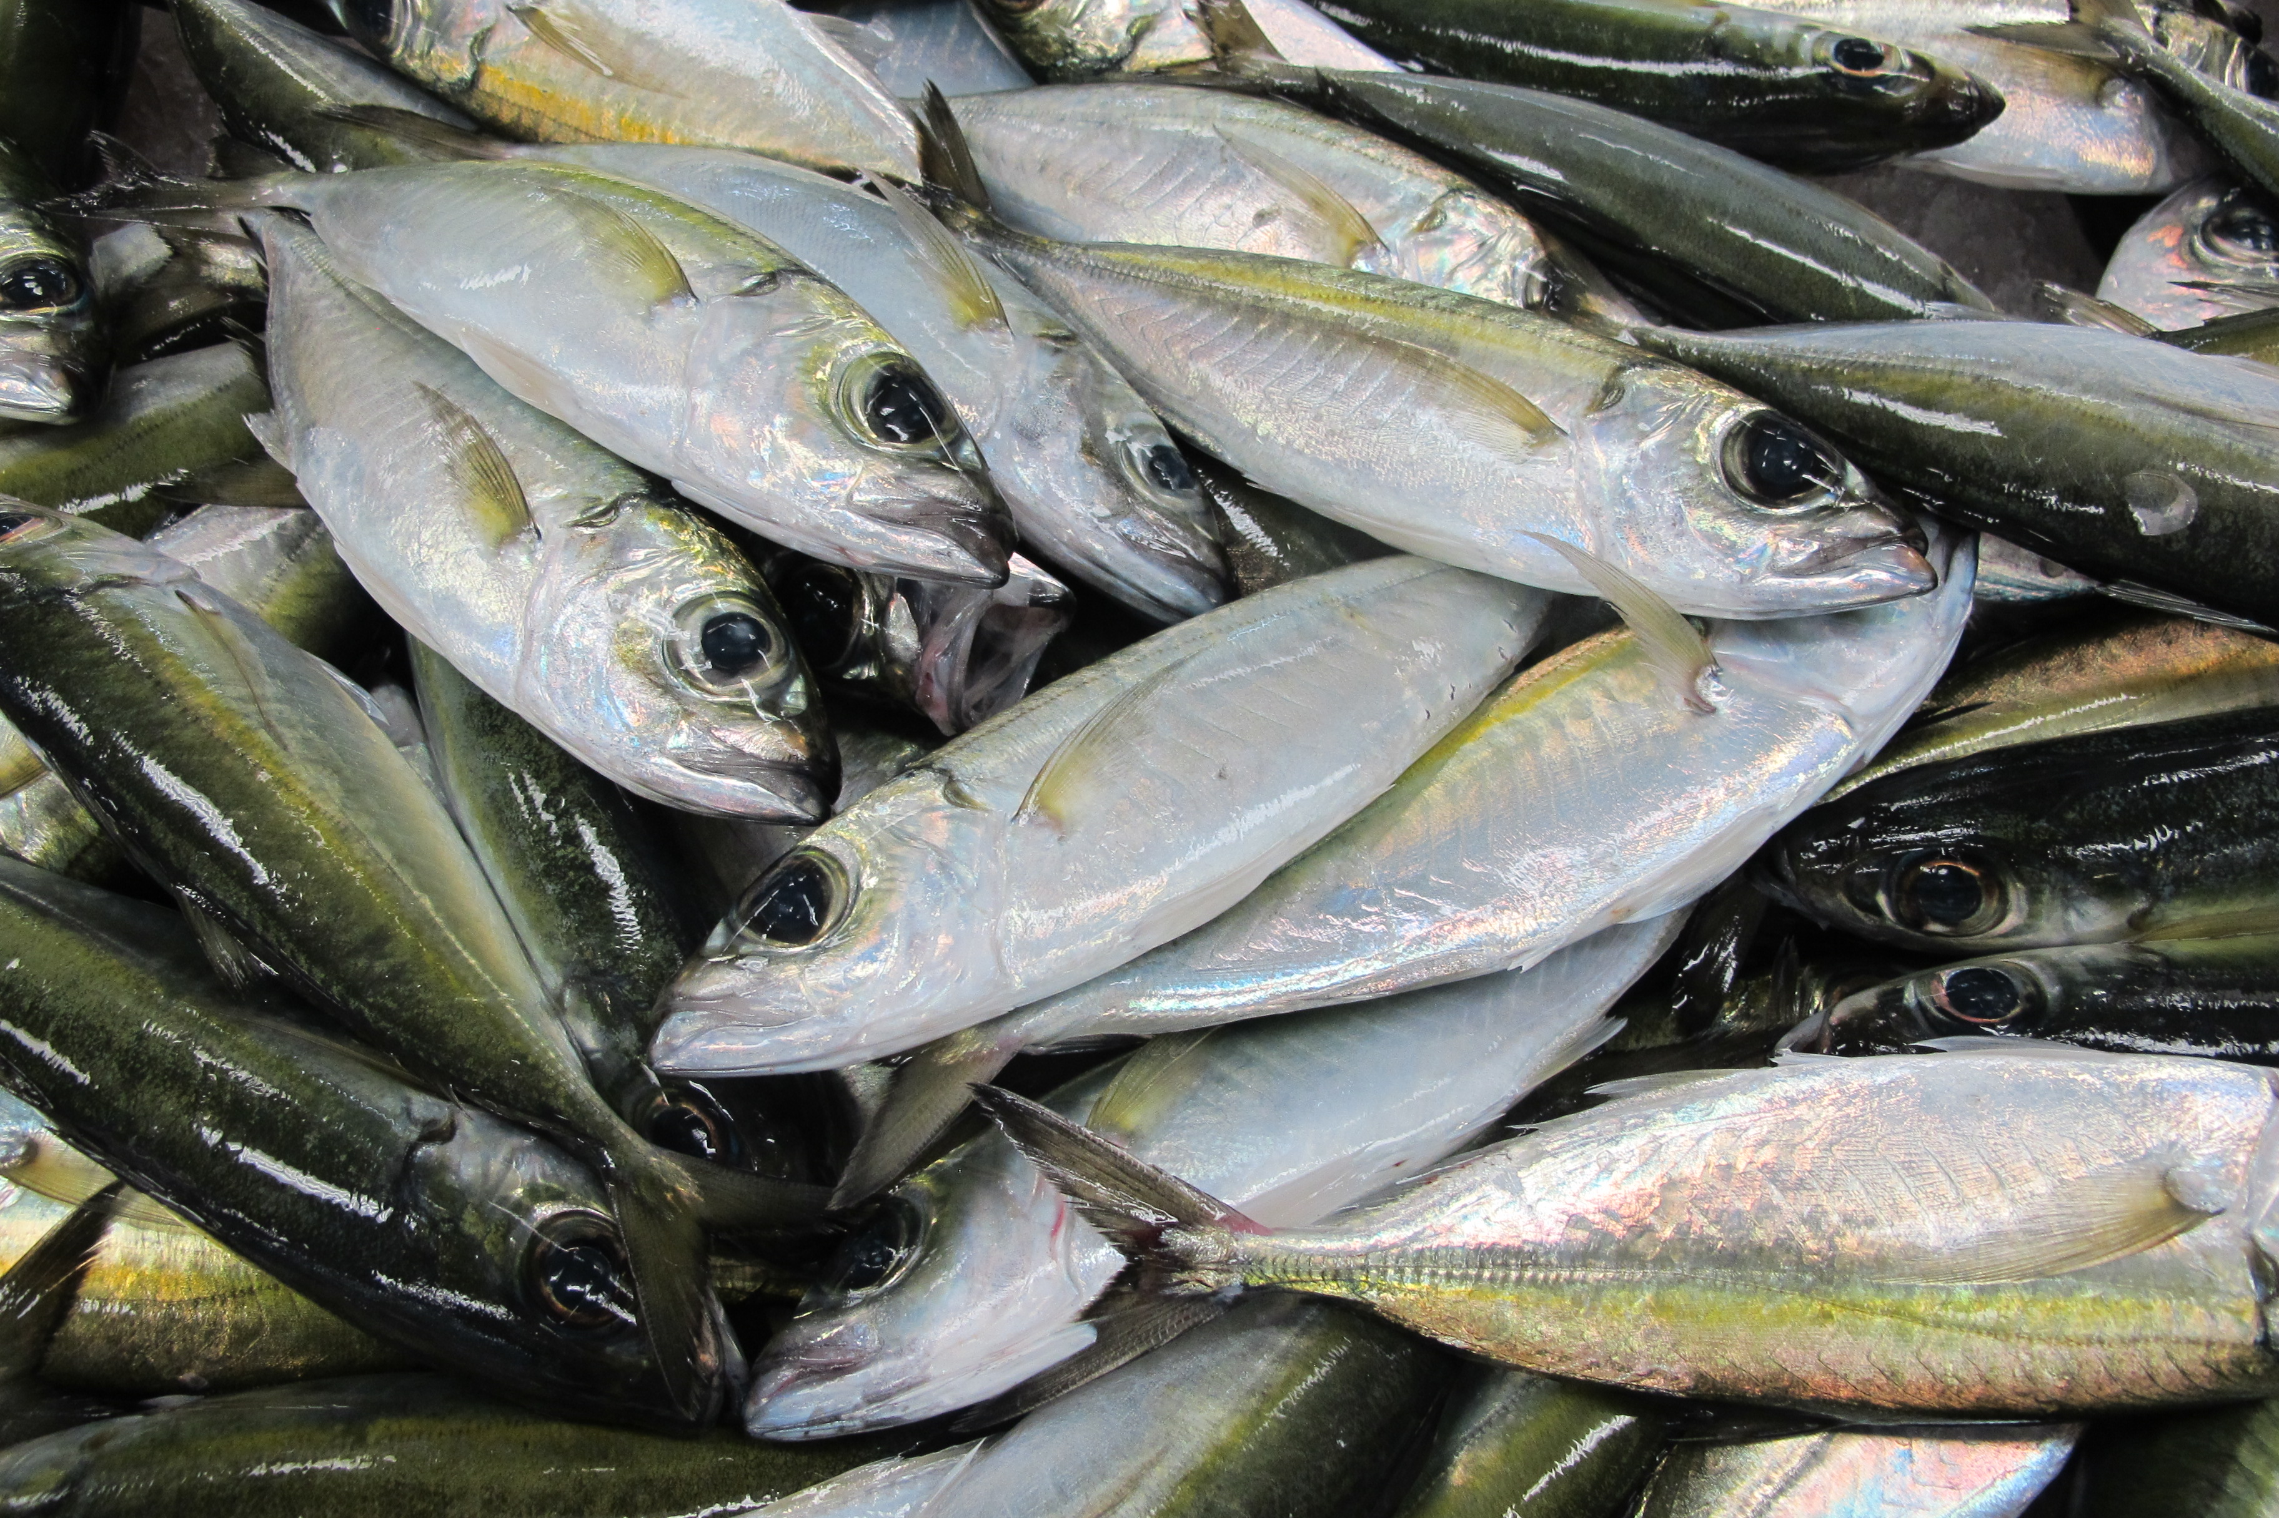
fish ecology and habitat
Coastal Pelagic Species
Schooling fish that occur in coastal waters but are not associated with the bottom.
Most feed on plankton and
are a main food source for higher-level predators such
as jacks, tuna and humans.
Species include
opelu (mackerel scad) and
akule (bigeye scad).
Photo: John Kaneko

Slide 14
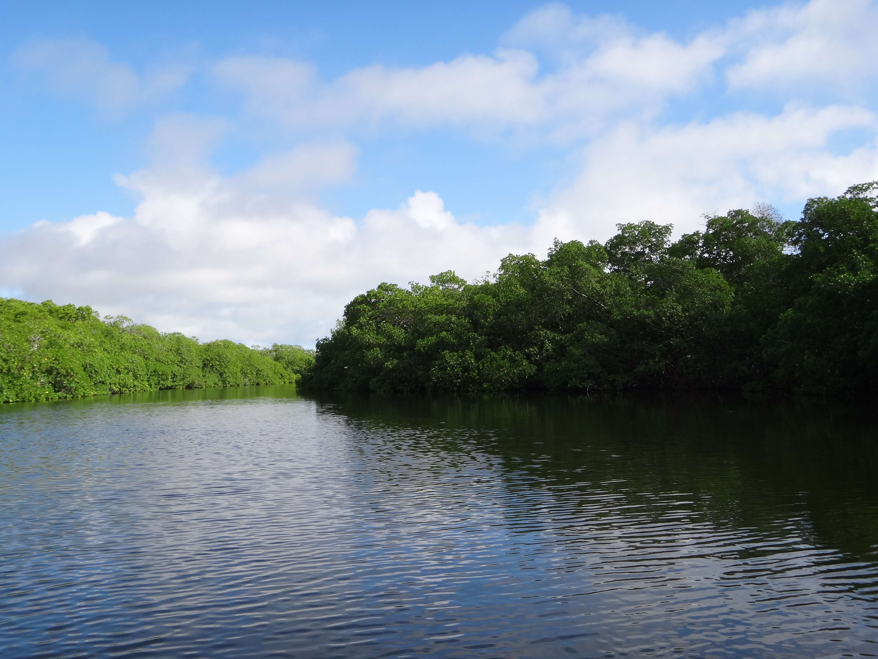
fish ecology and habitat
Estuarine
Occurs in estuaries where fresh and seawater mix to create a brackish (intermediate salinity) habitat.
An estuary may occur at a river’s mouth where sea
water becomes diluted by freshwater.
Species of estuarine fish include mullet and milkfish.
Photo: John Kaneko

Slide 15



Fish Ecology & Habitat
Written by John Kaneko MS, DVM, Hawaii Seafood Council, Honolulu, Hawaii
July 2015
With support from the
Harold K.L Castle Foundation
Photo: Octavio Aburto-Oropeza/Marine Photobank

